Slide 1
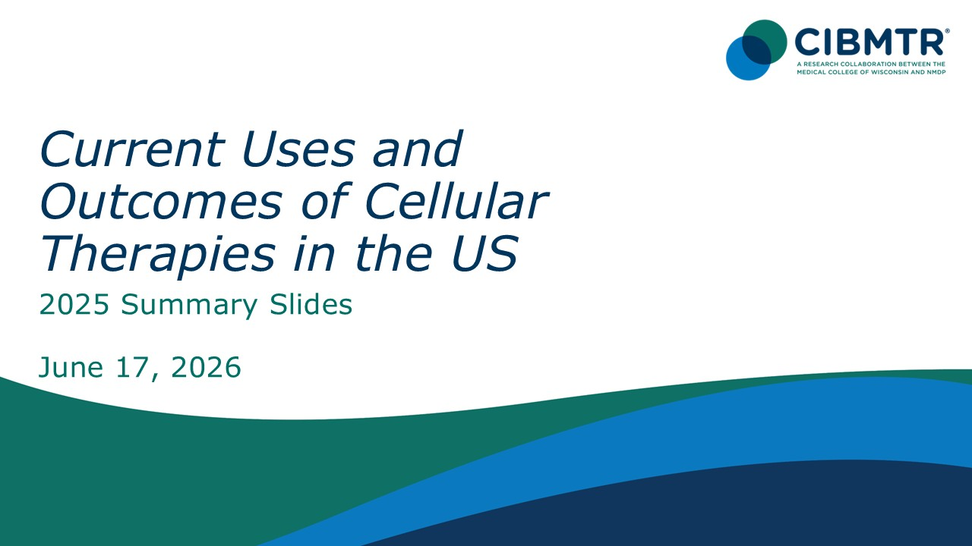

Slide 2
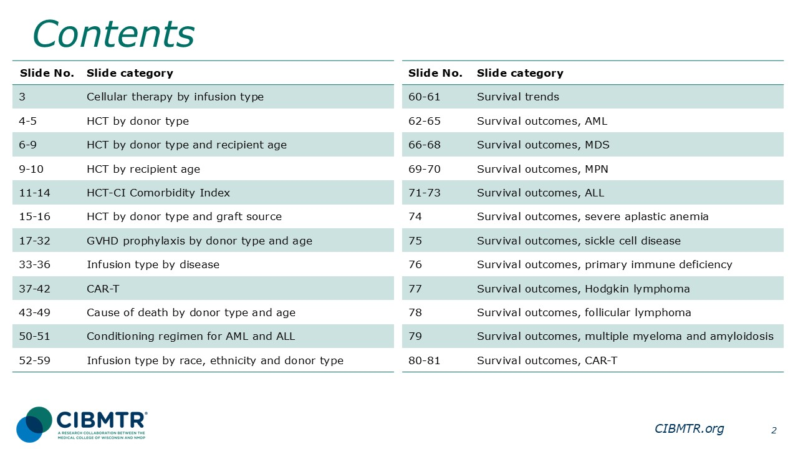

Slide 3
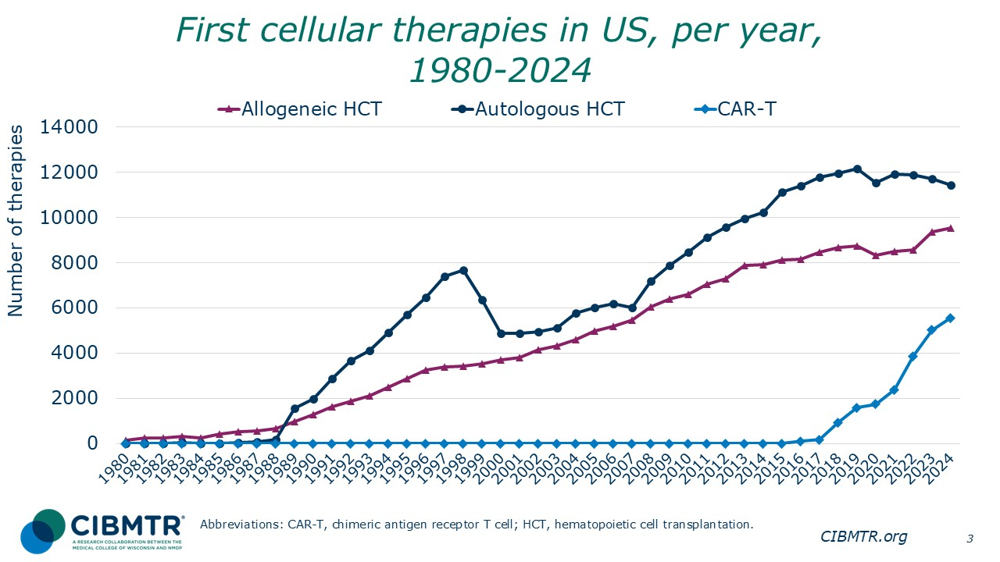
Notes:
The annual numbers of first allogeneic and first autologous transplants and first CAR-T therapy in the US were compiled for recipients registered with the CIBMTR.

Slide 4
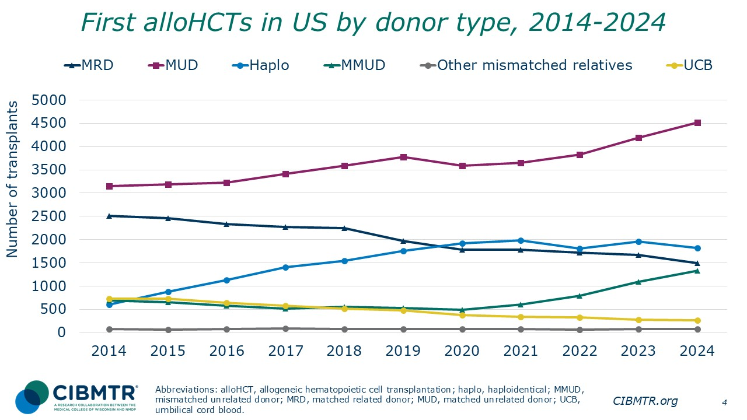
Notes:
Upon further stratifying the number of first allogeneic transplants in the US by donor type, matched unrelated donor (MUD) transplants represent the largest group, which continues to grow. The number of matched related donor (MRD) transplants has been decreasing for several years. The number of haploidentical procedures surpassed MRD transplants in 2020. There has been steady growth in mismatched unrelated donor (MMUD) transplants since 2020.

Slide 5
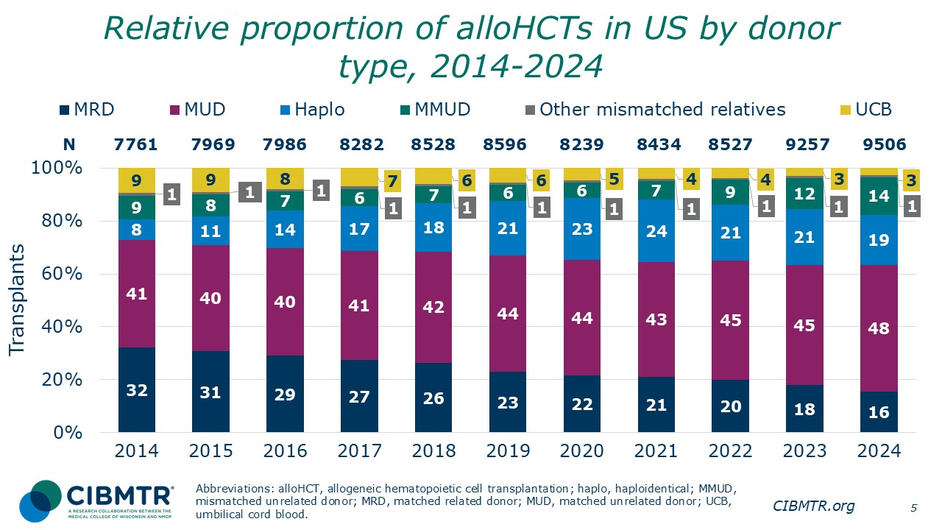
Notes:
This slide shows the relative proportion of first allogeneic transplants performed, by donor type, annually, 2014-2024. The percentage of each is represented on the bar graph.

Slide 6
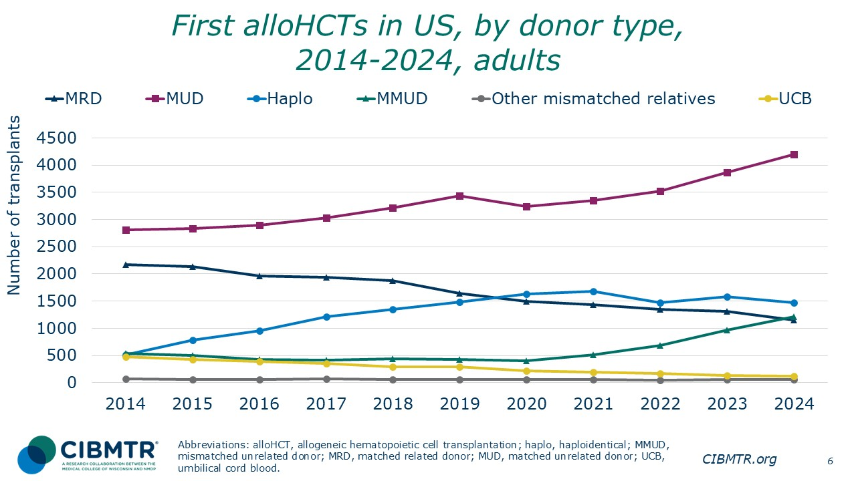
Notes:
This is a subset of the previous slide, looking specifically at adult patients. The trends of donor type used for adult patients reflect the general overall trends on the previous slide.

Slide 7
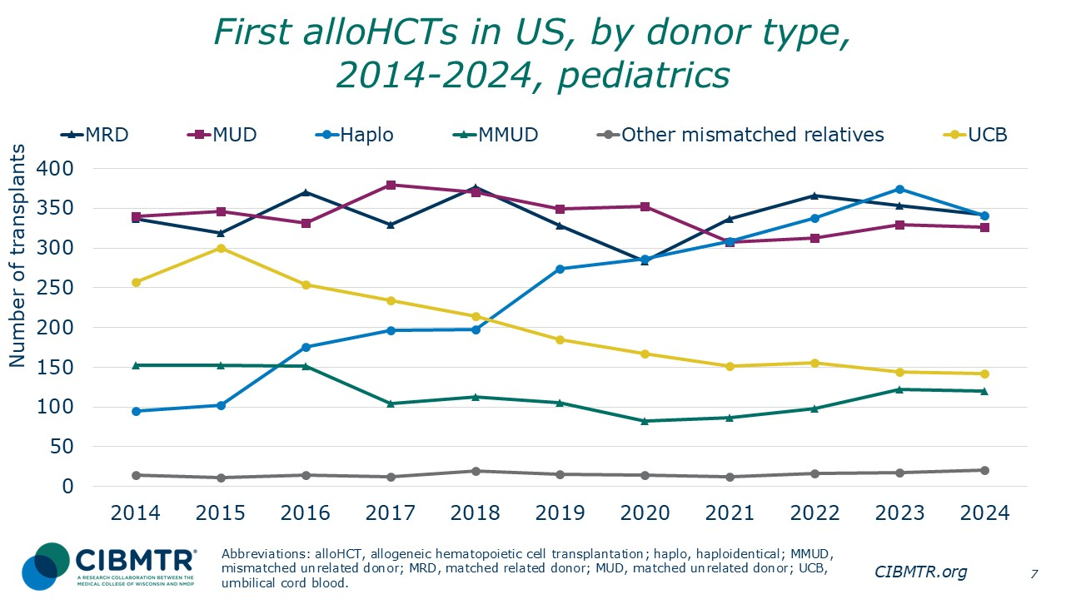
Notes:
In pediatric first allogeneic transplants (recipients younger than 18), haploidentical related donor (haplo) and matched related donor (MRD) transplants are equally popular and are the most frequently used donor groups, followed by matched unrelated (MUD) donors. Haplo transplants increased steadily over the last 10 years, while the number of umbilical cord blood donor (UCB) transplants decreased steadily. The use of MMUD has varied over time, increasing since 2020.

Slide 8
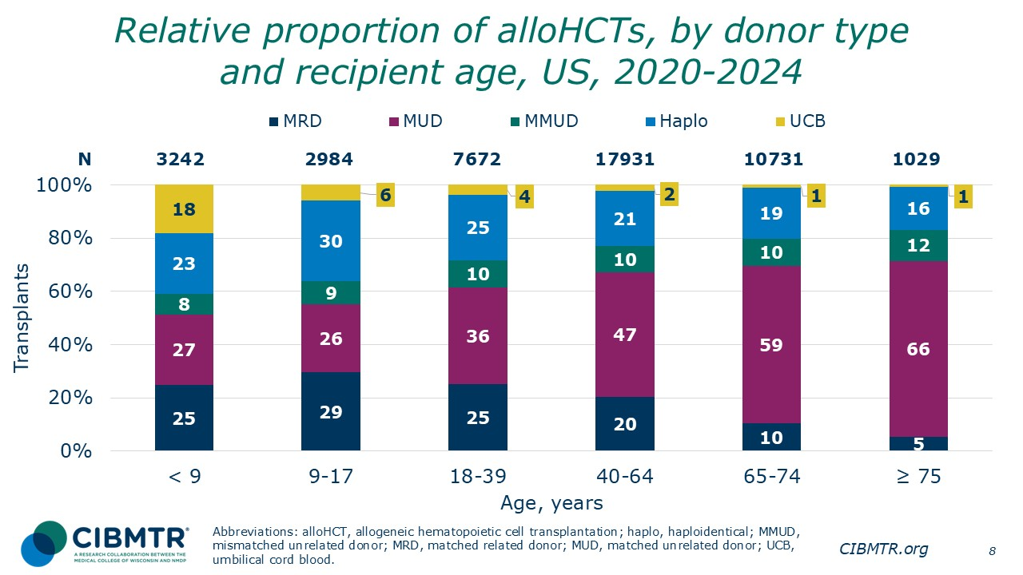
Notes:
This slide shows the relative proportion of first allogeneic transplants, by donor type, performed for different recipient age groups during 2020-2024. The percentage of each is represented on the bar graph.

Slide 9
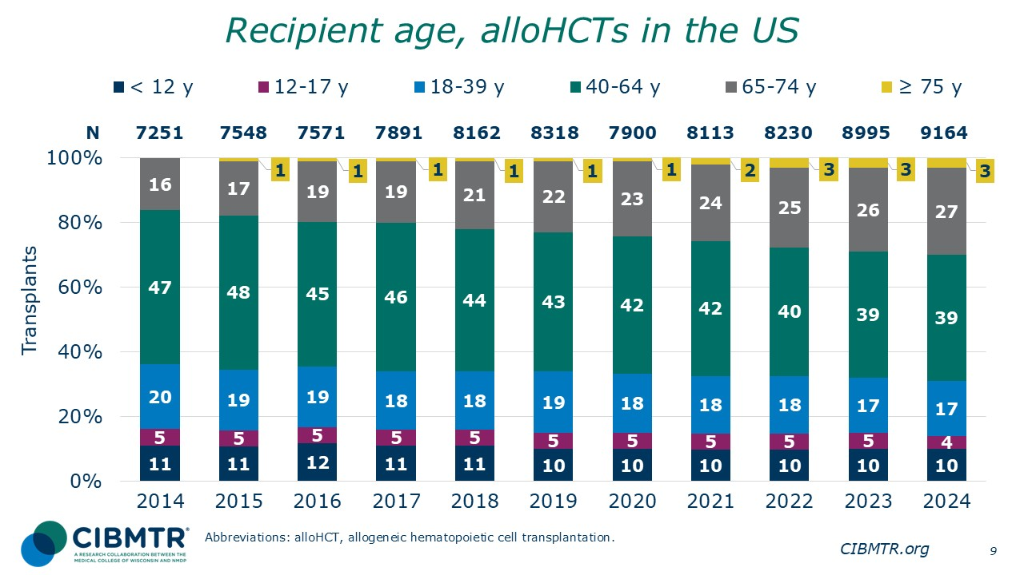
Notes:
This slide shows the relative proportion of age groups in first allogeneic HCT recipients, 2014-2024. The percentage of each is represented on the bar graph. The percentage of recipients younger than 40 remains relatively constant. The percentage of patients aged 65 and older is increasing substantially over time.

Slide 10
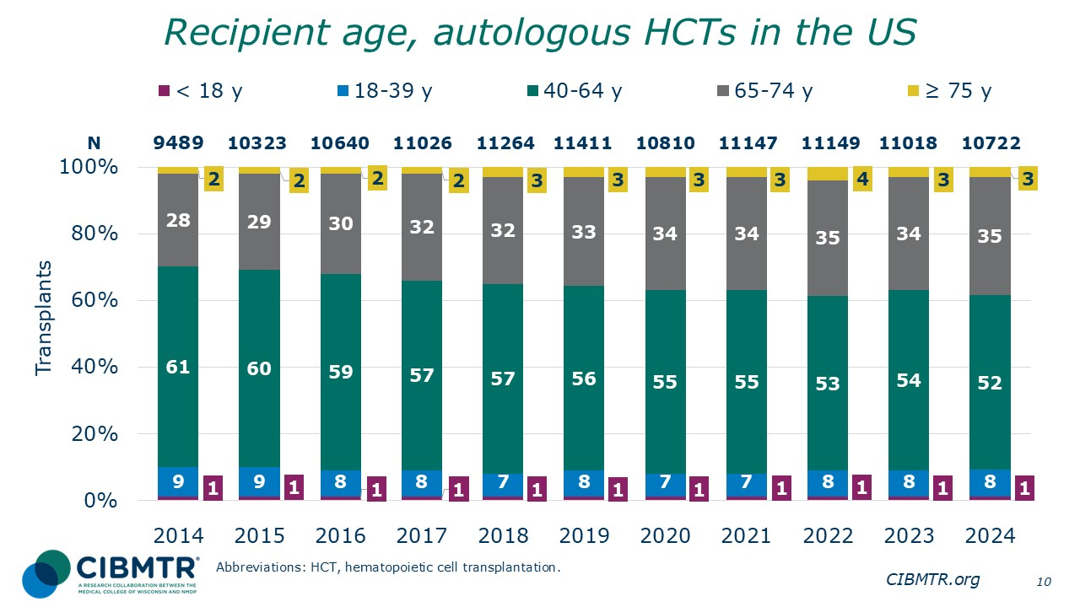
Notes:
This slide shows the relative proportion of recipient age groups for first autologous HCT recipients, 2014-2024. The percentage of each is represented on the bar graph. The percentage of recipients younger than 40 remains relatively constant. The percentage of patients aged 65 and older increased substantially over time.

Slide 11
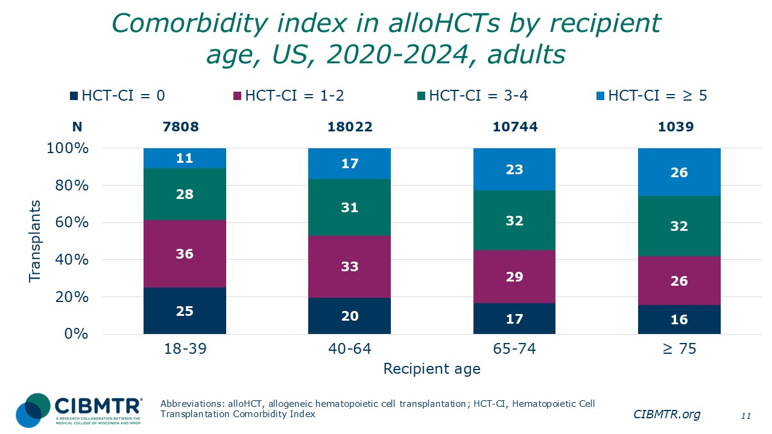
Notes:
This slide shows the relative proportion of first allogeneic transplants performed by Hematopoietic Cell Transplantation Comorbidity Index group (HCT-CI) among adult patients during 2020-2024. There is a greater proportion of higher HCT-CI scores in the older populations.

Slide 12
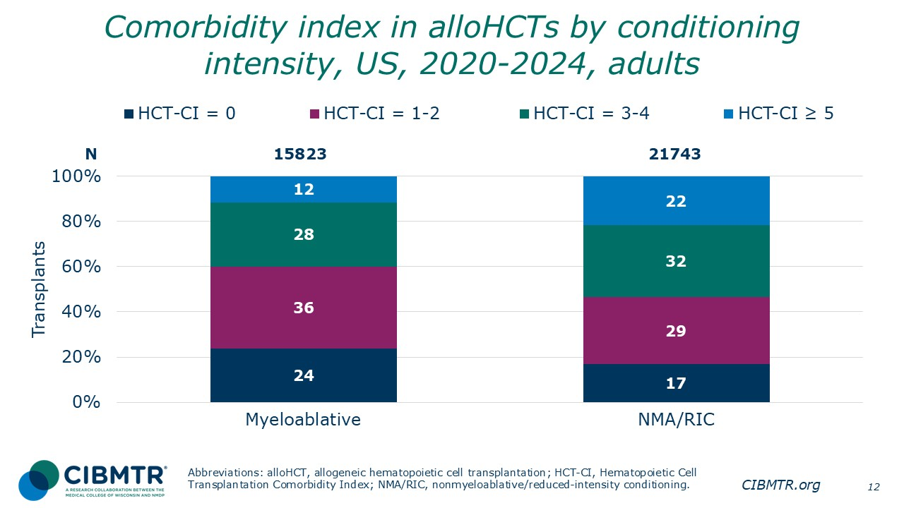
Notes:
The percentage of adult recipients of first allogeneic transplant, by Hematopoietic Cell Transplantation Comorbidity Index (HCT-CI) group. receiving myeloablative or nonmyeloablative/reduced-intensity conditioning, 2020-2024. There were a higher percentage of HCT-CI = 3-4 and HCT-CI = ≥ 5 in the nonmyeloablative and reduced-intensity conditioning group.

Slide 13
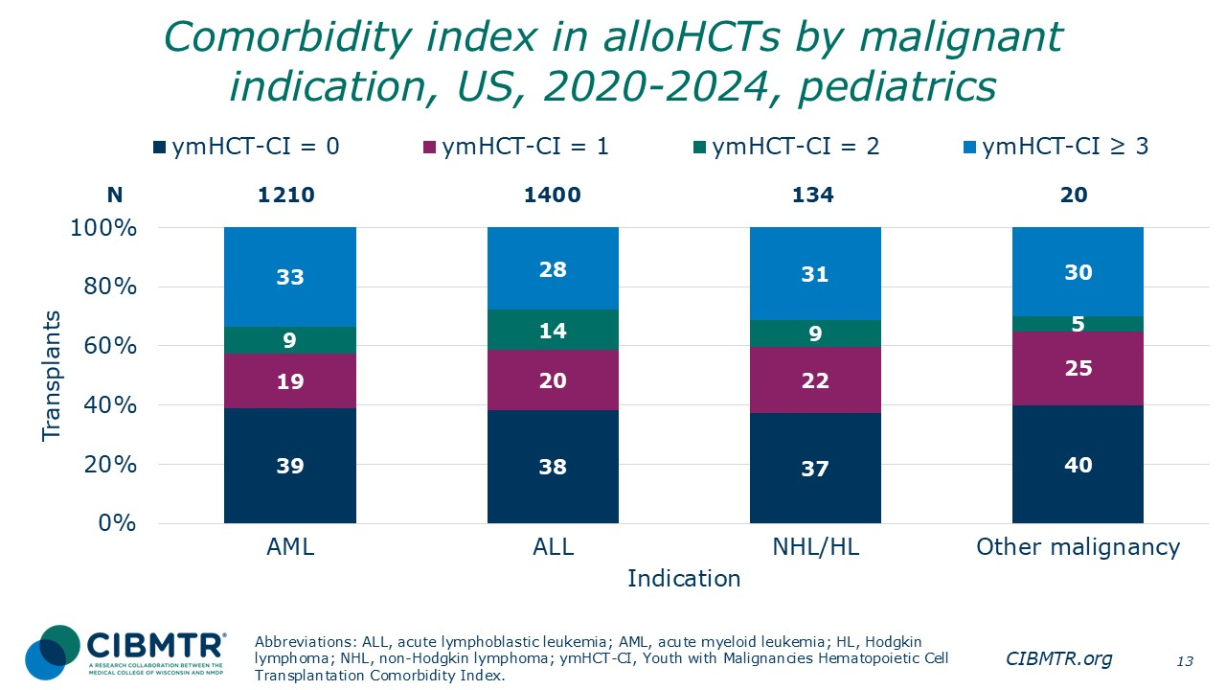
Notes:
This slide shows the relative proportion of first allogeneic transplants performed by Youth Malignant Hematopoietic Cell Transplantation Comorbidity Index group (ymHCT-CI), among pediatric patients with malignant disease indications during 2020-2024.
Reference:
Friend BD, Broglie L, Logan BR, Chhabra S, Bupp C, Schiller G, Beitinjaneh A, Perez MAD, Guilcher GMT, Hashem H, Hildebrandt GC, Krem MM, Lazarus HM, Nishihori T, Nusrat R, Rotz SJ, Wirk B, Wieduwilt M, Pasquini M, Savani BN, Stadtmauer EA, Sorror ML, Thakar MS. Adapting the HCT-CI Definitions for Children, Adolescents, and Young Adults with Hematologic Malignancies Undergoing Allogeneic Hematopoietic Cell Transplantation. Transplant Cell Ther. 2023 Feb;29(2):123.e1-123.e10. doi: 10.1016/j.jtct.2022.11.019. Epub 2022 Nov 26. PMID: 36442769; PMCID: PMC9911376.

Slide 14
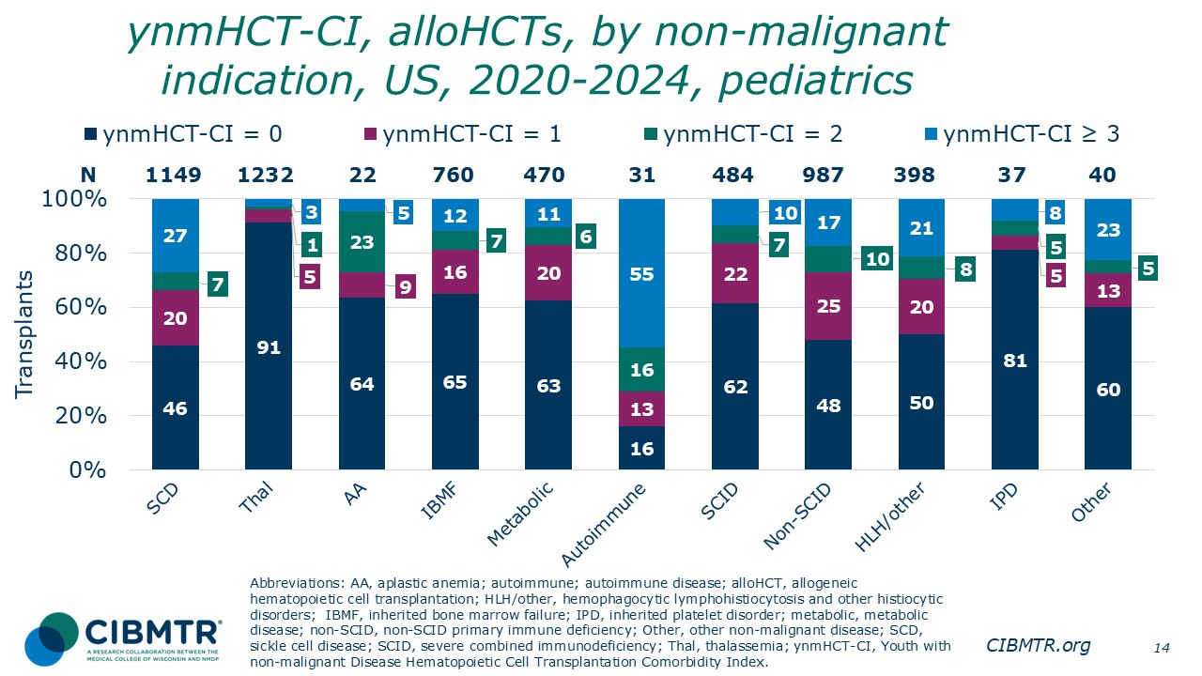
Notes:
This slide shows the relative proportion of first allogeneic transplants performed, by Youth Non-Malignant Hematopoietic Cell Transplantation Comorbidity Index group (ynmHCT-CI), among pediatric patients during 2020-2024.
Reference:
Broglie L, Friend BD, Chhabra S, Logan BR, Bupp C, Schiller G, Savani BN, Stadtmauer E, Abraham AA, Aljurf M, Badawy SM, Perez MAD, Guinan EC, Hashem H, Krem MM, Lazarus HM, Rotz SJ, Wirk B, Yared JA, Pasquini M, Thakar MS, Sorror ML. Expanded HCT-CI Definitions Capture Comorbidity Better for Younger Patients of Allogeneic HCT for Nonmalignant Diseases. Transplant Cell Ther. 2023 Feb;29(2):125.e1-125.e9. doi: 10.1016/j.jtct.2022.11.020. Epub 2022 Nov 25. PMID: 36442768; PMCID: PMC9911359.

Slide 15
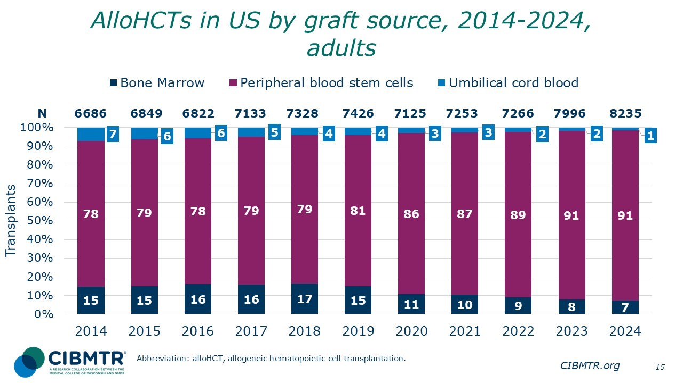
Notes:
This slide shows the number of first allogeneic procedures by graft source in adult patients since 2014. Peripheral blood stem cells represents the largest graft source consistently by year.

Slide 16
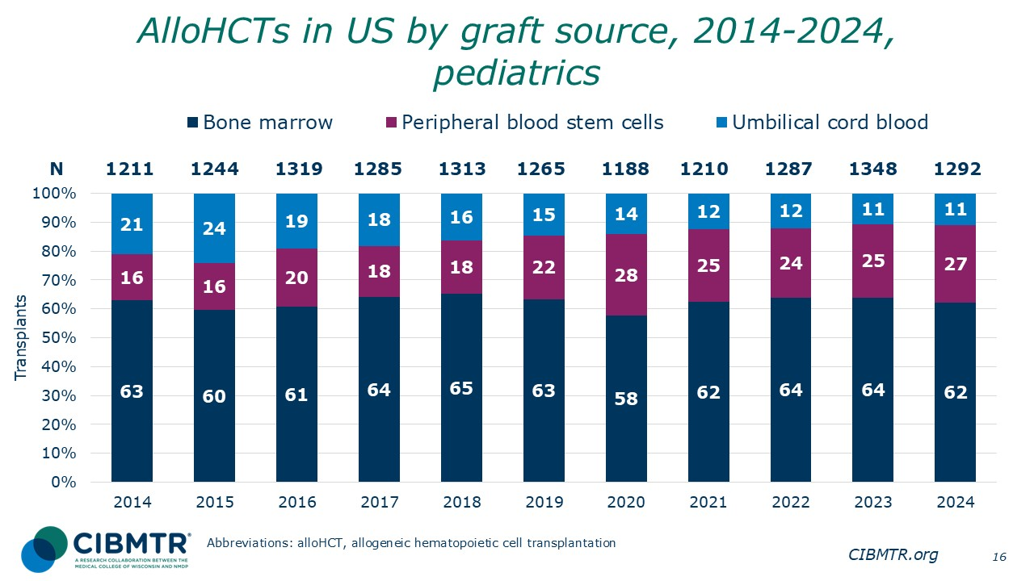
Notes:
This slide shows the number of first allogeneic procedures by graft sources among pediatric recipients, 2014-2024. Bone marrow represents the largest graft source consistently each year.

Slide 17
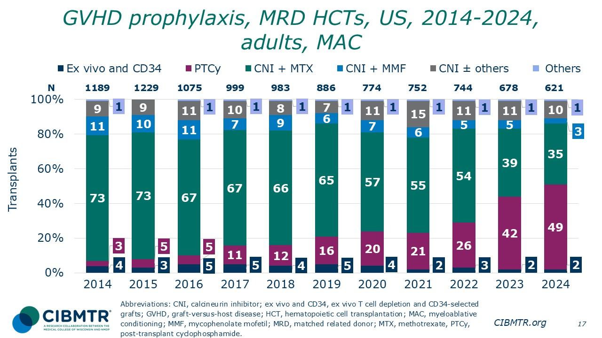
Notes:
Post-transplant cyclophosphamide (PTCy) became the most common graft-versus-host-disease (GVHD) prophylaxis approach in the adult matched related donor (MRD) recipients in the myeloablative conditioning (MAC) setting, starting in 2024.

Slide 18
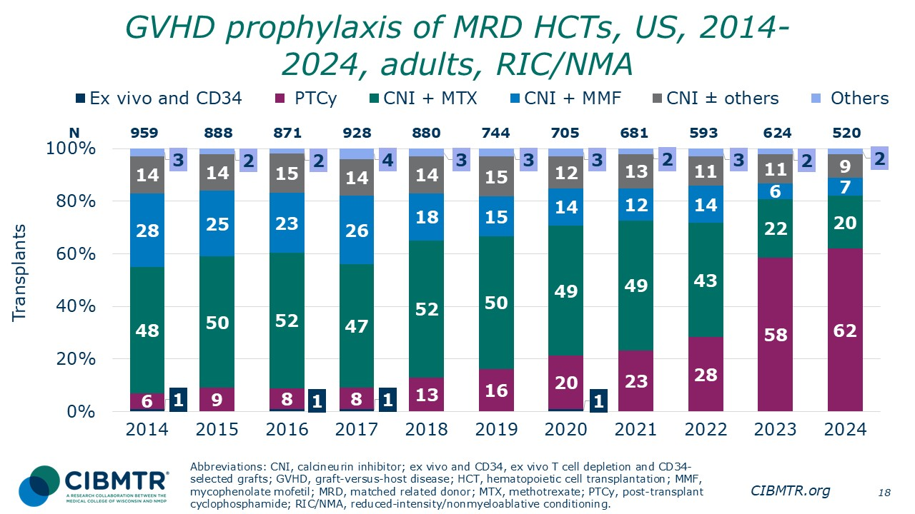
Notes:
The use of post-transplant cyclophosphamide (PTCy) became the most common GVHD prophylaxis approach in the reduced-intensity /nonmyeloablative (RIC/NMA) setting, starting in 2023.

Slide 19
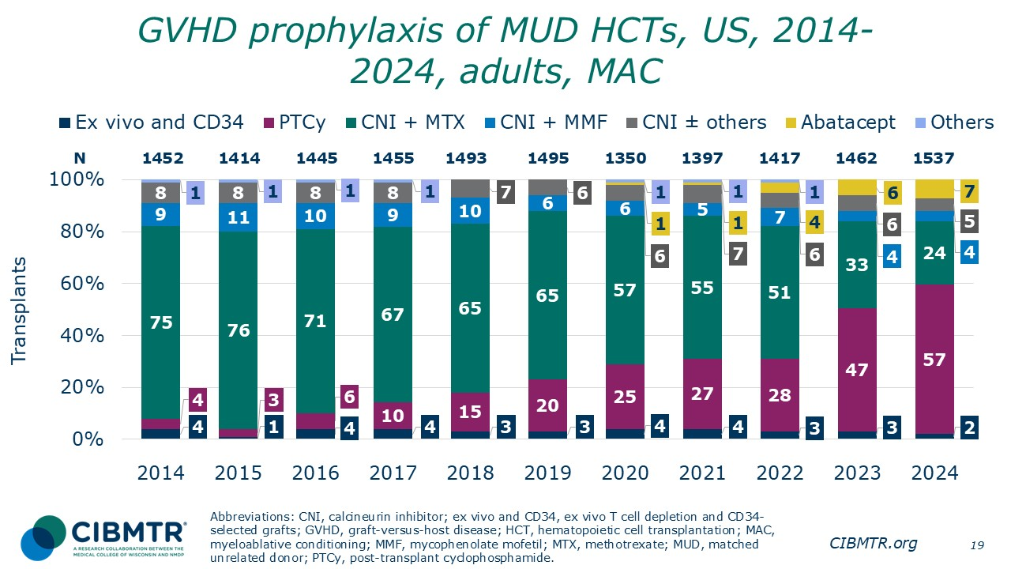
Notes:
Post-transplant cyclophosphamide (PTCy) became the most common GVHD prophylaxis approach in adult MUD recipients in the myeloablative conditioning (MAC) setting, starting in 2023.

Slide 20
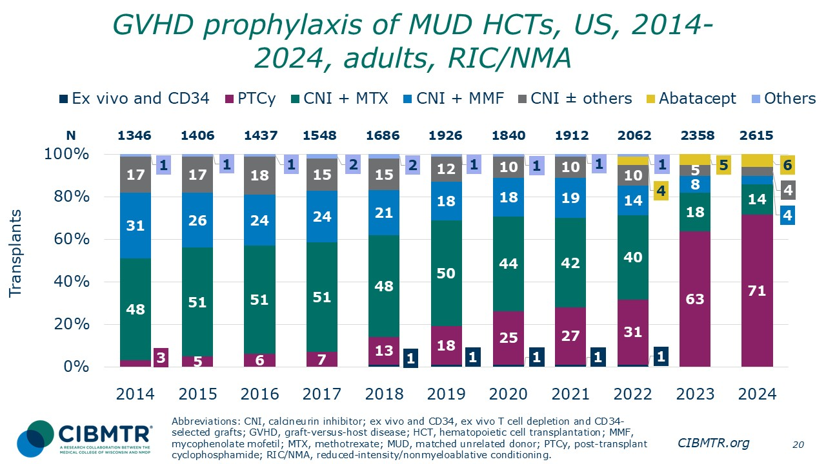
Notes:
Post-transplant cyclophosphamide (PTCy) became the most common GVHD prophylaxis approach in the reduced-intensity/nonmyeloablative (RIC/NMA) setting, starting in 2023.

Slide 21
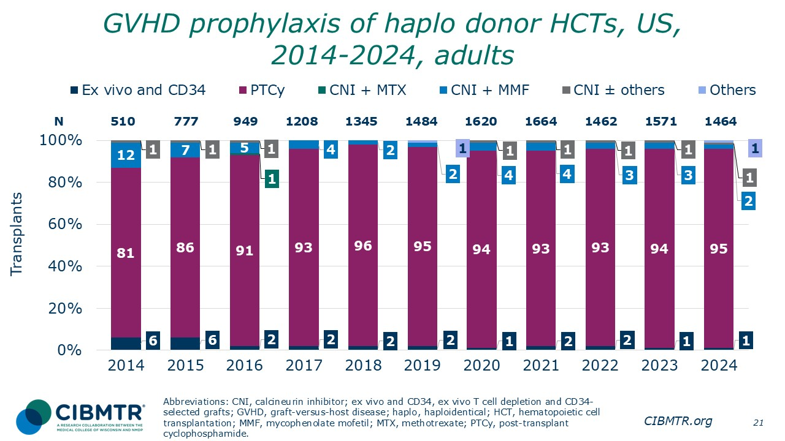
Notes:
GVHD prophylaxis for adults receiving haplo donor HCT is almost exclusively with PTCy.

Slide 22
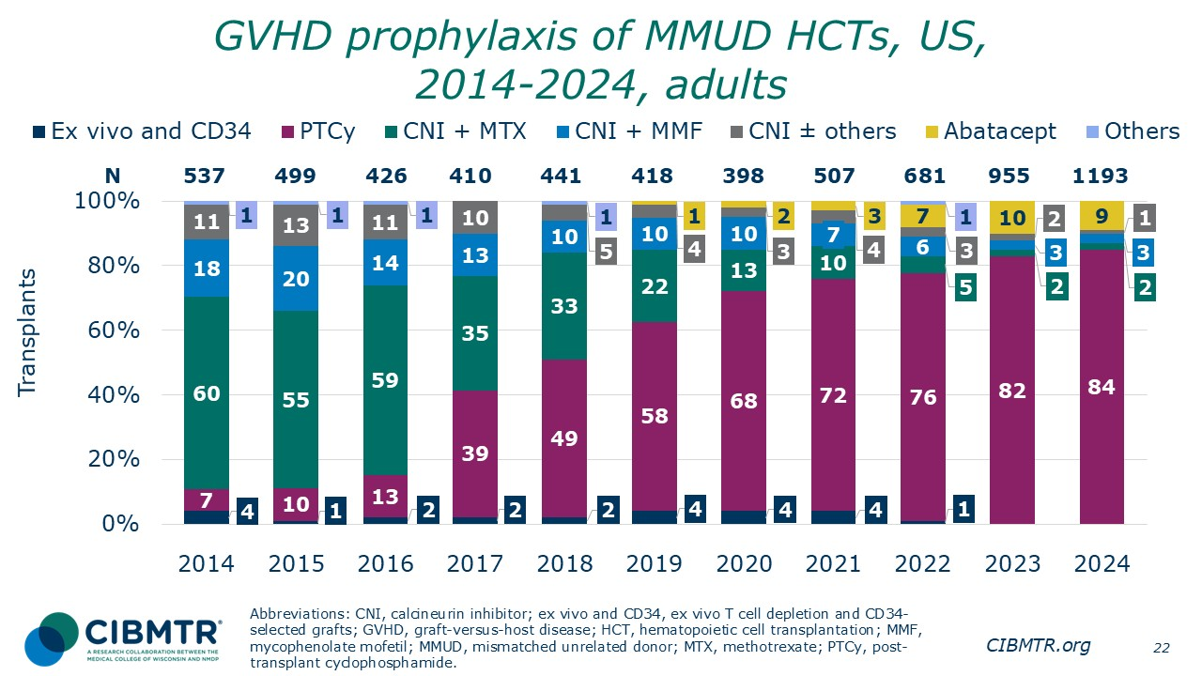
Notes:
Since 2019, GVHD prophylaxis for adults receiving MMUD HCT with PTCy is > 50%, and this continues to increase.

Slide 23
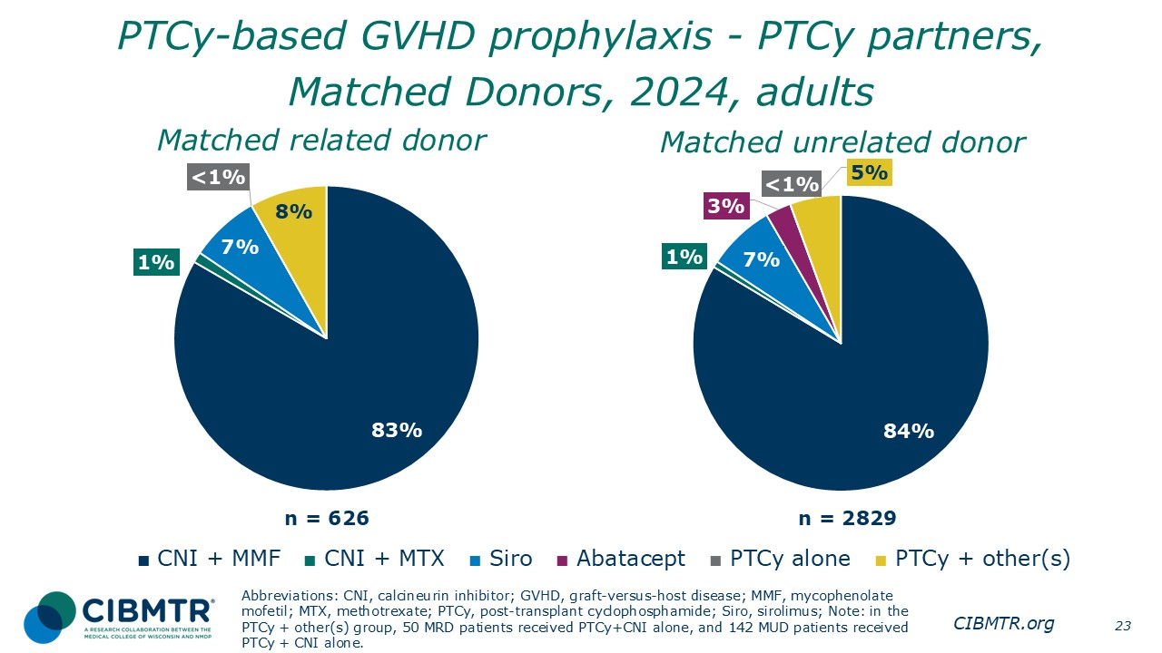
Notes:
CNI and MMF is the most common GVHD prophylaxis group within the PTCy GVHD prophylaxis setting for adults in 2024.

Slide 24
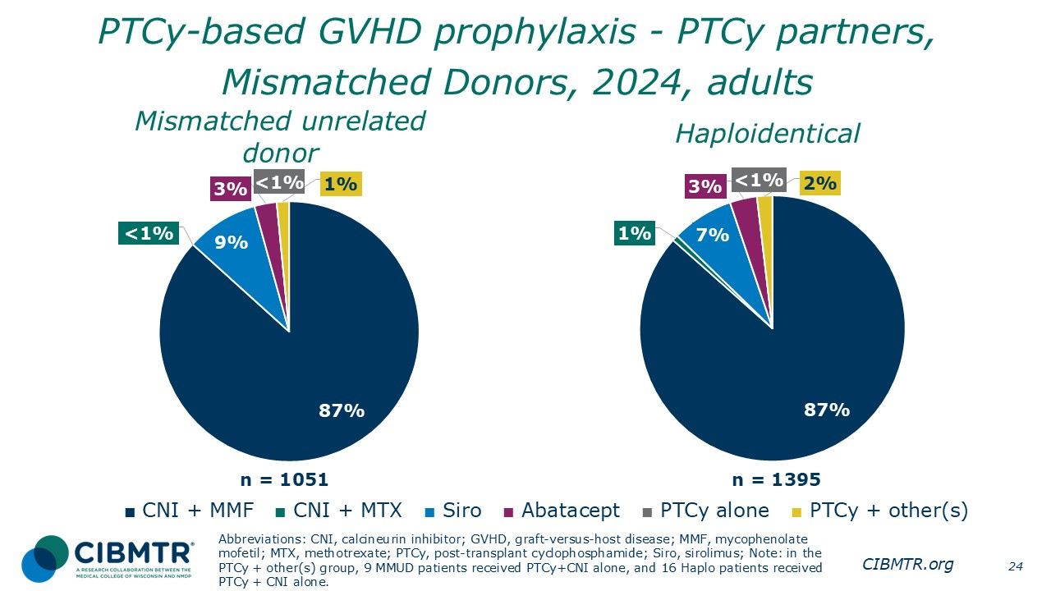
Notes:
CNI and MMF is the most common GVHD prophylaxis group within the PTCy GVHD prophylaxis setting for adults in 2024.

Slide 25
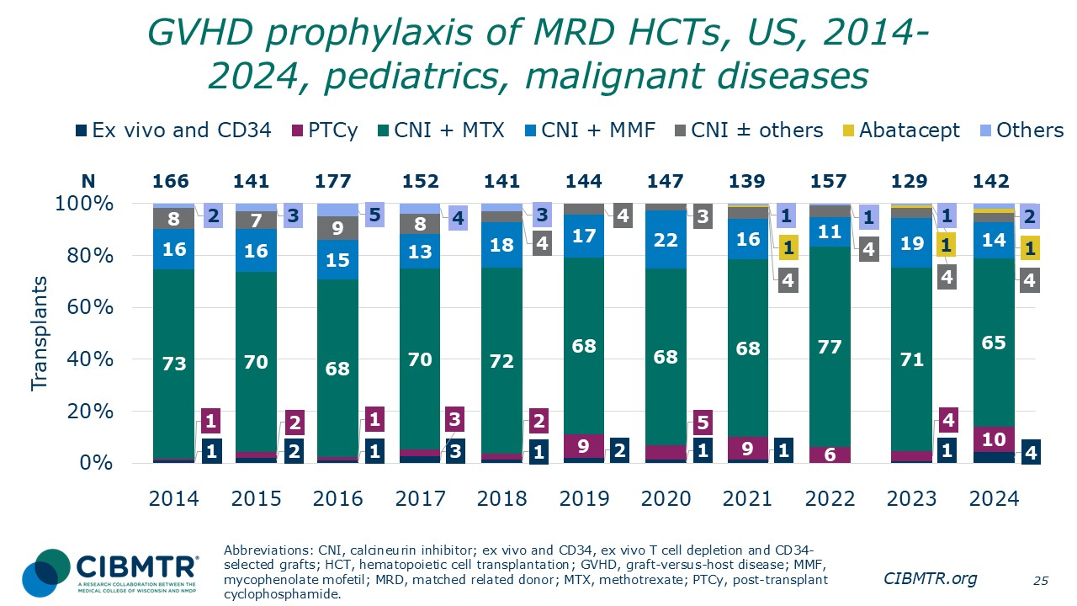
Notes:
CNI-based GVHD prophylaxis remains most commonly used in pediatric MRD recipients with malignant indication.

Slide 26
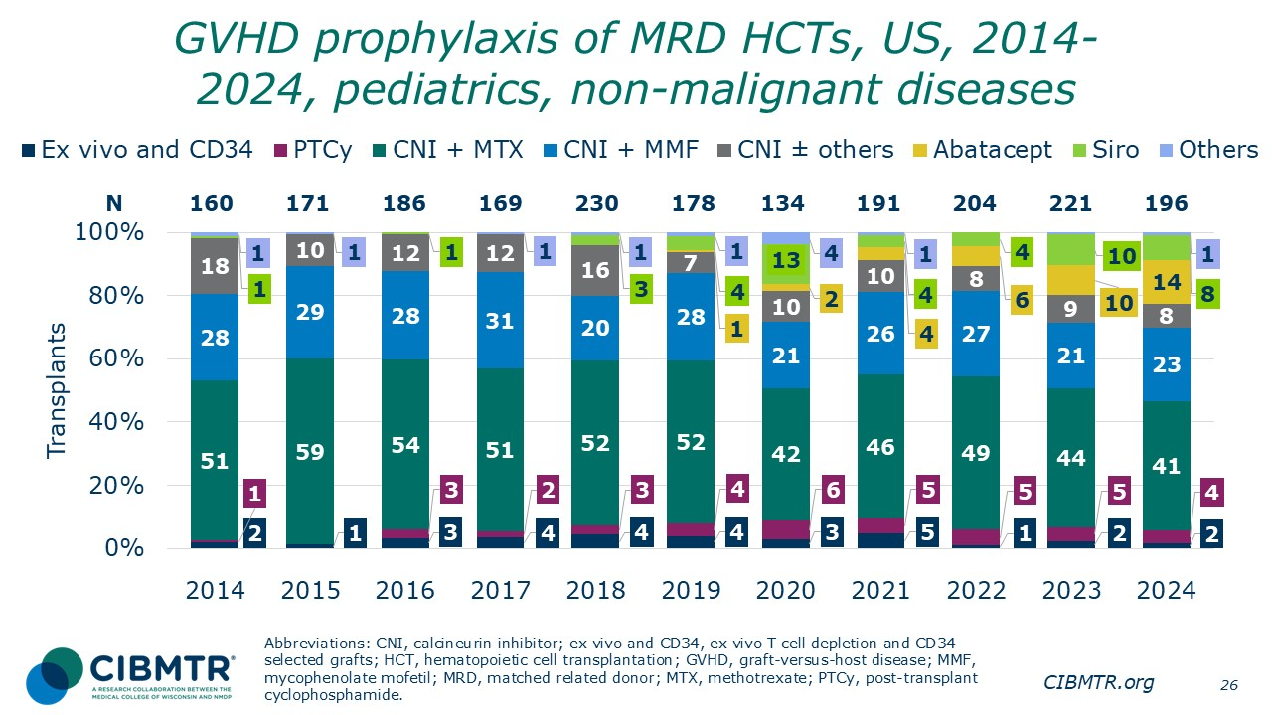
Notes:
CNI-based GVHD prophylaxis remains most commonly used in pediatric MRD recipients with non-malignant indication. There has been a notable increase in the use of abatacept and sirolimus since 2020.

Slide 27
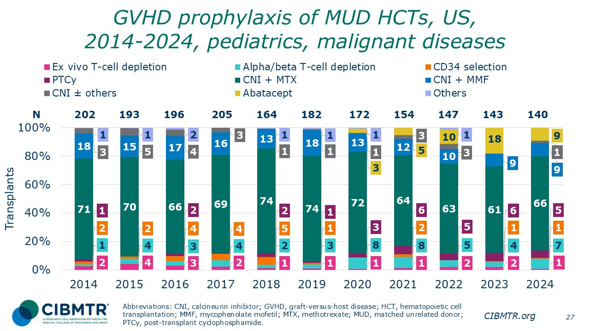
Notes:
CNI-based GVHD prophylaxis remains most commonly used in pediatric MUD recipients with malignant indication. There has been a notable increase in the use of abatacept since 2020.

Slide 28
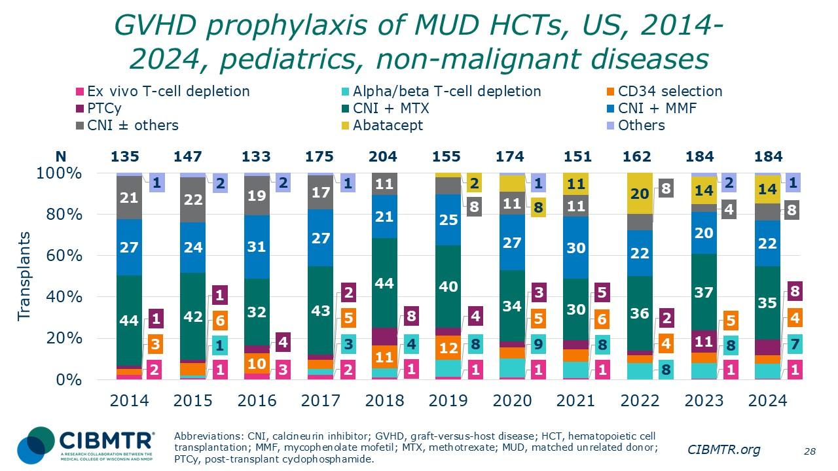
Notes:
CNI-based GVHD prophylaxis remains most commonly used in pediatric matched unrelated donor (MUD) recipients with non-malignant indications. There has been a notable increase in the use of abatacept since 2020.

Slide 29
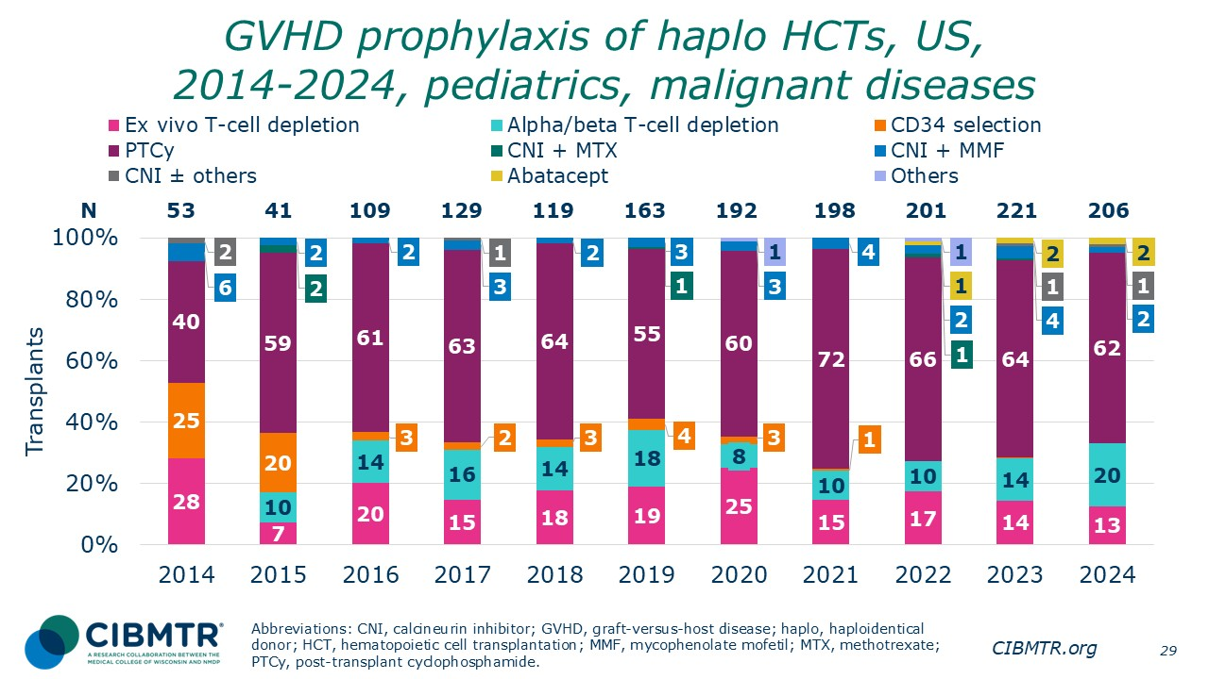
Notes:
PTCy remains most commonly used in pediatric haploidentical recipients for malignant indication.

Slide 30
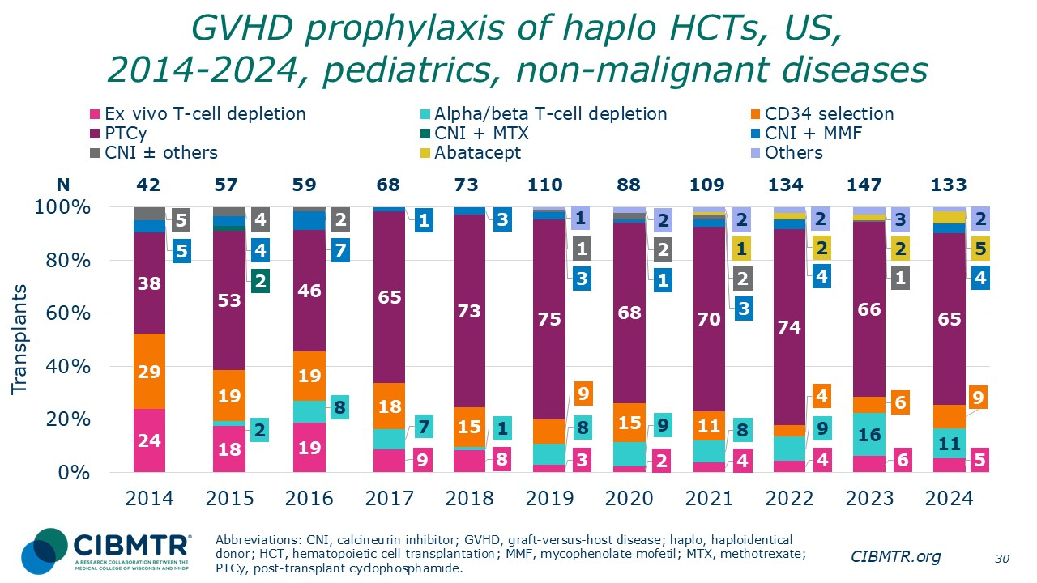
Notes:
PTCy remains most commonly used in pediatric haploidentical recipients for non-malignant indication.

Slide 31
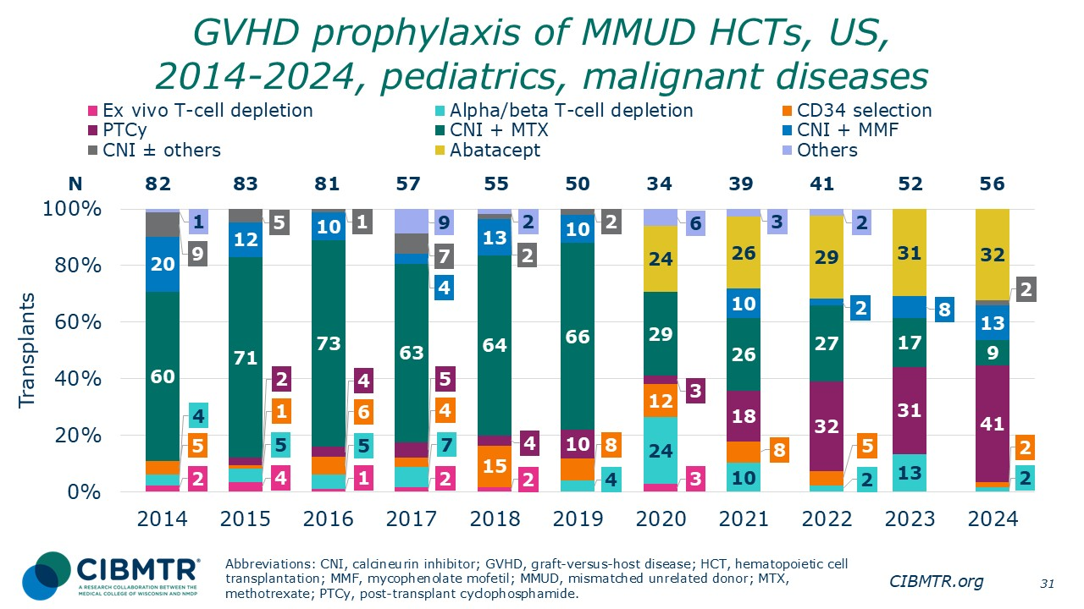
Notes:
CNI-based GVHD prophylaxis remained the most commonly used approach in pediatric mismatched unrelated donor recipients with malignant indications through 2019. There was a notable increase in the use of abatacept starting in 2020 and of PTCy in 2021.

Slide 32
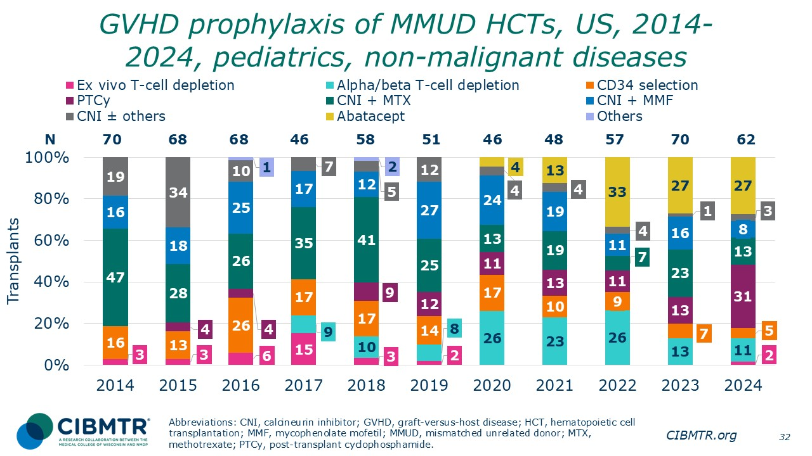
Notes:
CNI-based GVHD prophylaxis remained the most commonly used approach in pediatric mismatched unrelated donor recipients with non-malignant indications through 2019. There was a notable increase in the use of abatacept starting in 2020.

Slide 33
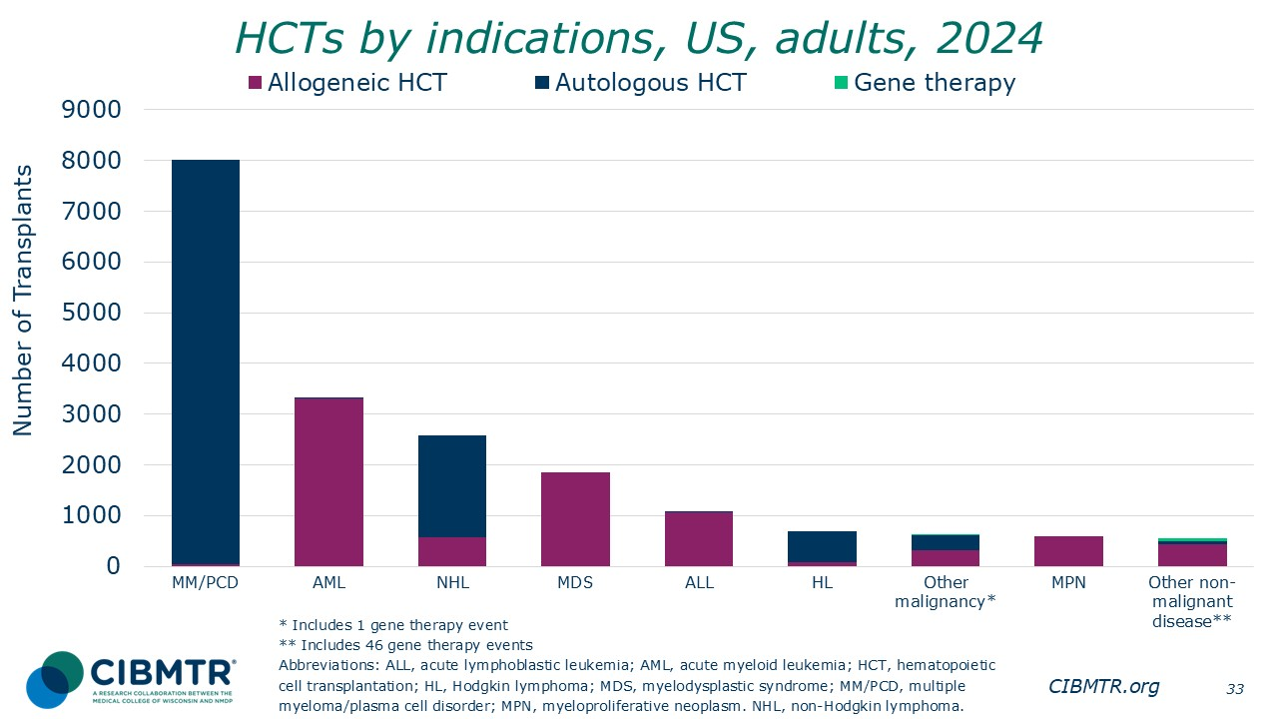
Notes:
The most common indications are AML for first allogeneic HCT and MM/PCD for first autologous HCT in the US in 2024 for adult patients. Forty-six (46) gene therapies for other non-malignant diseases were reported for treatment of primary immune deficiency, AA, sickle cell disease, thalassemia, and Scheie syndrome.

Slide 34
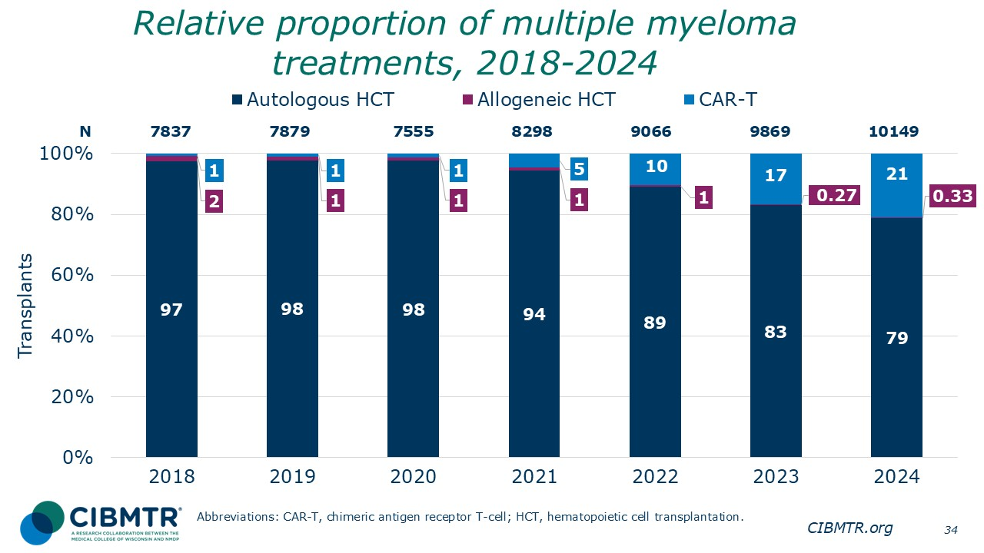
Notes:
The most common treatment type for multiple myeloma is autologous HCT, accounting for majority of the cases, with an increase in the use of CAR-T therapies seen since 2021.

Slide 35
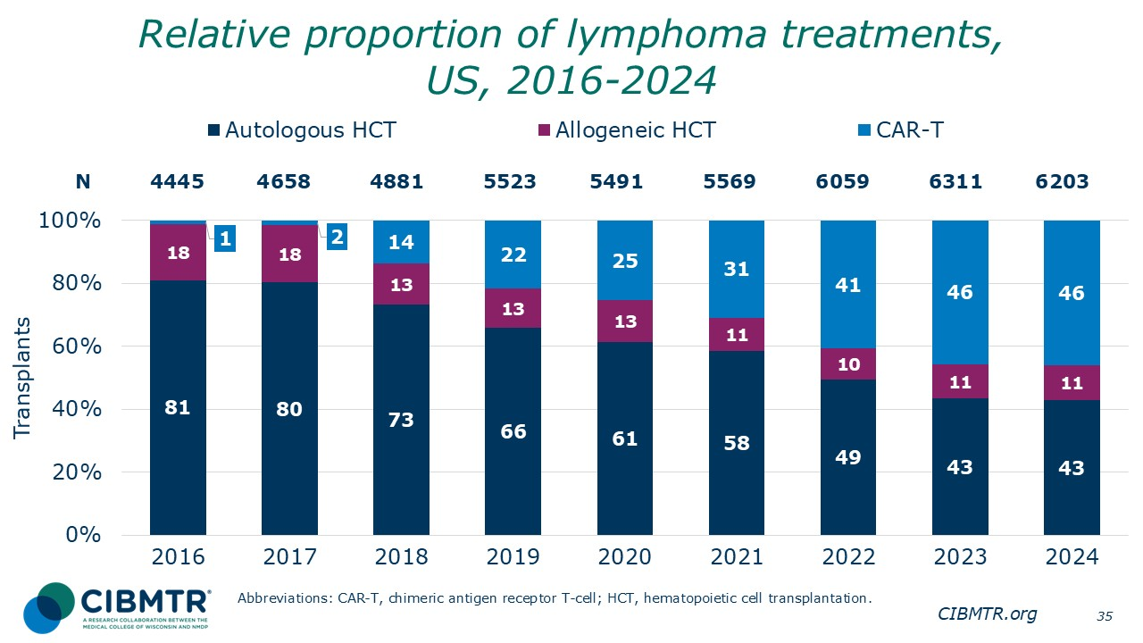
Notes:
The most common treatment type for lymphoma remained autologous HCT through 2022. Since 2023, CAR-T therapies are now the most common treatment type. The percentage of allogeneic HCT remains approximately stable.

Slide 36
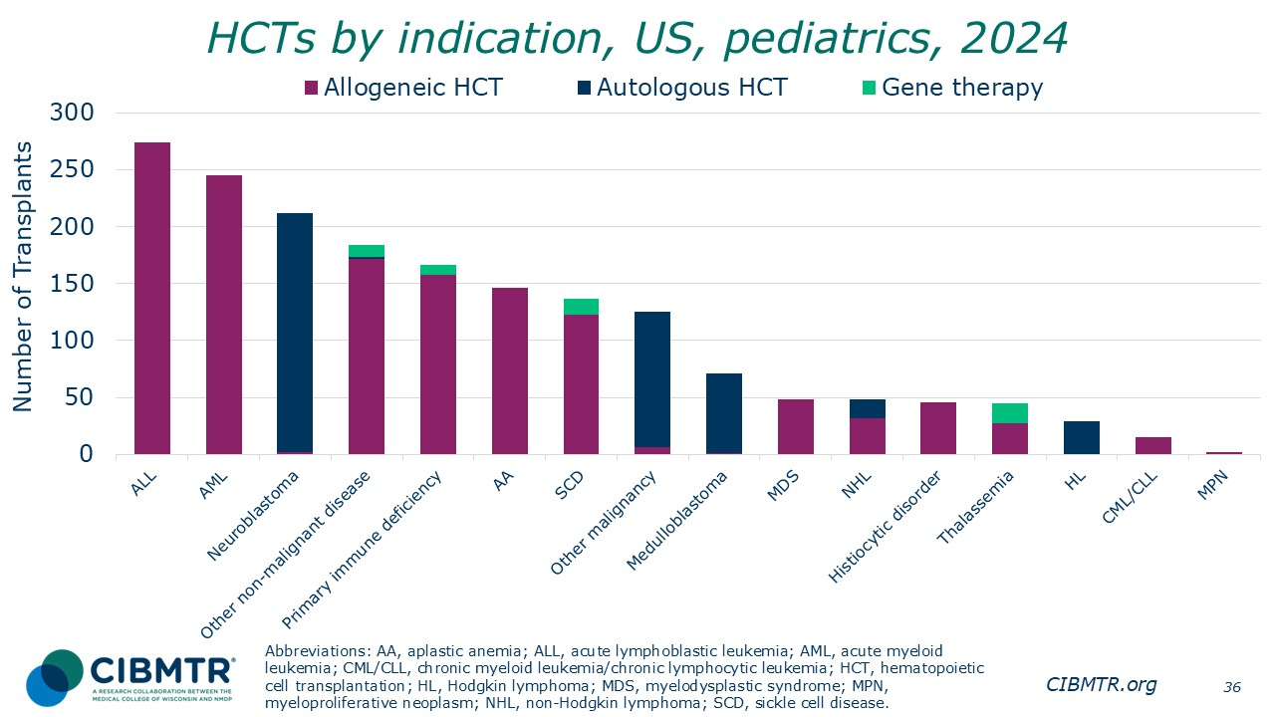
Notes:
The most common indications are ALL for first allogeneic HCT and neuroblastoma for first autologous HCT in the US in 2024 for pediatric patients. A total of 51 gene therapies were reported for treatment of primary immune deficiency, sickle cell disease, thalassemia, and other non-malignant disease.

Slide 37
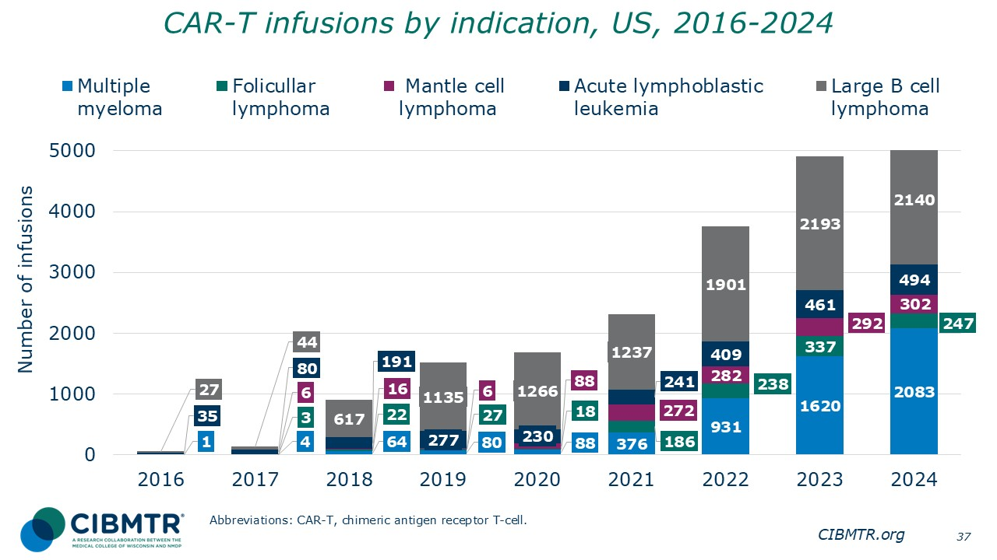
Notes:
Diffuse large B-cell lymphoma (DLBCL) is the most common indication among patients receiving CAR-T, increasing in number from 2016 to 2024. The number of patients who received CAR-T for multiple myeloma (MM) increased since 2021.

Slide 38
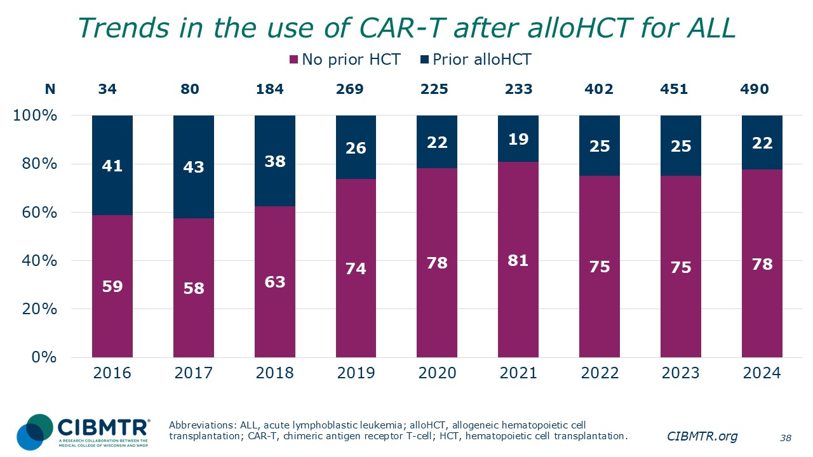
Notes:
The percentage of patients receiving CAR-T with no prior HCT increased during 2016 to 2021 but remained approximately stable thereafter.

Slide 39
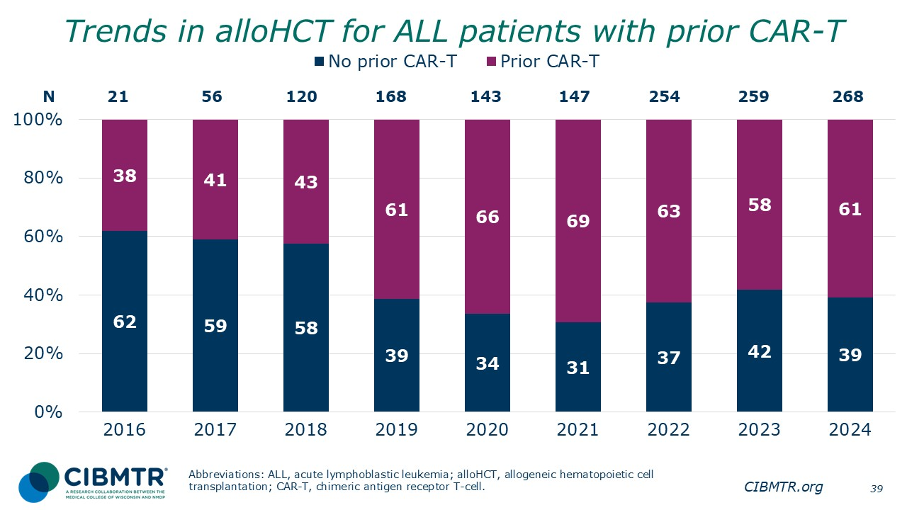
Notes:
The percentage of patients receiving first alloHCT with no prior CAR-T decreased in 2019 but started to increase and stabilize after 2022.

Slide 40
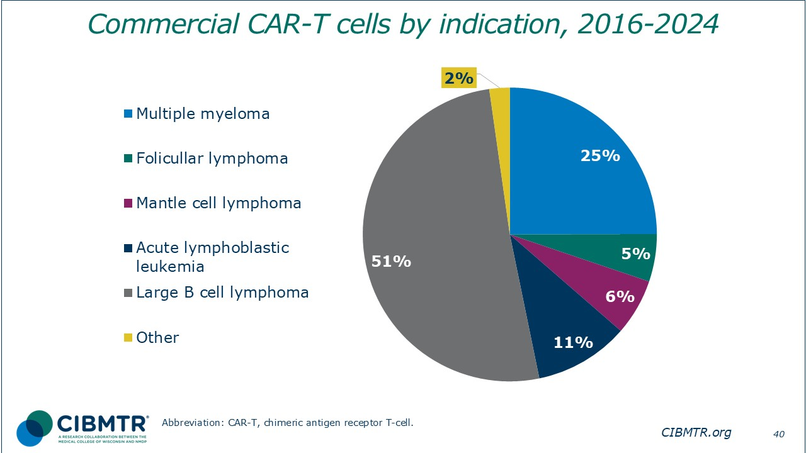
Notes:
LBCL was the most common indication for commercial CAR-T cells during 2016-2024, accounting for 51% of all cases.

Slide 41
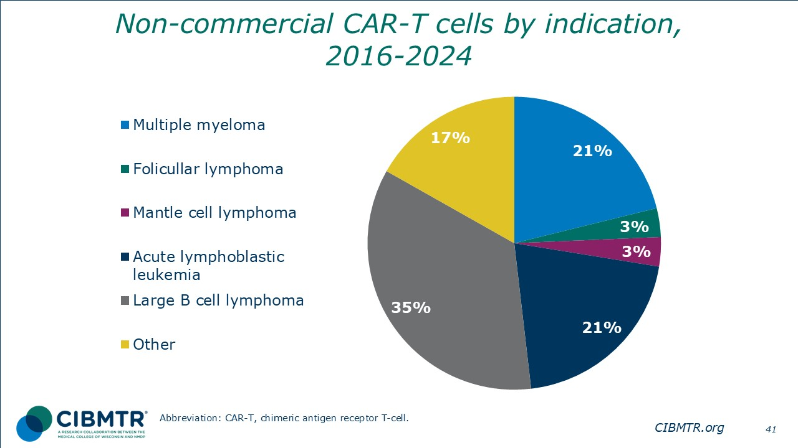
Notes:
LBCL was also the most common non-commercial CAR-T cell indication during 2016-2024, accounting for 35% of all cases for the same time interval.

Slide 42
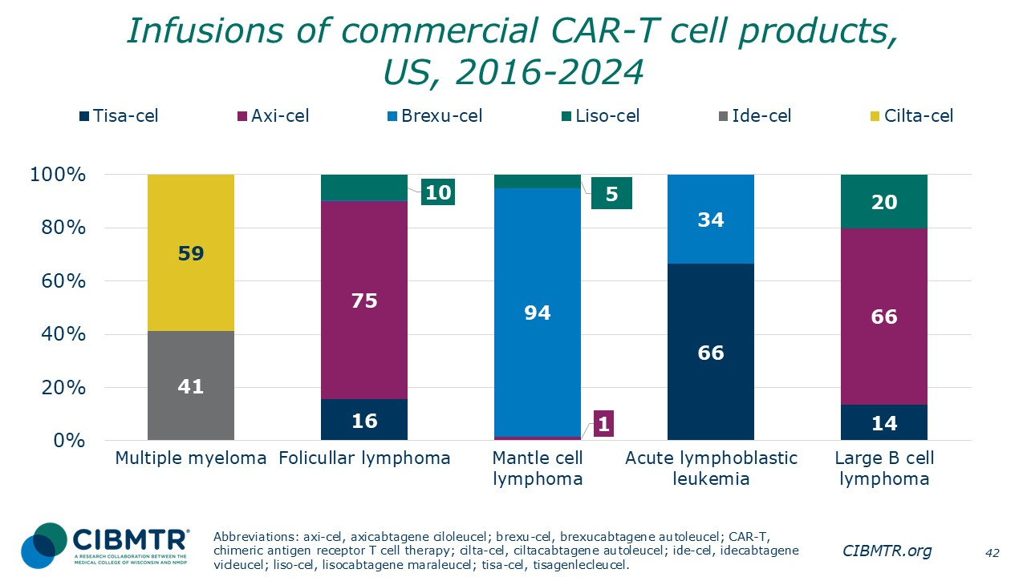
Notes:
Number of commercial CAR-T cell products by disease, 2016-2024. Axicabtagene ciloleucel accounts for 75% of follicular lymphoma cases, and brexucabtagene autoleucel accounts for 94% of mantle cell lymphoma cases.

Slide 43
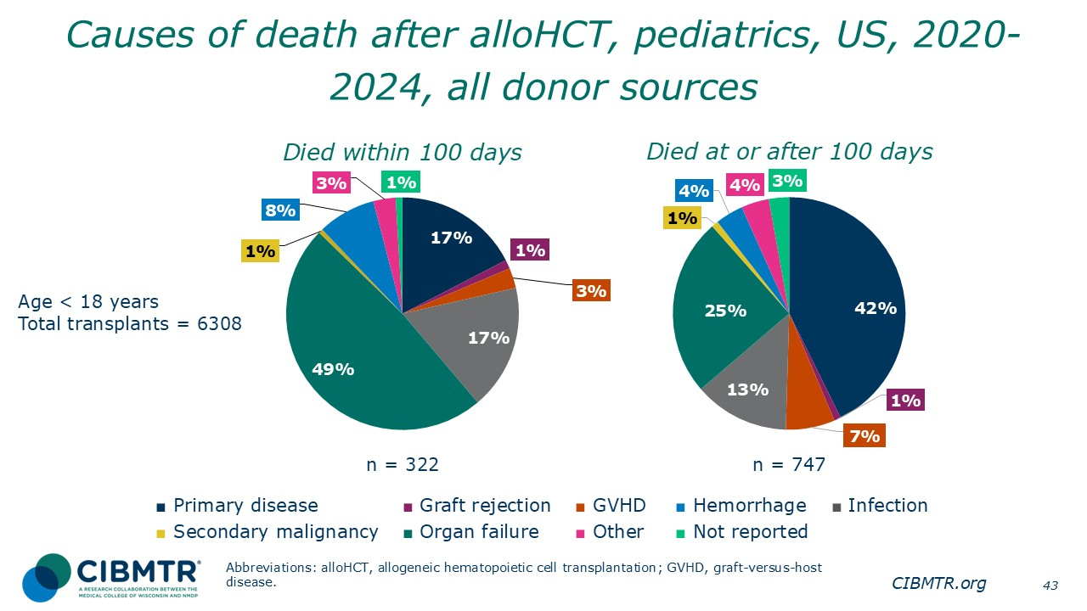
Notes:
Approximately half of deaths for recipients of first allogeneic transplants were due to disease relapse after 100 days. Within the first 100 days, disease relapse, organ failure, and infection were the 3 most common causes of death.

Slide 44
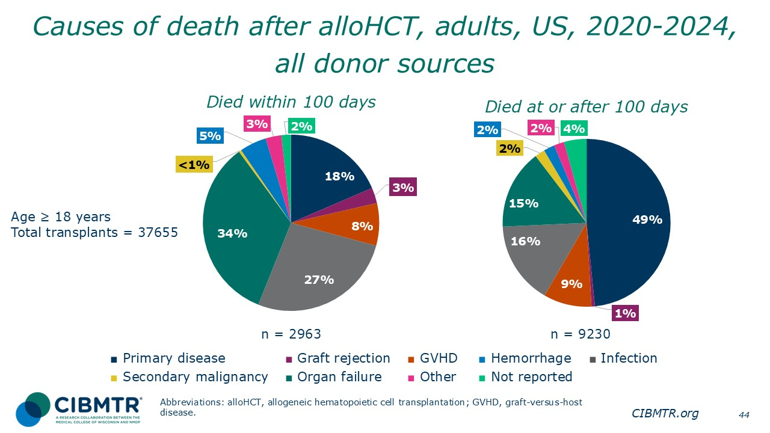
Notes:
Approximately half of deaths for recipients of first allogeneic transplants were due to disease relapse after 100 days. Within the first 100 days, disease relapse, organ failure, and infection were the 3 most common causes of death.

Slide 45
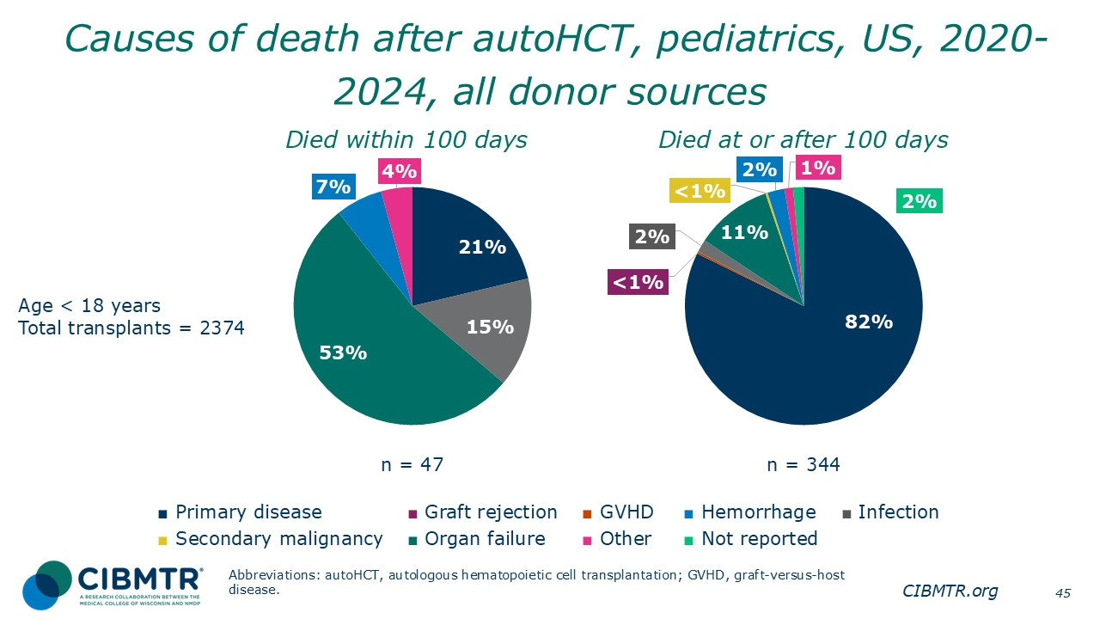
Notes:
The primary cause of death for recipients of first autologous transplants is disease relapse after 100 days. Though organ failure and infection are common in the first 100 days.

Slide 46
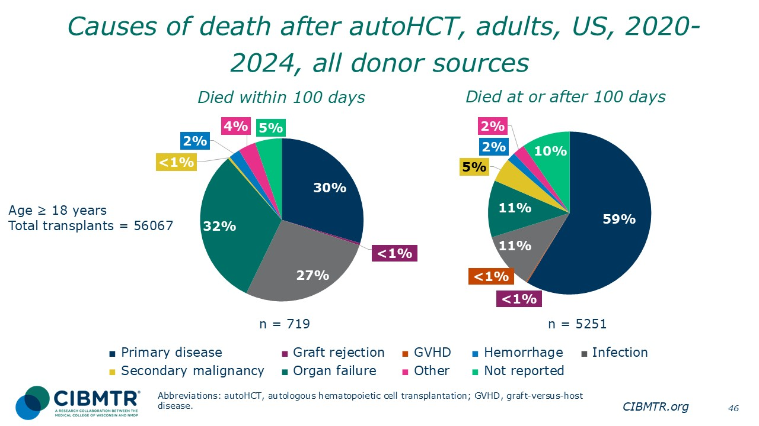
Notes:
The primary cause of death for recipients of first autologous transplants is disease relapse after 100 days. Though organ failure and infection are common in the first 100 days.

Slide 47
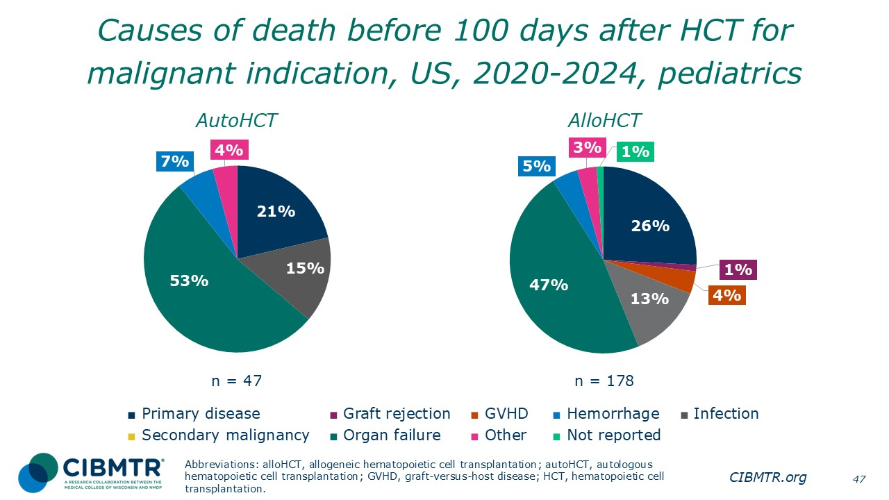
Notes:
Disease relapse, organ failure, and infection were the 3 most common causes of death for malignant disease in pediatrics.

Slide 48
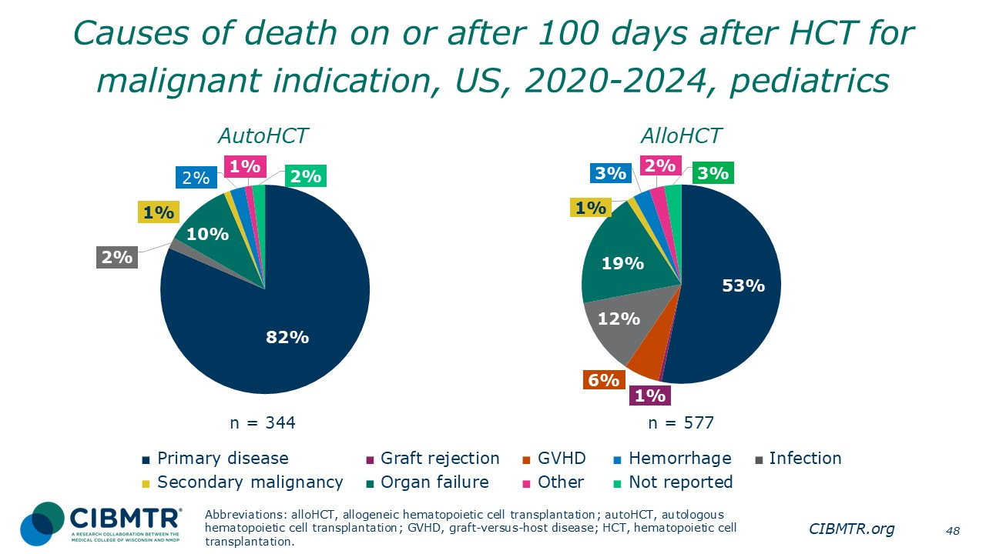
Notes:
Disease relapse is the primary cause of death for pediatric recipients of first transplants for malignant indication.

Slide 49
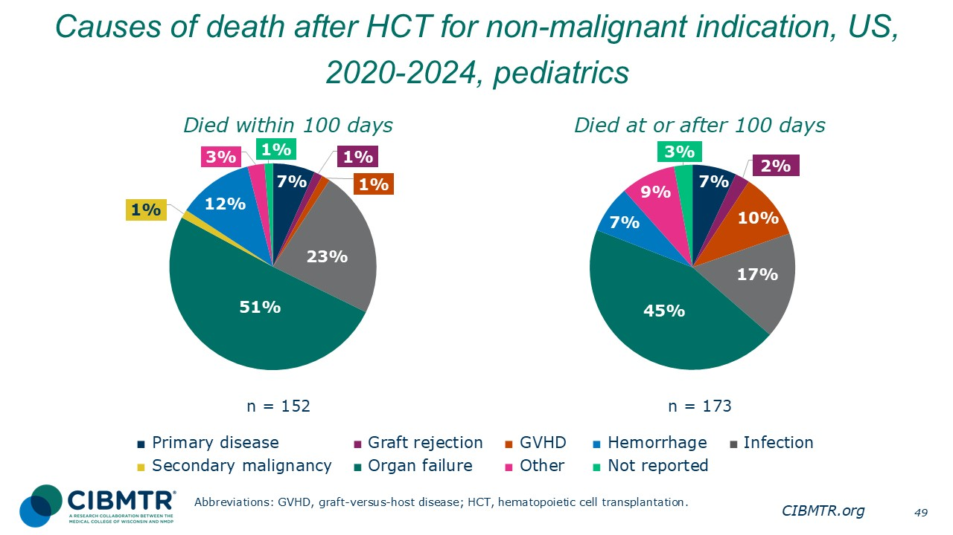
Notes:
The primary cause of death for pediatric recipients of first transplants for non-malignant organ failure.

Slide 50
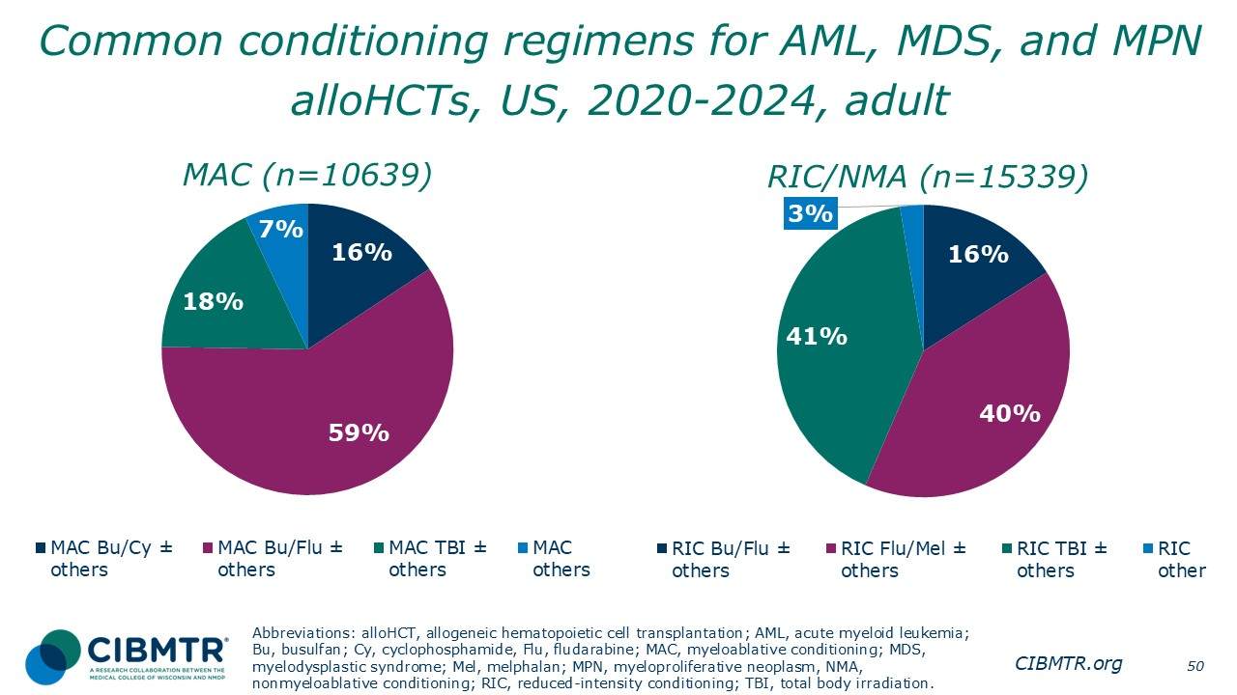
Notes:
This slide shows a breakdown of commonly used conditioning regimens for myeloablative (MAC) and reduced-intensity/nonmyeloablative (RIC/NMA) conditioning in adult patients with AML or MDS/MPN.
Myeloablative conditioning regimen: regimens with total body irradiation doses of ≥500 cGY, single fractionated doses of ≥ 800 cGY, busulfan doses of > 9 mg/kg oral or Bu ≥ 7.2 mg/kg IV, or melphalan doses of >150 mg/m² given as single agents or in combination with other drugs.
Reduced-intensity conditioning/nonmyeloablative regimen: regimens with lower doses of total body irradiation, fractionated radiation therapy, busulfan, and melphalan than those used to define a myeloablative conditioning regimen (above).
References for conditioning intensity:
Bacigalupo A, Ballen K, Rizzo D, Giralt S, Lazarus H, Ho V, et al. Defining the intensity of conditioning regimens: working definitions. Biology of Blood and Marrow Transplantation: Journal of the American Society for Blood and Marrow Transplantation. 2009;15(12):1628–1633. doi: 10.1016/j.bbmt.2009.07.004.
Giralt S, Ballen K, Rizzo D, Bacigalupo A, Horowitz M, Pasquini M, et al. Reduced-intensity conditioning regimen workshop: defining the dose spectrum. Report of a workshop convened by the Center for International Blood and Marrow Transplant Research. Biology of Blood And Marrow Transplantation: Journal of the American Society for Blood and Marrow Transplantation. 2009;15(3):367–369. doi: 10.1016/j.bbmt.2008.12.497.

Slide 51

Notes:
This slide shows a breakdown of commonly used conditioning regimens for myeloablative (MAC) and reduced-intensity/nonmyeloablative (RIC/NMA) conditioning in adult patients with ALL.
Myeloablative conditioning regimen: regimens with total body irradiation doses of ≥500 cGY, single fractionated doses of ≥ 800 cGY, busulfan doses of > 9mg/kg oral or Bu ≥ 7.2 mg/kg IV, or melphalan doses of >150 mg/m² given as single agents or in combination with other drugs.
Reduced-intensity conditioning/nonmyeloablative regimen: regimens with lower doses of total body irradiation, fractionated radiation therapy, busulfan, and melphalan than those used to define a myeloablative conditioning regimen (above).
References for conditioning intensity:
Bacigalupo A, Ballen K, Rizzo D, Giralt S, Lazarus H, Ho V, et al. Defining the intensity of conditioning regimens: working definitions. Biology of Blood and Marrow Transplantation: Journal of the American Society for Blood and Marrow Transplantation. 2009;15(12):1628–1633. doi: 10.1016/j.bbmt.2009.07.004.
Giralt S, Ballen K, Rizzo D, Bacigalupo A, Horowitz M, Pasquini M, et al. Reduced-intensity conditioning regimen workshop: defining the dose spectrum. Report of a workshop convened by the Center for International Blood and Marrow Transplant Research. Biology of Blood And Marrow Transplantation: Journal of the American Society for Blood and Marrow Transplantation. 2009;15(3):367–369. doi: 10.1016/j.bbmt.2008.12.497.

Slide 52

Notes:
Percentage of center-reported race and ethnicity for first allogeneic HCT recipients, 2014-2024. There is a slight increase in Hispanic or Latino recipients of allogeneic HCT over time.

Slide 53

Notes:
Percentage of donor type for first allogeneic HCT recipients by race and ethnicity.

Slide 54

Notes:
Percentage of center-reported recipient race and ethnicity for first autologous HCT recipients, 2014-2024. There is a slight increase in Hispanic or Latino recipients of autologous HCT over time.

Slide 55

Notes:
Percentage of center-reported recipient by race and ethnicity for first autologous HCT recipients, adults, 2014-2024. There is an increase in non-Hispanic White recipients over this period.

Slide 56

Notes:
Percentage of center-reported recipient by race and ethnicity for first autologous HCT recipients, pediatrics, 2014-2024.

Slide 57

Notes:
The percentage of patient center-reported by race and ethnicity for commercial CAR-T cell product types.

Slide 58

Notes:
The percentage of patient center-reported data for adults by race and ethnicity for commercial CAR-T cell product types.

Slide 59

Notes:
The percentage of patient center-reported data for pediatrics by race and ethnicity for commercial CAR-T cell product types.

Slide 60

Notes:
Among the 146,026 patients receiving first allogeneic HCT in US during 2004-2023, the 3-year probabilities (95% CI) of survival after allogeneic HCT during 2004-2023 in US are:
2019-2023 63.6% (63.1-64.1%)
2014-2018 58.6% (58.1-59.1%)
2009-2013 52.8% (52.2-53.3%)
2004-2008 47.6% (46.9-48.2%)
Two-group comparison P value:
2019-2023 vs 2014-2018, P <.0001
Trend data only are presented, and any significant P values reflect global differences between indicated groups and not any specific differences between indicated groups. Caution interpreting these univariate curves is important, as adjustment for other relevant factors using multivariable analyses has not been done.

Slide 61

Notes:
Among the 190,946 patients receiving first autologous HCT in US during 2004-2023, the 3-year probabilities (95% CI) of survival after autologous HCT during 2004-2023 in US are:
2019-2023 83.9% (83.5-84.2%)
2014-2018 81.2% (80.8-81.5%)
2009-2013 77.8% (77.5-78.2%)
2004-2008 70.8% (70.3-71.4%)
Two-group comparison, 2019-2023 vs 2014-2018, P <.0001
Trend data only are presented, and any significant P values reflect global differences between indicated groups and not any specific differences between indicated groups. Caution interpreting these univariate curves is important, as adjustment for other relevant factors using multivariable analyses has not been done.

Slide 62

Notes:
Among 2,784 adult patients with a matched related donor, the 3-year probabilities (95% CI) of survival following transplant according to disease status are:
CR1 66.3% (64.1-68.4%)
CR2+ (2nd or subsequent complete remission) 65.1% (60.2-70.4%)
Relapse/never in CR (includes primary induction failure) 38.1% (32.7-44.4%)
Two-group comparison:
MRD CR1 vs CR2+, P = 0.2229;
MRD CR2+ vs relapse, P <.0001;
Among the 7,210 adult recipients of matched unrelated donor, The 3-year probabilities (95% CI) of survival following transplant according to disease status are:
CR1 62.5% (61.1-63.9%)
CR2+ (2nd or subsequent complete remission) 57.9% (54.6-61.4%)
Relapse/never in CR (includes primary induction failure) 36.6% (33.2-40.3%)
Two-group comparison:
MUD CR1 vs CR2+, P = 0.0038;
MUD CR2+ vs relapse, P <.0001;
Trend data only are presented, and any significant P values reflect global differences between indicated groups and not any specific differences between indicated groups. Caution interpreting these univariate curves is important, as adjustment for other relevant factors using multivariable analyses has not been done.

Slide 63

Notes:
Among 2,953 adult patients with a haplo donor, the 3-year probabilities (95% CI) of survival following transplant according to disease status are:
CR1 62.1% (59.9-64.3%)
CR2+ (2nd or subsequent complete remission) 59.9% (55.4-64.7%)
Relapse/never in CR (includes primary induction failure) 32.6% (27.6-38.5%)
Two-group comparison:
MRD CR1 vs CR2+, P = 0.5047;
MRD CR2+ vs relapse, P <.0001;
Among the 1,246 adult recipients of mismatched unrelated donor, The 3-year probabilities (95% CI) of survival following transplant according to disease status are:
CR1 60.1% (56.5-63.8%)
CR2+ (2nd or subsequent complete remission) 62.6% (54.8-71.6%)
Relapse/never in CR (includes primary induction failure) 29.3% (21.2-40.3%)
Two-group comparison:
MUD CR1 vs CR2+, P = 0.5770;
MUD CR2+ vs relapse, P <.0001;
Trend data only are presented, and any significant P values reflect global differences between indicated groups and not any specific differences between indicated groups. Caution interpreting these univariate curves is important, as adjustment for other relevant factors using multivariable analyses has not been done.

Slide 64

Notes:
Among 1,131 pediatric patients, the 3-year probabilities (95% CI) of survival following transplant according to disease status are:
CR1 67.0% (63.5-70.6%)
CR2+ (2nd or subsequent complete remission) 74.5% (69.0-80.3%)
Relapse/never in CR (includes primary induction failure) 35.7% (25.3-50.3%)
Two-group comparison:
MRD CR1 vs CR2+, P = 0.0275;
MRD CR2+ vs relapse, P <.0001;
Trend data only are presented, and any significant P values reflect global differences between indicated groups and not any specific differences between indicated groups. Caution interpreting these univariate curves is important, as adjustment for other relevant factors using multivariable analyses has not been done.

Slide 65

Notes:
Among 1,041 pediatric patients with AML receiving first allogeneic transplant during 2019-2023, the 3-year probabilities (95% CI) of survival following transplant according to donor types are:
Matched related donor 69.7% (64.1-75.8%)
Matched unrelated donor 67.7% (62.4-73.4%)
Haplo related donor 68.3% (63.4-73.6%)
Mismatched unrelated donor 60.8% (50.0-74.0%)
Two-group comparison:
Pediatrics MRD vs MUD, P = 0.4189;
Pediatrics MRD vs Haplo, P = 0.3007;
Pediatrics MRD vs MMUD, P = 0.1236;
Trend data only are presented, and any significant P values reflect global differences between indicated groups and not any specific differences between indicated groups. Caution interpreting these univariate curves is important, as adjustment for other relevant factors using multivariable analyses has not been done.

Slide 66

Notes:
Among 701 patients with a matched related donor allogeneic transplants performed during 2019-2023 in recipients with early and advanced disease MDS, the 3-year probabilities (95% CI) of survival following transplant according to IPSS-R Score are:
Very low 68.1% (59.6-77.7%)
Low 73.0% (66.1-80.5%)
Intermediate 49.5% (42.4-57.9%)
High 44.5% (36.5-54.3%)
Very high 28.5% (20.2-40.1%)
Two-group comparison: 0.2708;
MRD very low vs intermediate, P = 0.0100;
MRD very low vs high, P = 0.0014;
MRD very low vs very high, P < 0.0001;
The 3-year probabilities (95% CI) of survival following transplant among 2,615 patients with a matched unrelated donor according to IPSS-R score are:
Very low 65.8% (60.8-71.2%)
Low 61.0% (57.3-64.9%)
Intermediate 50.5% (46.7-54.5%)
High 43.5% (38.8-48.6%)
Very high 33.7% (28.3-40.0%)
Two-group comparison:
MUD very low vs low, P = 0.0506;
MUD very low vs intermediate, P <.0001;
MUD very low vs high, P <.0001;
MUD very low vs very high, P <.0001;
Reference for MDS classifications:
Greenberg PL, Tuechler H, Schanz J, et al. Revised international prognostic scoring system for myelodysplastic syndrome. Blood. 2012;120(12):2454-2465.
Trend data only are presented, and any significant P values reflect global differences between indicated groups and not any specific differences between indicated groups. Caution interpreting these univariate curves is important, as adjustment for other relevant factors using multivariable analyses has not been done.

Slide 67

Notes:
Among 797 adult patients with a haplo donor receiving first allogeneic transplant for early and advanced MDS performed during 2019-2023, the 3-year probabilities (95% CI) of survival following transplant according to IPSS-R Score are:
Very low 55.1% (45.4-66.9%)
Low 57.0% (50.3-64.5%)
Intermediate 43.0% (36.6-50.4%)
High 38.9% (31.2-48.5%)
Very high 23.9% (16.8-34.1%)
Two-group comparison:
Haplo very low vs low, P = 0.7417;
Haplo very low vs intermediate P = 0.0899;
Haplo very low vs high, P = 0.0165;
Haplo very low vs very high P <.0001;
Among 350 adult patients with a mismatched unrelated donor, the 3-year probabilities (95% CI) of survival following transplant according to IPSS-R Score are:
Very low 59.6% (47.8-74.5%)
Low 58.1% (47.8-70.7%)
Intermediate 46.6% (36.3-59.8%)
High 30.7% (18.8-50.3%)
Very high 28.0% (17.1-45.9%)
Two-group comparison:
MMUD very low vs low, P = 0.6282;
MMUD very low vs intermediate, P = 0.1408;
MMUD very low vs high, P = 0.0036;
MMUD very low vs very high P value: 0.0042;
Trend data only are presented, and any significant P values reflect global differences between indicated groups and not any specific differences between indicated groups. Caution interpreting these univariate curves is important, as adjustment for other relevant factors using multivariable analyses has not been done.

Slide 68

Notes:
Among 170 pediatric patients receiving first allogeneic transplant for early and advanced MDS performed during 2019-2023, the 3-year probabilities (95% CI) of survival following transplant by donor type are:
Matched related donor 72.9% (58.2-91.2%)
Matched unrelated donor 75.6% (65.2-87.7%)
Haplo donor 75.6% (64.0-89.5%)
Mismatched unrelated donor 60.1% (43.5-83.0%)
Two-group comparison:
Pediatrics MRD vs MUD, P = 0.8523;
Pediatrics MRD vs Haplo, P = 0.7302;
Pediatrics MRD vs MMUD, P = 0.1687;
Among 99 pediatric patients receiving first allogeneic transplant for early and advanced MDS performed during 2019-2023, the 3-year probabilities (95% CI) of survival following transplant by IPSS-R Score are:
Very low 71.4% (44.7-100.0%)
Low 78.1% (58.3-100.0%)
Intermediate 68.3% (52.3-89.3%)
High 67.2% (49.9-90.5%)
Very high 58.6% (39.8-86.3%)
Two-group comparison:
Pediatrics very low vs low, P = 0.5409;
Pediatrics very low vs intermediate, P = 0.7633;
Pediatrics very low vs high, P = 0.9266;
Pediatrics very low vs very high, P = 0.6831;
Trend data only are presented, and any significant P values reflect global differences between indicated groups and not any specific differences between indicated groups. Caution interpreting these univariate curves is important, as adjustment for other relevant factors using multivariable analyses has not been done.

Slide 69

Notes:
Among 604 adult patients with a matched related donor, the 3-year probabilities (95% CI) of survival following transplant according to disease status are:
Myelofibrosis 68.5% (63.0-74.5%)
Other MPN 59.1% (53.6-65.2%)
Among 1,888 adult patients with a matched unrelated donor, the 3-year probabilities (95% CI) of survival following transplant according to disease status are:
Myelofibrosis 60.8% (57.2-64.5%)
Other MPN 55.4% (52.2-58.8%)
Trend data only are presented, and any significant P values reflect global differences between indicated groups and not any specific differences between indicated groups. Caution interpreting these univariate curves is important, as adjustment for other relevant factors using multivariable analyses has not been done.

Slide 70

Notes:
Among 606 adult patients with a Haplo donor, the 3-year probabilities (95% CI) of survival following transplant according to disease status are:
Myelofibrosis 56.1% (50.2-62.8%)
Other MPN 56.8% (51.5-62.7%)
Among 285 adult patients with a mismatched unrelated donor, the 3-year probabilities (95% CI) of survival following transplant according to disease status are:
Myelofibrosis 59.3% (50.3-69.9%)
Other MPN 56.1% (47.8-65.8%)
Trend data only are presented, and any significant P values reflect global differences between indicated groups and not any specific differences between indicated groups. Caution interpreting these univariate curves is important, as adjustment for other relevant factors using multivariable analyses has not been done.

Slide 71

Notes:
Among 1,225 adult patients with a matched related donor, the 3-year probabilities (95% CI) of survival following transplant according to disease status are:
CR1 76.3% (73.4-79.4%)
CR2+ (2nd or subsequent complete remission) 56.6% (50.6-63.4%)
Relapse/never in CR (includes primary induction failure) 52.6% (38.5-71.7%)
Two-group comparison:
MRD CR1 vs CR2+, P = <.0001;
MRD CR2+ vs relapse, P = 0.6378;
Among the 1,956 adult recipients of matched unrelated donor, The 3-year probabilities (95% CI) of survival following transplant according to disease status are:
CR1 72.1% (69.6-74.6%)
CR2+ (2nd or subsequent complete remission) 58.1% (53.2-63.6%)
Relapse/never in CR (includes primary induction failure) 44.8% (33.4-60.0%)
Two-group comparison:
MUD CR1 vs CR2+, P <.0001;
MUD CR2+ vs relapse, P = 0.0351;
Trend data only are presented, and any significant P values reflect global differences between indicated groups and not any specific differences between indicated groups. Caution interpreting these univariate curves is important, as adjustment for other relevant factors using multivariable analyses has not been done.

Slide 72

Notes:
Among 1,277 adult patients receiving a haplo donor transplant for ALL during 2019-2023, the 3-year probabilities (95% CI) of survival following transplant according to disease status are:
CR1 73.9% (70.8-77.1%)
CR2+ (2nd or subsequent complete remission) 53.9% (48.8-59.5%)
Relapse/never in CR (includes primary induction failure) 42.6% (29.4-61.7%)
Two-group comparison:
Haplo CR1 vs CR2+, P <.0001;
Haplo CR2+ vs relapse, P = 0.1325;
Trend data only are presented, and any significant P values reflect global differences between indicated groups and not any specific differences between indicated groups. Caution interpreting these univariate curves is important, as adjustment for other relevant factors using multivariable analyses has not been done.

Slide 73

Notes:
Among 1197 pediatric patients receiving first allogeneic transplant for ALL during 2019-2023, the 3-year probabilities (95% CI) of survival following transplant by donor type are:
Matched related donor 80.4% (76.0-85.0%)
Matched unrelated donor 71.0% (66.1-76.3%)
Haplo donor 73.7% (69.5-78.1%)
Mismatched unrelated donor 68.7% (59.0-80.0%)
Two-group comparison:
Pediatrics MRD vs MUD, P = 0.0059;
Pediatrics MRD vs haplo, P = 0.0461;
Pediatrics MRD vs MMUD, P = 0.0199;
Among 1,403 pediatric patients receiving first allogeneic transplant for ALL during 2019-2023, the 3-year probabilities (95% CI) of survival following transplant according to disease status are:
CR1 80.0% (76.0-84.2%)
CR2+ (2nd or subsequent complete remission) 72.4% (69.5-75.5%)
Relapse/never in CR (includes primary induction failure) 58.0% (43.3-77.8%)
Two-group comparison:
Pediatrics CR1 vs CR2+, P = 0.0024;
Pediatrics CR2+ vs relapse, P = 0.0170;
Trend data only are presented, and any significant P values reflect global differences between indicated groups and not any specific differences between indicated groups. Caution interpreting these univariate curves is important, as adjustment for other relevant factors using multivariable analyses has not been done.

Slide 74

Notes:
Allogeneic HCT is the treatment of choice for young patients with severe aplastic anemia (SAA) who have an HLA-matched sibling donor.
Among 733 pediatric patients who underwent transplantation for SAA during 2019-2023, the 3-year probabilities (95% CI) of survival following transplant according by donor type are:
Matched related donors 99.2% (98.0-100.0%)
Matched unrelated donors 93.1% (90.0-96.2%)
Haplo donors 89.2% (84.3-94.4%)
Mismatched unrelated donors 95.9% (91.6-100.0%)
Two-group comparison:
Pediatrics MRD vs MUD, P = 0.0008;
Pediatrics MRD vs Haplo, P <.0001;
Pediatrics MRD vs MMUD, P = 0.0152;
Among 1,022 adult patients who underwent transplantation for SAA during 2019-2023, the 3-year probabilities (95% CI) of survival following transplant according by donor type are:
Matched related donors 91.8% (88.4-95.3%)
Haplo donors 77.8% (73.7-82.2%)
Matched unrelated donors 81.3% (76.2-86.7%)
Mismatched unrelated donors 78.1% (69.4-88.0%)
Two-group comparison:
Adults MRD vs MUD, P <.0001;
Adults MRD vs Haplo, P = 0.0033;
Adults MRD vs MMUD, P = 0.0008;
Trend data only are presented, and any significant P values reflect global differences between indicated groups and not any specific differences between indicated groups. Caution interpreting these univariate curves is important, as adjustment for other relevant factors using multivariable analyses has not been done.

Slide 75

Notes:
Among 558 pediatric patients receiving first allogeneic transplant for SCD during 2019-2023, the 3-year probabilities (95% CI) of survival following transplant is:
Matched related donors 98.1% (96.7-99.6%)
Haplo donors 96.7% (90.5-100.0%)
Matched unrelated donors 90.4% (85.8-95.2%)
Mismatched unrelated donors 82.9% (68.9-99.8%)
Two-group comparison:
Pediatrics MRD vs MUD, P = 0.7103;
Pediatrics MRD vs Haplo, P = 0.0004;
Pediatrics MRD vs MMUD, P <.0001;
Among 282 adult patients receiving first allogeneic transplant for SCD during 2019-2023, the 3-year probabilities (95% CI) of survival following transplant is:
Matched related donors 89.3% (82.6-96.5%)
Haplo donors 85.0% (78.3-92.2%)
Matched unrelated donors 95.2% (86.6-100.0%)
Mismatched unrelated donors 90.9% (75.4-100.0%)
Two-group comparison:
Adults MRD vs MUD, P = 0.4871;
Adults MRD vs Haplo, P = 0.2850;
Adults MRD vs MMUD, P = 0.8740;
Trend data only are presented, and any significant P values reflect global differences between indicated groups and not any specific differences between indicated groups. Caution interpreting these univariate curves is important, as adjustment for other relevant factors using multivariable analyses has not been done.

Slide 76

Notes:
Among 648 pediatric patients receiving first allogeneic transplant for PID during 2019-2023, the 3-year probabilities (95% CI) of survival following transplant is:
Matched related donors 94.5% (91.1-98.1%)
Matched unrelated donors 82.6% (77.9-87.5%)
Haplo donors 77.8% (71.3-84.8%)
Mismatched unrelated donors 73.5% (62.6-86.2%)
Two-group comparison:
Pediatrics MRD vs MUD, P = 0.0007;
Pediatrics MRD vs MMUD, P <.0001;
Pediatrics MRD vs haplo, P <.0001;
Trend data only are presented, and any significant P values reflect global differences between indicated groups and not any specific differences between indicated groups. Caution interpreting these univariate curves is important, as adjustment for other relevant factors using multivariable analyses has not been done.

Slide 77

Notes:
Among the 4,207 patients receiving first autologous HCT for Hodgkin lymphoma (HL) during 2019-2023, the 3-year probabilities (95% CI) of survival following transplant according to disease status are:
Chemosensitive disease 93.4% (92.4-94.4%)
Chemoresistant disease 86.7% (81.0-92.8%)
Among the 534 patients receiving first allogeneic HCT for HL during 2019-2023, the 3-year probabilities (95% CI) of survival following transplant according to disease status are:
Chemosensitive disease 76.5% (72.4-80.8%)
Chemoresistant disease 70.1% (60.3-81.5%)
Trend data only are presented, and any significant P values reflect global differences between indicated groups and not any specific differences between indicated groups. Caution interpreting these univariate curves is important, as adjustment for other relevant factors using multivariable analyses has not been done.

Slide 78

Notes:
Among the 532 patients receiving first autologous HCT for FL during 2019-2023, the 3-year probabilities (95% CI) of survival following transplant according to disease status are:
Chemosensitive disease 88.0% (84.9-91.2%)
Chemoresistant disease 76.2% (52.1-100.0%)
Among the 117 patients receiving first allogeneic HCT for FL during 2019-2023, the 3-year probabilities (95% CI) of survival following transplant according to disease status are:
Chemosensitive disease 76.4% (68.2-85.6%)
Chemoresistant disease 80.1% (64.3-99.8%)
Trend data only are presented, and any significant P values reflect global differences between indicated groups and not any specific differences between indicated groups. Caution interpreting these univariate curves is important, as adjustment for other relevant factors using multivariable analyses has not been done.

Slide 79

Notes:
Among the 38,095 patients receiving first autologous HCT for multiple myeloma and amyloidosis during 2019-2023, the 3-year probabilities (95% CI) of survival after their autologous HCT are:
Amyloidosis 91.1% (89.4-92.9%)
Multiple myeloma 86.9% (86.4-87.3%)
Trend data only are presented, and any significant P values reflect global differences between indicated groups and not any specific differences between indicated groups. Caution interpreting these univariate curves is important, as adjustment for other relevant factors using multivariable analyses has not been done.

Slide 80

Notes:
Among 7,732 patients receiving CAR-T infusion in commercial and non-commercial (academic settings) for DLBCL during 2019-2023 in US, the 3-year probabilities (95% CI) of survival are:
Overall: 46.5% (45.2-47.8%)
Trend data only are presented, and any significant P values reflect global differences between indicated groups and not any specific differences between indicated groups. Caution interpreting these univariate curves is important, as adjustment for other relevant factors using multivariable analyses has not been done.

Slide 81

Notes:
The 3-year probabilities (95% CI) of survival for 1,618 patients who received first CAR-T infusion in commercial and non-commercial (academic settings) during 2019-2023 in US for ALL, by age groups are:
Pediatrics 65.9% (62.4-69.5%)
Adults 49.9% (45.9-54.3%)
Trend data only are presented, and any significant P values reflect global differences between indicated groups and not any specific differences between indicated groups. Caution interpreting these univariate curves is important, as adjustment for other relevant factors using multivariable analyses has not been done.

