Slide 1
Current Uses and Outcomes of Hematopoietic Cell Transplantation (HCT) in the U.S.
Notes:
INTRODUCTION: The Summary Slides are an annual report on data submitted to the CIBMTR by centers in U.S. and describes information related to practices and general survival outcomes after hematopoietic cell transplantation. The current edition includes transplants performed prior to 2022.
Slides 2 to 82 exhibit data on frequency of transplants according to transplant type, donor, patient age, graft source, GVHD prophylaxis, disease, causes of death, conditioning regimen, and race and/or ethnicity. All frequencies represent first autologous and allogeneic transplants registered with the CIBMTR during the period.
Slides 83 to 102 include overall survival outcomes according to age, donor type, disease, disease status, year of transplant, and race and ethnicity. Comparisons across survival curves are univariate and do not adjust for all potentially important factors; consequently, results should be interpreted cautiously.
Acute Myeloid Leukemia (AML), and Acute Lymphocytic Leukemia (ALL) have disease status at HCT classified as CR1, CR2+ (2nd or subsequent complete remission) and relapse/ never in CR (includes primary induction failure).
Myelodysplastic Syndromes (MDS) stage is divided into
Early disease (refractory anemia [RA] or refractory anemia with ringed sideroblasts [RARS], refractory cytopenia with unilineage dysplasia [RCUD], refractory cytopenia with multilineage dysplasia [RCMD], MDS with isolated del(5q))
Advanced disease(refractory anemia with excess blasts [RAEB] or Chronic Myelomonocytic Leukemia [CMML]) disease).
Myeloproliferative Neoplasms (MPN) include myelofibrosis, polycythemia vera, essential thrombocythemia, Chronic Myelomonocytic Leukemia, Chronic Myeloproliferative disease-unclassifiable, Chronic Neutrophilic Leukemia, Chronic Eosinophilic Leukemia and MPN-not otherwise specified.
Chronic Myelogenous Leukemia (CML) have disease stage classified as hematologic CR, chronic phase, accelerated phase or blast crisis.
Lymphomas are classified according to sensitivity to prior chemotherapy (chemosensitive or chemoresistant).
The classification of conditioning regimen intensity is based on the agents, doses and schedules used. Several classification systems are available, and for this report we used a composite classification. Cases defined as reduced-intensity by the transplant center were classified as such. Cases without such information and with available data on chemotherapy agents, radiation and doses, were classified according to the CIBMTR operational definition of conditioning regimen intensity:
Myeloablative conditioning regimen: regimens with total body irradiation doses of ≥500 cGY, single fractionated doses of ≥800 cGY, busulfan doses of >9mg/kg oral or Bu >= 7.2 mg/kg IV, or melphalan doses of >150 mg/m² given as single agents or in combination with other drugs.
Reduced-intensity conditioning/Non-myeloablative regimen: regimens with lower doses of total body irradiation, fractionated radiation therapy, busulfan, melphalan, Thiotepa and Treosulfan than those used to define a myeloablative conditioning regimen (above).
References for conditioning intensity:
1. Bacigalupo A, Ballen K, Rizzo D, Giralt S, Lazarus H, Ho V, et al. Defining the intensity of conditioning regimens: working definitions. Biology of blood and marrow transplantation : journal of the American Society for Blood and Marrow Transplantation. 2009;15(12):1628–1633. doi: 10.1016/j.bbmt.2009.07.004.
2. Giralt S, Ballen K, Rizzo D, Bacigalupo A, Horowitz M, Pasquini M, et al. Reduced-intensity conditioning regimen workshop: defining the dose spectrum. Report of a workshop convened by the center for international blood and marrow transplant research. Biology of blood and marrow transplantation : journal of the American Society for Blood and Marrow Transplantation. 2009;15(3):367–369. doi: 10.1016/j.bbmt.2008.12.497.
Bolon YT, Atshan R, Allbee-Johnson M, Estrada-Merly N, Lee SJ. Current use and outcome of hematopoietic stem cell transplantation: CIBMTR summary slides, 2022. Available at: http://www.cibmtr.org

Slide 2
Table of Contents

Slide 3
Number of 1st HCTs reported to CIBMTR in the U.S.
Notes:
Slide 3: The annual numbers of allogeneic and autologous transplant in the U.S. were compiled according to the number of first transplants of recipients registered with the CIBMTR.

Slide 4
Number of Allogeneic HCTs in the U.S. by Donor Type
Notes:
Slide 4: Upon further stratifying the number of allogeneic transplants in the U.S. by donor type, matched related donor (MRD) transplants represent the largest group before 2010. After then, matched unrelated donor (MUD) transplants represent the largest group. The number of cord blood transplants has been decreasing since 2011. The number of haplo procedures exceeded the number of cord blood transplants in 2015 and the number of matched related donors is 2020.

Slide 5
Relative Proportion of Allogeneic HCTs in the U.S. by Donor Type
Notes:
Slide 5: This slide shows the relative proportion of allogeneic transplants performed by donor type since 2000. The percentage of each is represented on the bar graph.

Slide 6
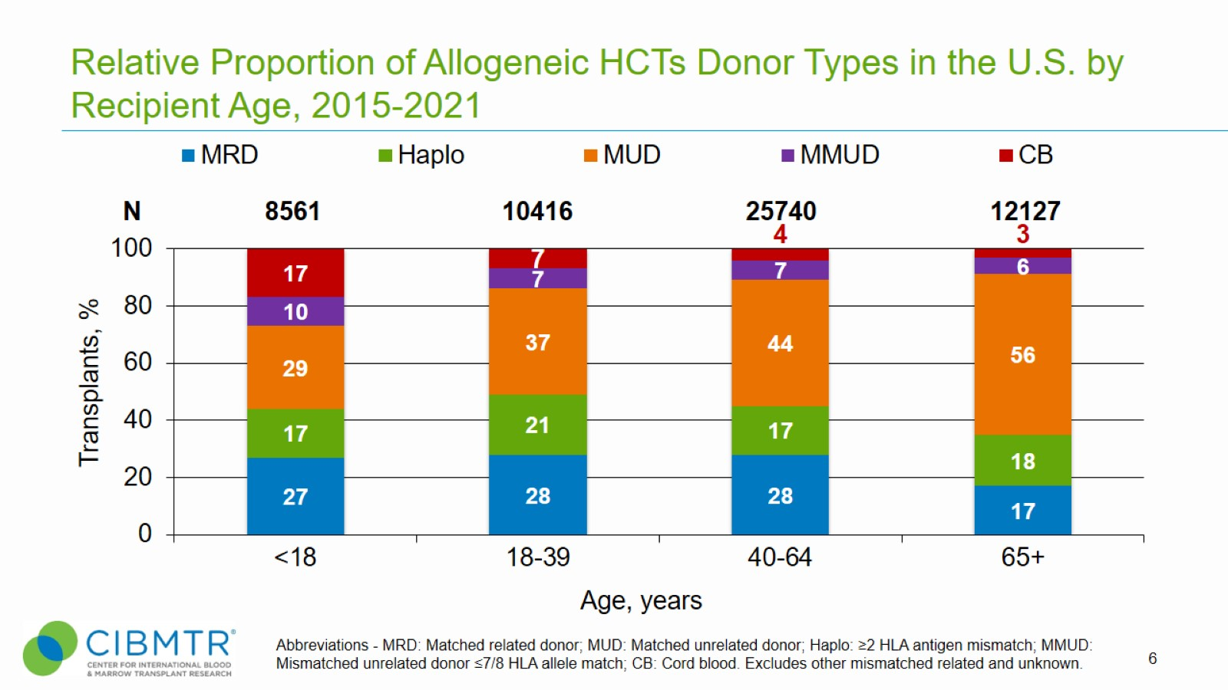
Relative Proportion of Allogeneic HCTs Donor Types in the U.S. by Recipient Age, 2015-2021
Notes:
Slide 6: Between 2015 and 2021, among pediatric recipients, matched unrelated donors were the most common donor type used followed by matched related donor. Haplo and CB donors are equally represented with a small proportion of transplant patients receiving MMUD.
For all age groups, MUDs are the most commonly used donor type, with the use of CB and MRDs diminishing with age.

Slide 7
Comorbidity Index in Allogeneic HCTs in the U.S. by HCT-CI Group, Adults
Notes:
Slide 7: This slide shows the relative proportion of transplants performed by HCT comorbidity index group for allogeneic recipients since 2011. The percentage of each is represented on the bar graph.

Slide 8
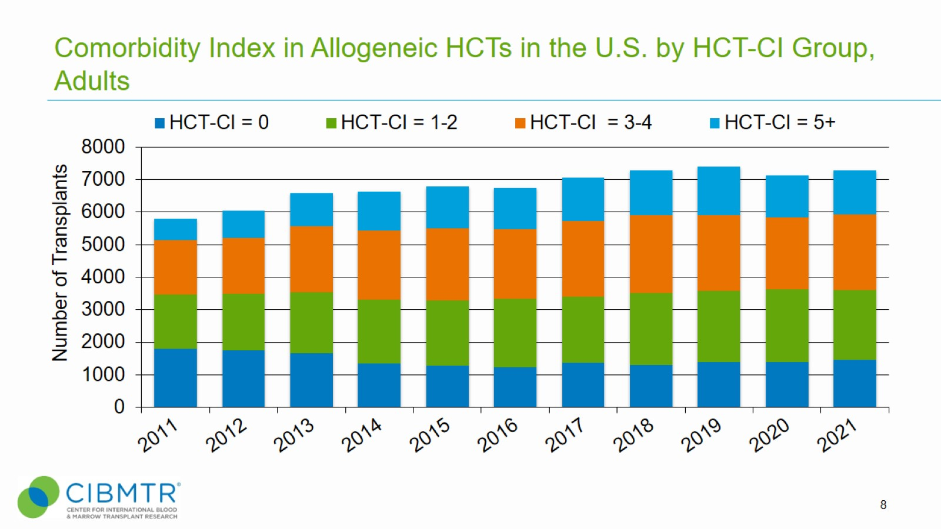
Comorbidity Index in Allogeneic HCTs in the U.S. by HCT-CI Group, Adults
Notes:
Slide 8: Since 2013, the number of allogeneic transplants with HCT comorbidity index 5 or more has increased while the number with HCT-CI = 0 decreased.

Slide 9
Comorbidity Index in Autologous HCTs in the U.S. by HCT-CI Group, Adults
Notes:
Slide 9: This slide shows the relative proportion of transplants performed by HCT comorbidity index group in autologous recipients since 2011. The percentage of each is represented on the bar graph.

Slide 10
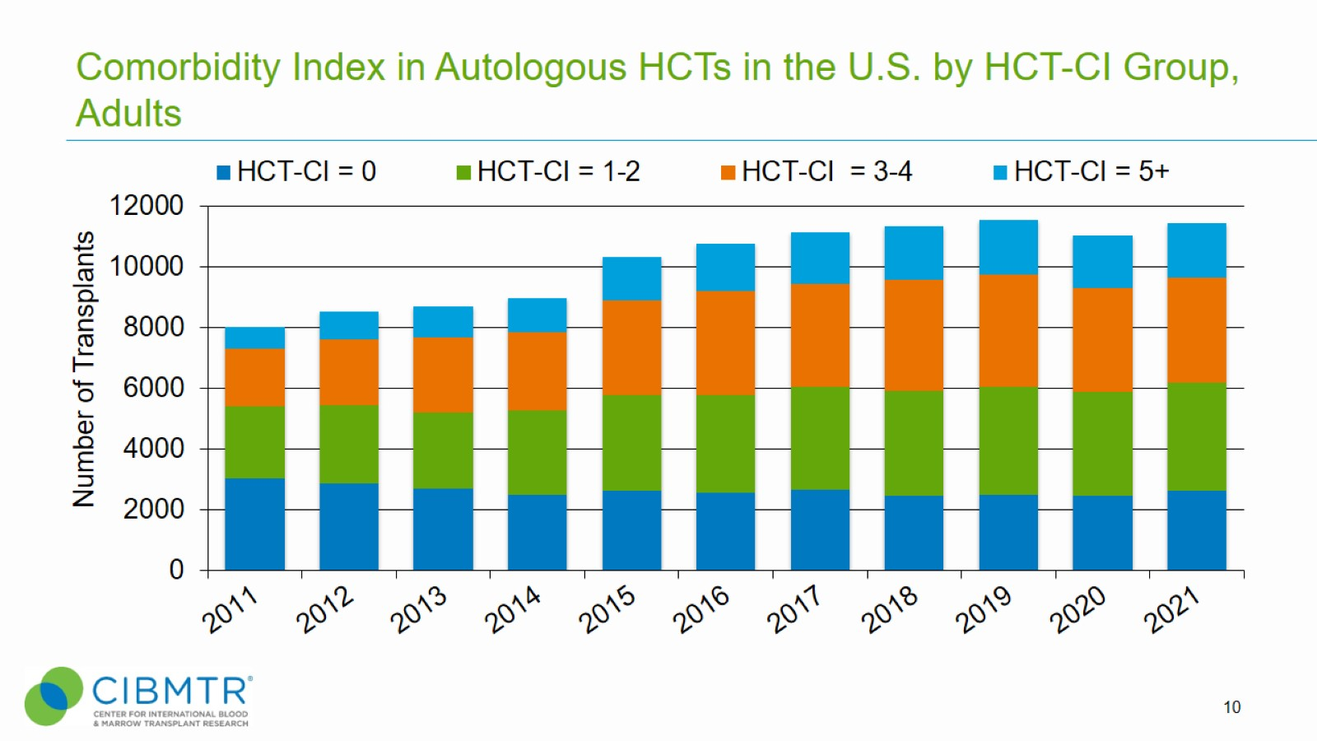
Comorbidity Index in Autologous HCTs in the U.S. by HCT-CI Group, Adults
Notes:
Slide 10: Since 2015, the number of autologous transplants with HCT-CI index > 0 has increased while the number with HCT-CI index = 0 has been fairly stable.

Slide 11
Comorbidity Index in Allogeneic HCTs in the U.S. by Conditioning Intensity, 2011-2021
Notes:
Slide 11: The percentage of allogeneic recipients by HCT-CI index group receiving myeloablative or non-myeloablative/reduced intensity conditioning. There was a higher percentage of HCT-CI = 5+ and lower percentage of HCT-CI = 0 in the NMA/RIC group compared to the myeloablative group.

Slide 12
Comorbidity Index in Allogeneic HCTs in the U.S. by Conditioning Intensity, 2011-2021
Notes:
Slide 12: The number of allogeneic recipients by HCT-CI index group receiving myeloablative or non-myeloablative/reduced intensity conditioning. There was a higher number of HCT-CI = 5+ and lower number of HCT-CI = 0 in the NMA/RIC group compared to the myeloablative group.

Slide 13
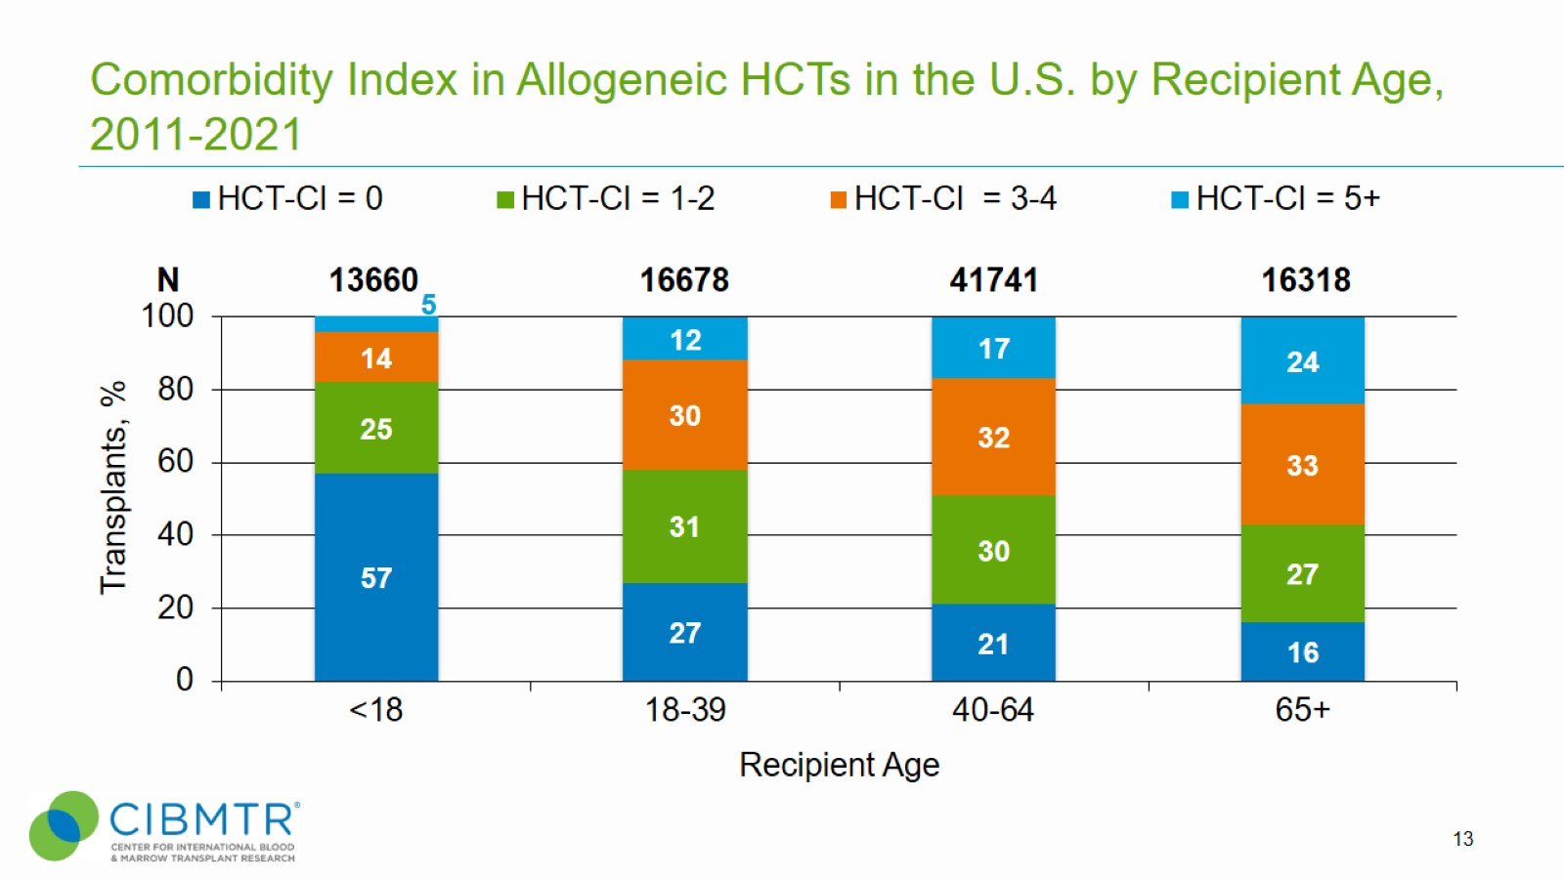
Comorbidity Index in Allogeneic HCTs in the U.S. by Recipient Age, 2011-2021
Notes:
Slide 13: This slide shows the relative proportion of allogeneic transplants performed by comorbidity index group in the different age groups since 2011. The percentage of each is represented on the bar graph.
It is not surprising that generally younger transplant recipients have lower HCT-CI index. In every age group, there appear to be more autologous than allogeneic transplants for HCT-CI = 0 and more allogeneic transplants than autologous transplants for HCT-CI of 5 and greater.

Slide 14
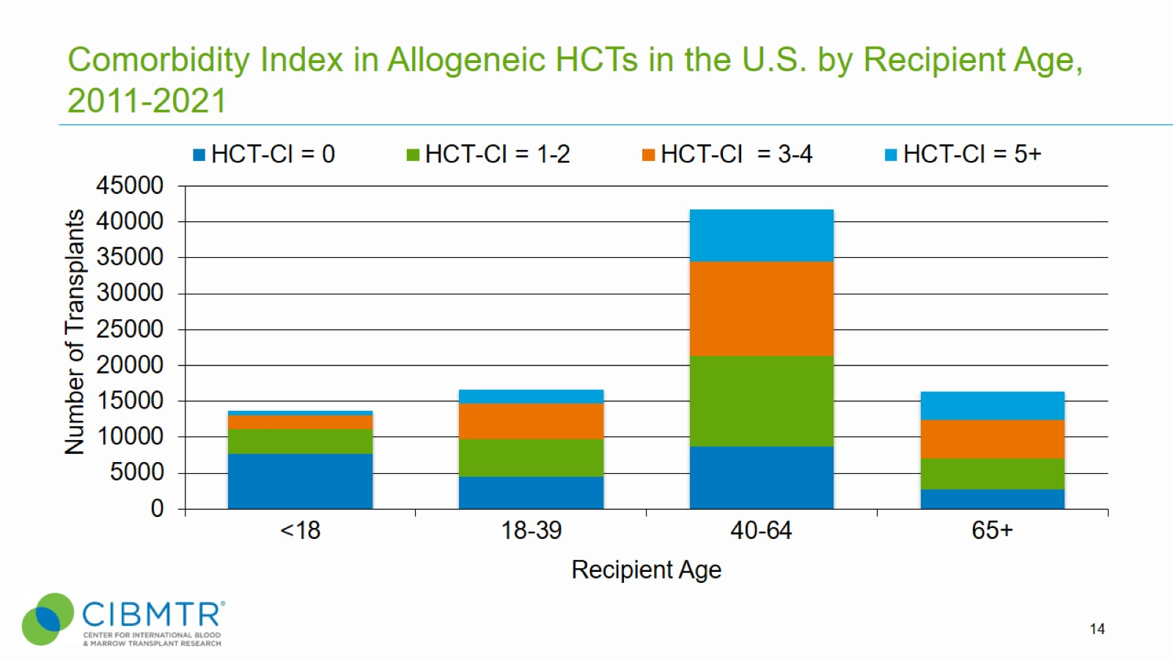
Comorbidity Index in Allogeneic HCTs in the U.S. by Recipient Age, 2011-2021
Notes:
Slide 14: This slide shows the number of allogeneic transplants performed by comorbidity index group in the different age groups since 2011.
It is not surprising that generally younger transplant recipients have lower HCT-CI index. In every age group, there appear to be more autologous than allogeneic transplants for HCT-CI index = 0 and more allogeneic transplants than autologous transplants for HCT-CI index of 5 and greater.

Slide 15
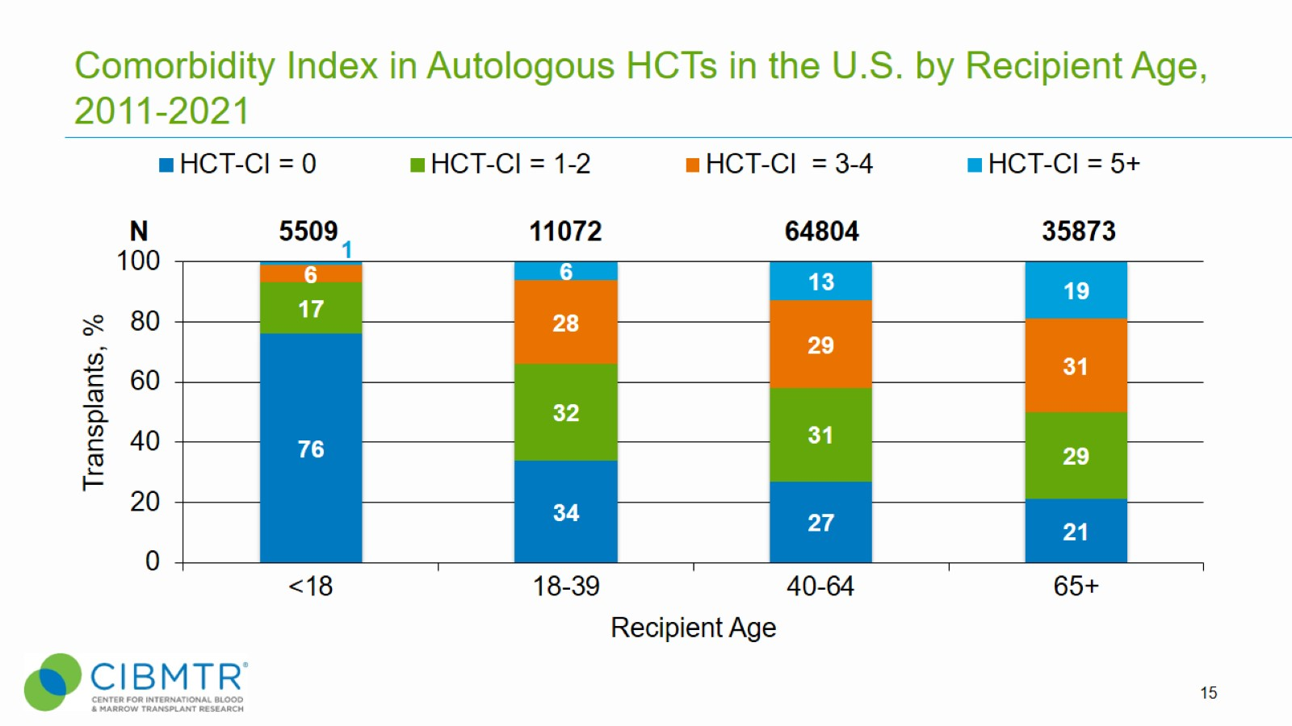
Comorbidity Index in Autologous HCTs in the U.S. by Recipient Age, 2011-2021
Notes:
Slide 15: This slide shows the relative proportion of autologous transplants performed by comorbidity index group in the different age groups since 2011. The percentage of each is represented on the bar graph.
It is not surprising that generally younger transplant recipients have lower HCT-CI. In every age group, there appear to be more autologous than allogeneic transplants for HCT-CI index = 0 and more allogeneic transplants than autologous transplants for HCT-CI index of 5 and greater.

Slide 16
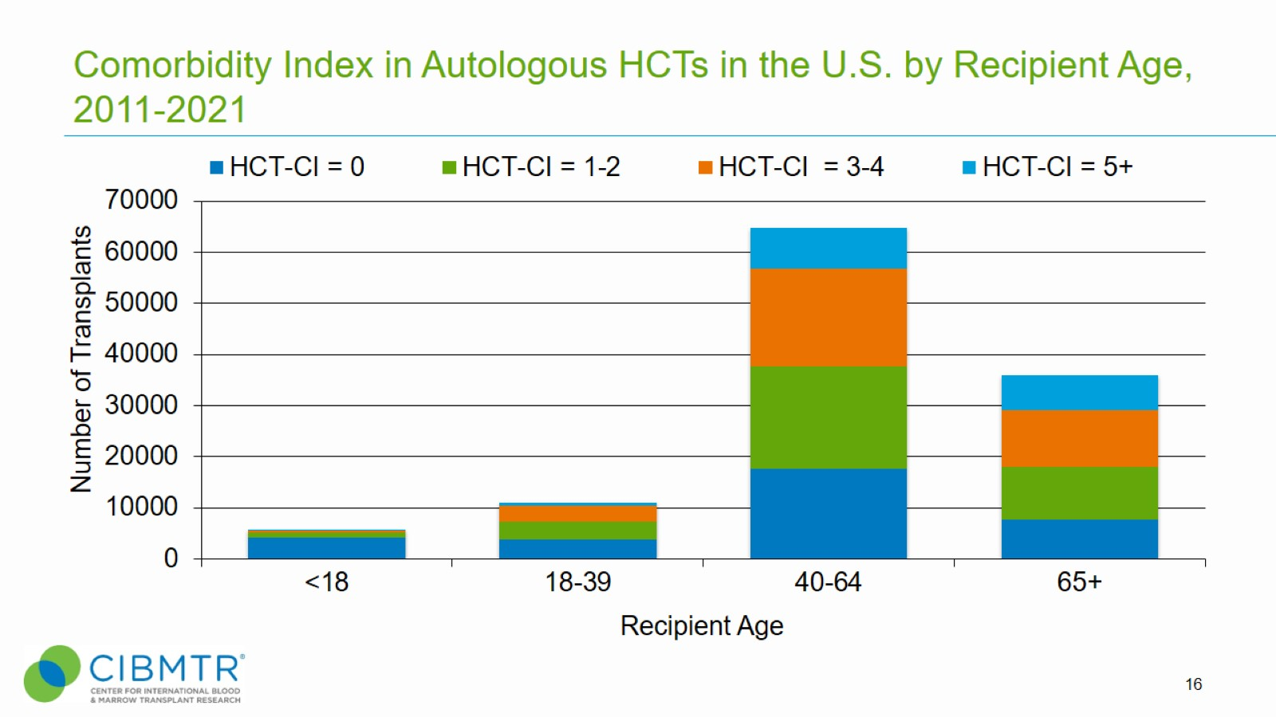
Comorbidity Index in Autologous HCTs in the U.S. by Recipient Age, 2011-2021
Notes:
Slide 16: This slide shows the number of autologous transplants performed by HCT comorbidity index group in the different age groups since 2011.
It is not surprising that generally younger transplant recipients have lower HCT-CI comorbidity index. In every age group, there appear to be more autologous than allogeneic transplants for HCT-CI index = 0 and more allogeneic transplants than autologous transplants for HCT-CI index of 5 and greater.

Slide 17
Comorbidity Index in Allogeneic HCTs in the U.S. by Race, Ethnicity, 2019-2021
Notes:
Slide 17: This slide shows the relative proportion of allogeneic transplants performed by HCT comorbidity index group in the racial/ethnic group since 2019. The percentage of each is represented on the bar graph.

Slide 18
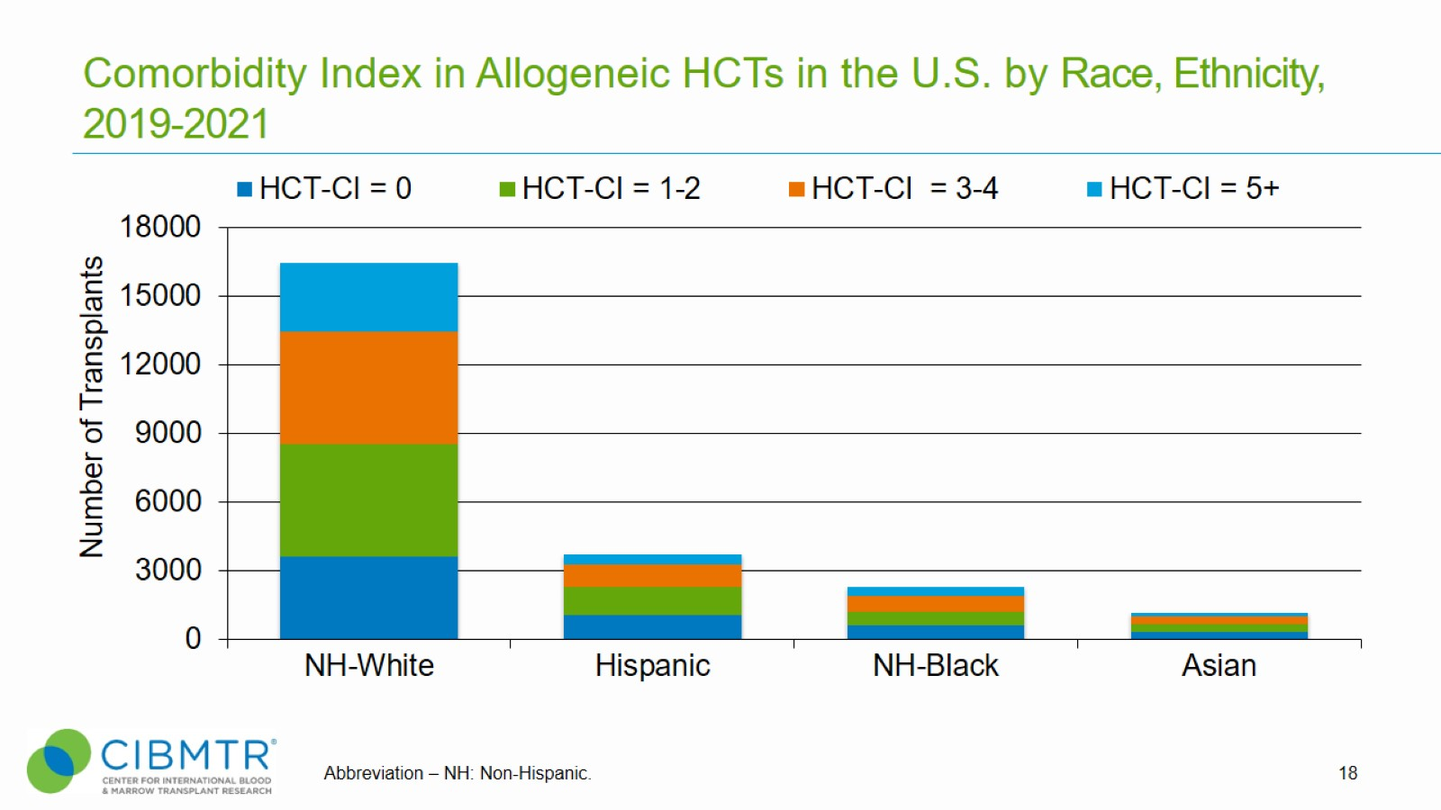
Comorbidity Index in Allogeneic HCTs in the U.S. by Race, Ethnicity, 2019-2021
Notes:
Slide 18: This slide shows the number of allogeneic transplants performed by HCT-CI index group in the different racial/ethnic groups since 2019.

Slide 19
Comorbidity Index in Autologous HCTs in the U.S. by Race, Ethnicity, 2019-2021
Notes:
Slide 19: This slide shows the relative proportion of autologous transplants performed by racial/ethnic group between 2019-2021. The percentage of each is represented on the bar graph.

Slide 20
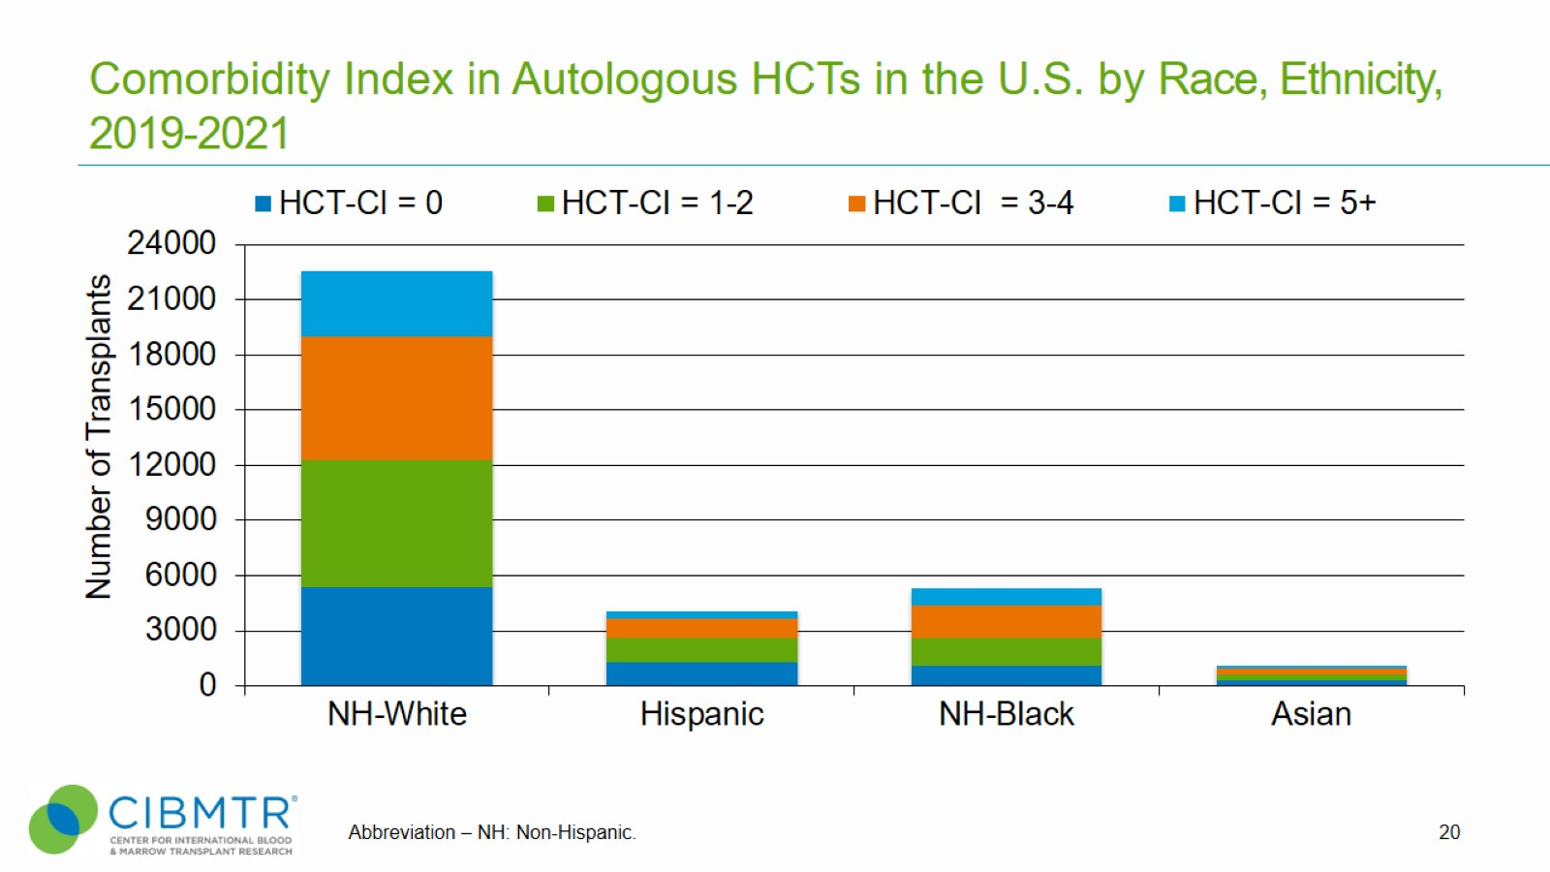
Comorbidity Index in Autologous HCTs in the U.S. by Race, Ethnicity, 2019-2021
Notes:
Slide 20: This slide shows the number of autologous transplants performed by HCT-CI index group in the different racial/ethnic groups since 2019.

Slide 21
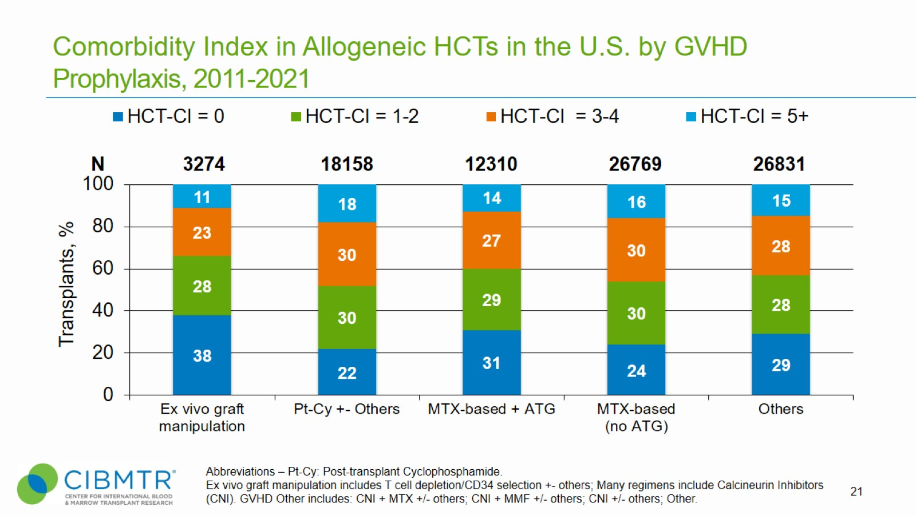
Comorbidity Index in Allogeneic HCTs in the U.S. by GVHD Prophylaxis, 2011-2021
Notes:
Slide 21: This slide shows the relative proportion of allogeneic transplants performed by HCT-CI index by acute GVHD prophylaxis type since 2011. The percentage of each is represented on the bar graph.

Slide 22
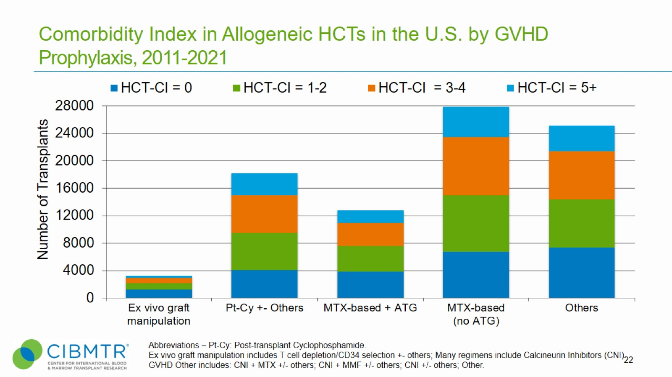
Comorbidity Index in Allogeneic HCTs in the U.S. by GVHD Prophylaxis, 2011-2021
Notes:
Slide 22: This slide shows the number of allogeneic transplants performed by HCT-CI index by acute GVHD prophylaxis type since 2011.

Slide 23
Number of Matched Related Donor HCTs in the U.S. in Recipients Aged <18 Years by Graft Source
Notes:
Slide 23: Bone marrow is more commonly used than peripheral blood in pediatric patients receiving a HCT from MRDs.

Slide 24
Number of Matched Unrelated Donor HCTs in the U.S. in Recipients Aged <18 Years by Graft Source
Notes:
Slide 24: Bone marrow is more commonly used than peripheral blood in pediatric patients receiving a HCT from MUDs.

Slide 25
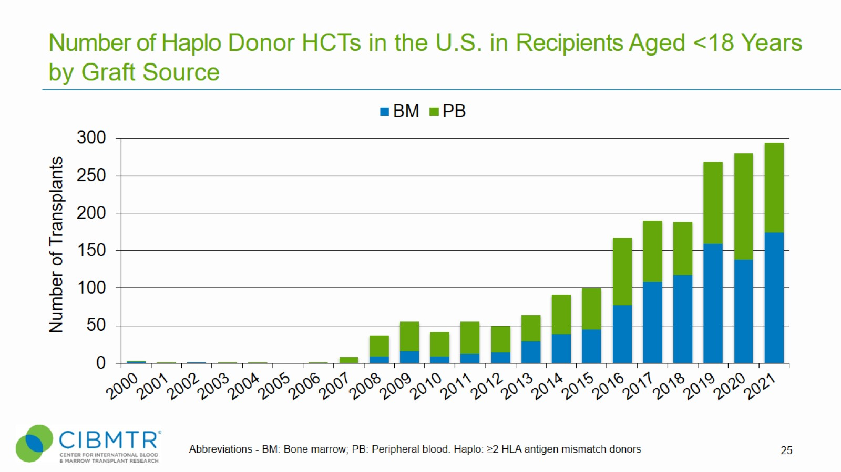
Number of Haplo Donor HCTs in the U.S. in Recipients Aged <18 Years by Graft Source
Notes:
Slide 25: Both peripheral blood and bone marrow are used in Haplo HCT in pediatric patients.

Slide 26
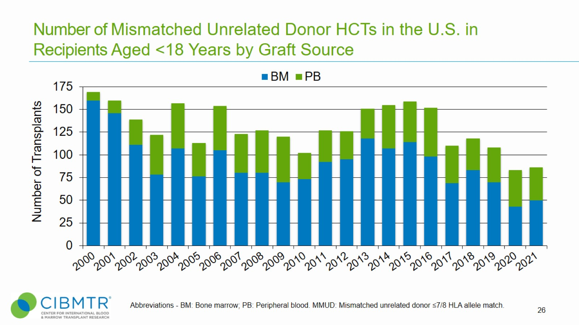
Number of Mismatched Unrelated Donor HCTs in the U.S. in Recipients Aged <18 Years by Graft Source
Notes:
Slide 26: Bone marrow is more commonly used than peripheral blood in pediatric patients receiving a HCT from MMUDs

Slide 27
Number of Matched Related Donor HCTs in the U.S. in Recipients Aged ≥18 Years by Graft Source
Notes:
Slide 27: Bone marrow is much less commonly used than peripheral blood in adult patients receiving a HCT from MRDs

Slide 28
Number of Matched Unrelated Donor HCTs in the U.S. in Recipients Aged ≥18 Years by Graft Source
Notes:
Slide 28: Bone marrow is much less commonly used than peripheral blood in adult patients receiving a HCT from MUDs. BM number declined further in the first year of the pandemic (2020).

Slide 29
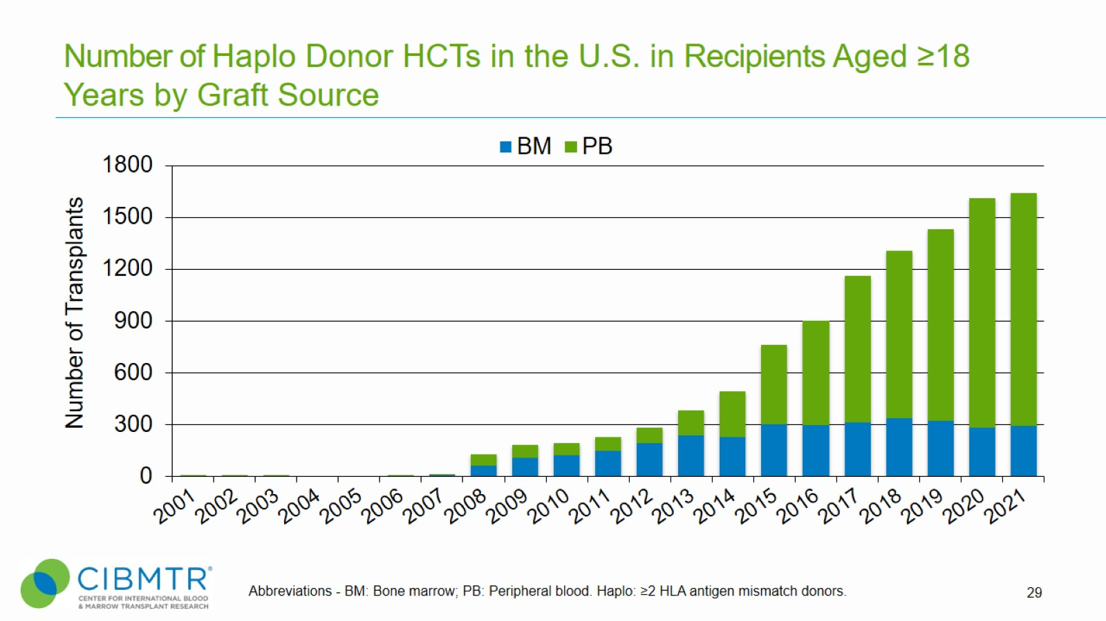
Number of Haplo Donor HCTs in the U.S. in Recipients Aged ≥18 Years by Graft Source
Notes:
Slide 29: Bone marrow is much less commonly used than peripheral blood in adult patients receiving a HCT from Haplo donors

Slide 30
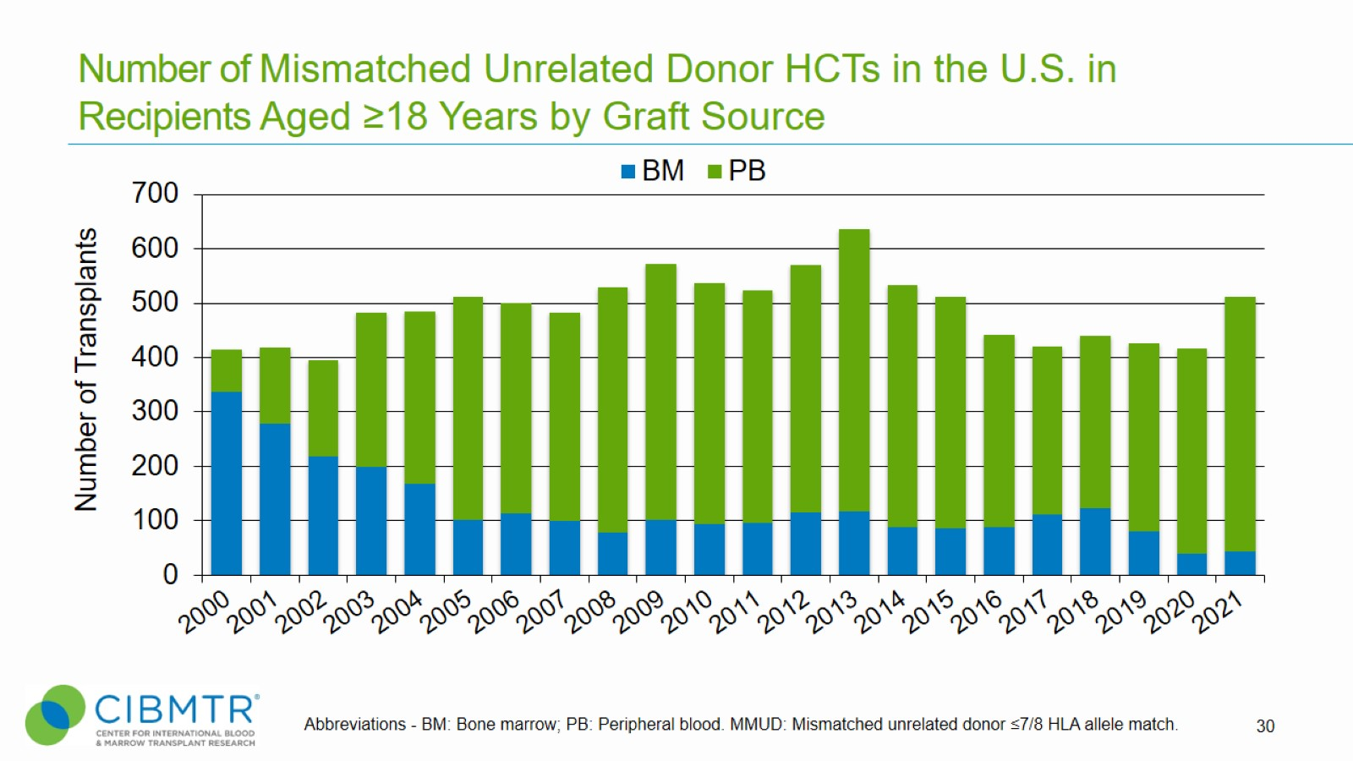
Number of Mismatched Unrelated Donor HCTs in the U.S. in Recipients Aged ≥18 Years by Graft Source
Notes:
Slide 30: Bone marrow is much less commonly used than peripheral blood in adult patients receiving a HCT from MMUDs. BM number declined further in the first year of the pandemic (2020).

Slide 31
Number of Allogeneic HCTs in the U.S. in Recipients Aged <18 Years by Graft Source
Notes:
Slide 31: This slide shows the number of allogeneic procedures by graft sources in pediatric patients since 2000.

Slide 32
Number of Allogeneic HCTs in the U.S. in Recipients Aged ≥18 Years by Graft Source
Notes:
Slide 32: This slide shows the number of allogeneic procedures by graft sources in adult patients since 2000.

Slide 33
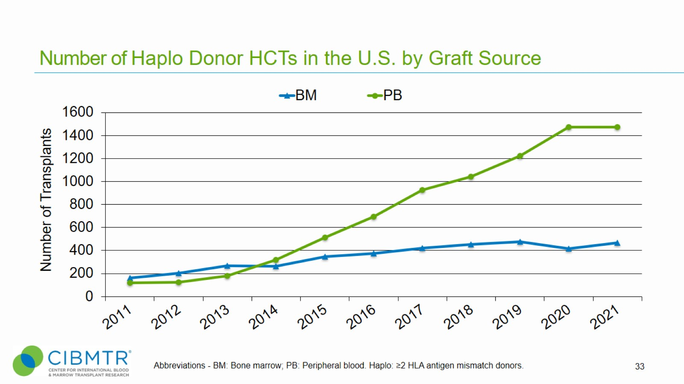
Number of Haplo Donor HCTs in the U.S. by Graft Source
Notes:
Slide 33: There is an overall trend for the increased use of peripheral blood over bone marrow.

Slide 34
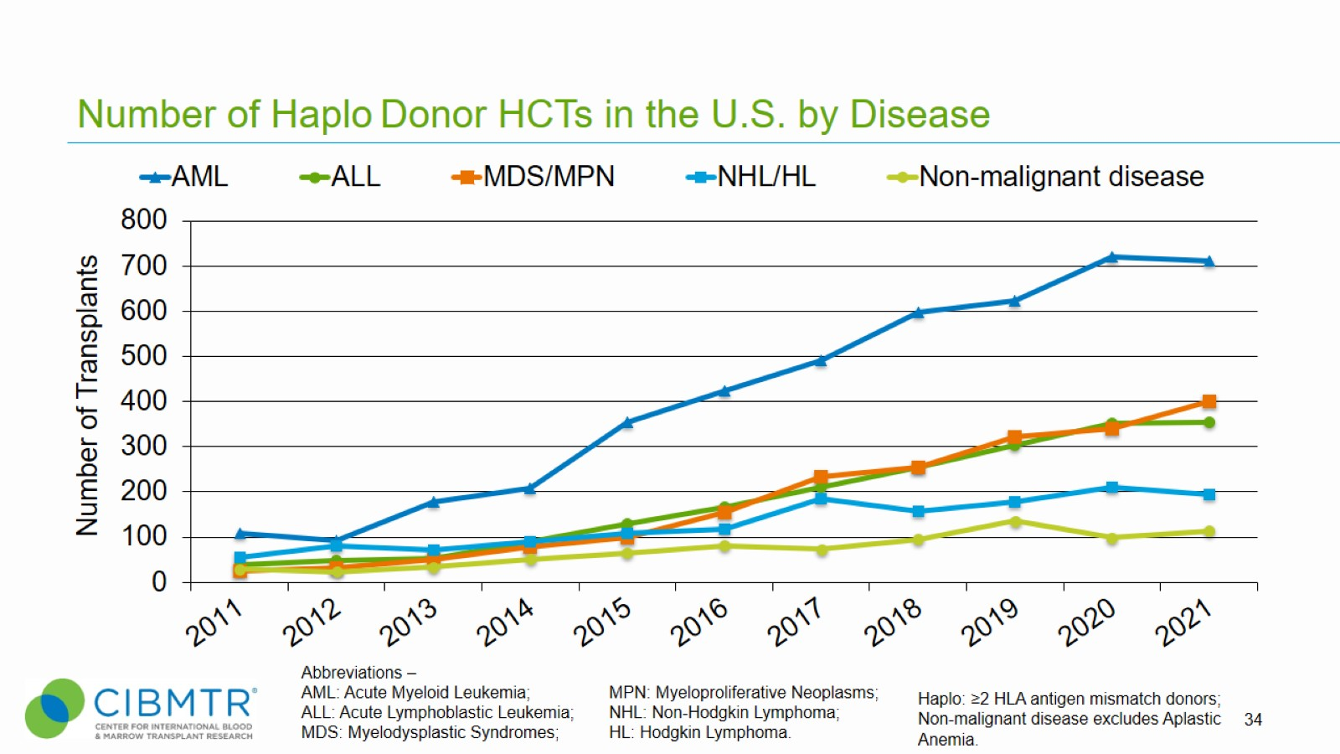
Number of Haplo Donor HCTs in the U.S. by Disease
Notes:
Slide 34: Diseases for which haplo transplant is used.
Non-malignant disease includes Inherited abnormalities erythrocyte differentiation or function, Severe combined immunodeficiency (SCID) and other immune system disorders, Inherited abnormalities of platelets, Inherited disorders of metabolism, Histiocytic disorders, and Autoimmune Diseases.

Slide 35
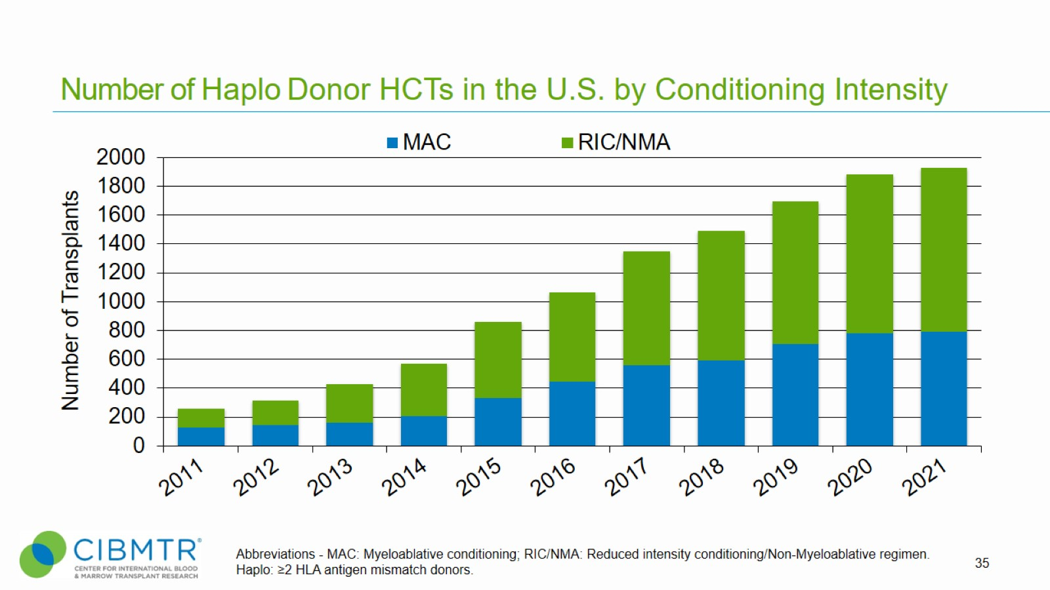
Number of Haplo Donor HCTs in the U.S. by Conditioning Intensity
Notes:
Slide 35: The number of haplo transplants according to conditioning regimen intensity since 2011.

Slide 36
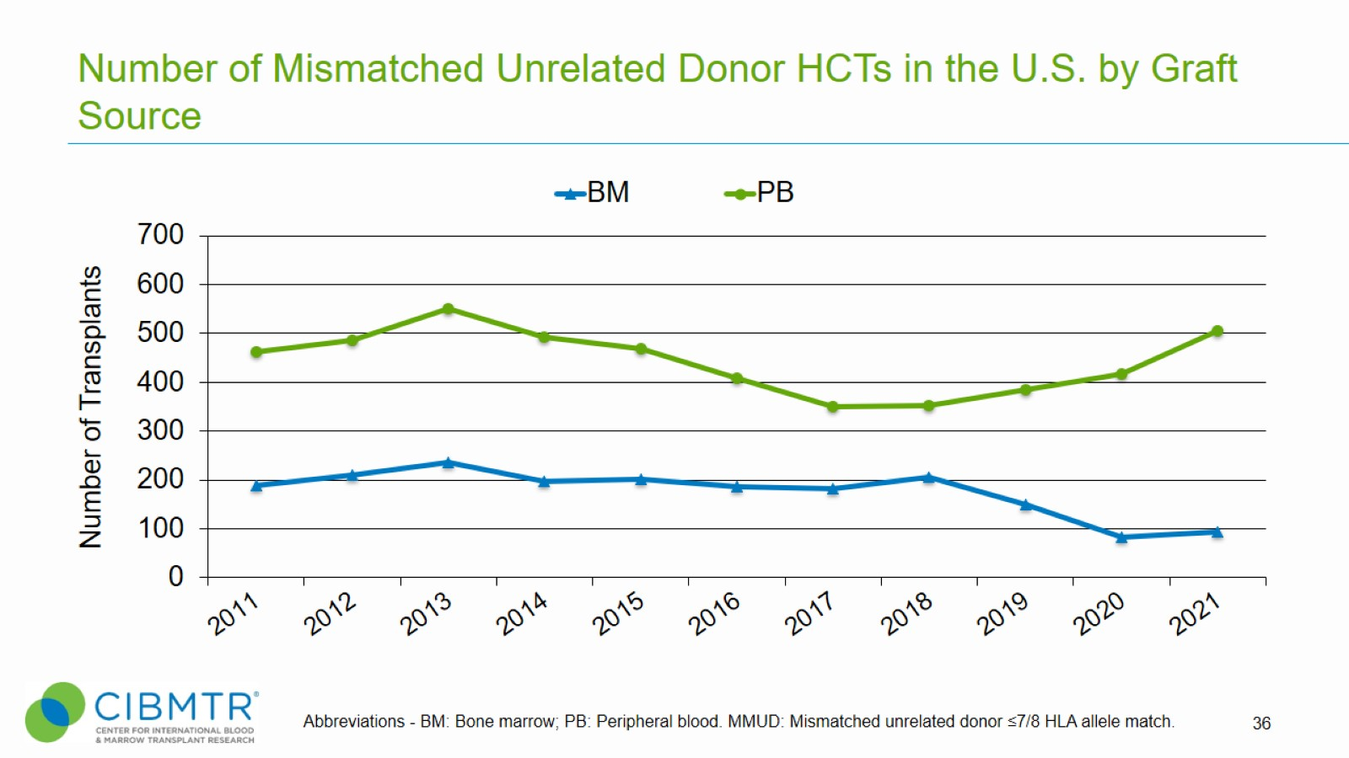
Number of Mismatched Unrelated Donor HCTs in the U.S. by Graft Source
Notes:
Slide 36: Peripheral blood is consistently the more common graft source for mismatched unrelated HCTs.

Slide 37
Number of Mismatched Unrelated Donor HCTs in the U.S. by Disease
Notes:
Slide 37: Use of MMUD for various diseases has remained fairly steady in recent years.
Non-malignant disease includes Inherited abnormalities erythrocyte differentiation or function, Severe combined immunodeficiency (SCID) and other immune system disorders, Inherited abnormalities of platelets, Inherited disorders of metabolism, Histiocytic disorders, and Autoimmune Diseases.

Slide 38
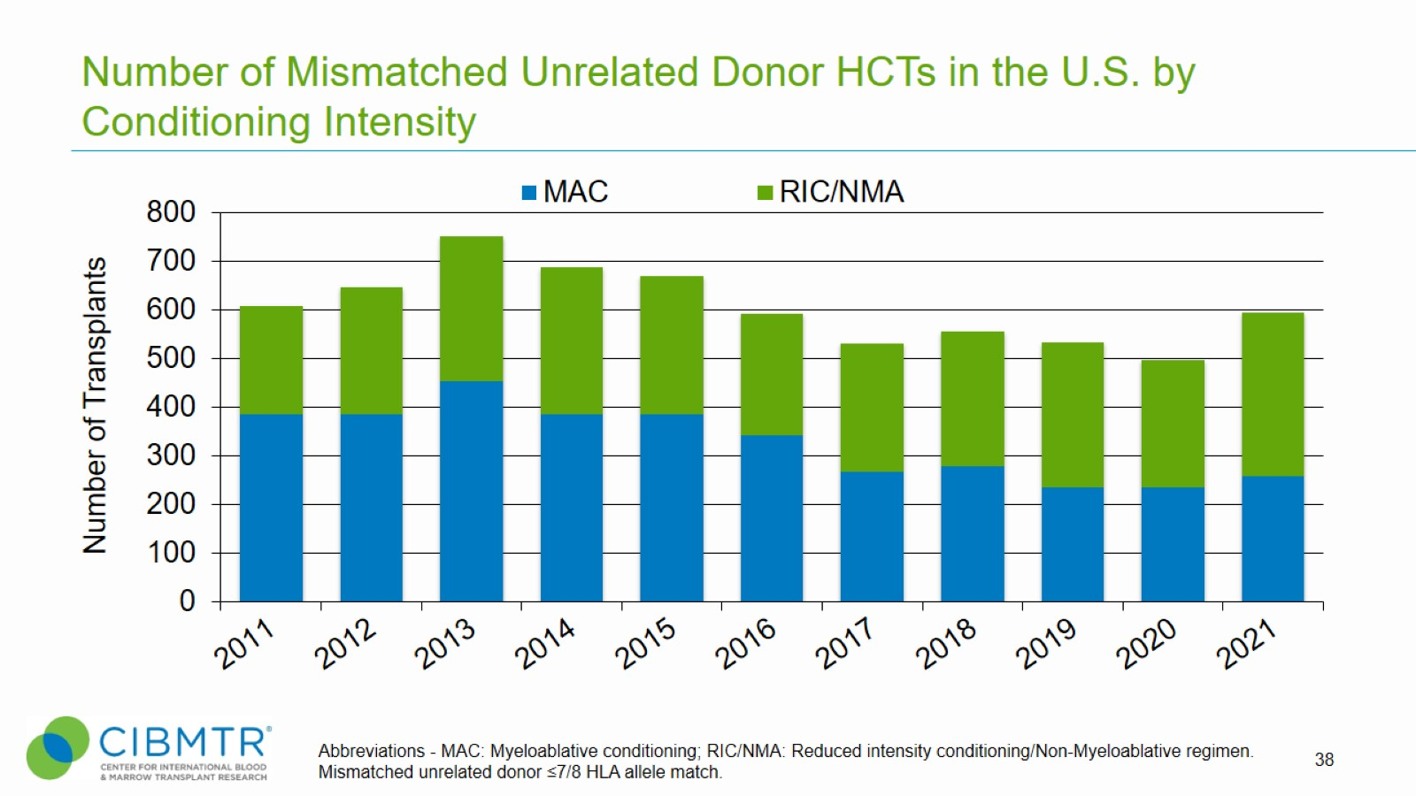
Number of Mismatched Unrelated Donor HCTs in the U.S. by Conditioning Intensity
Notes:
Slide 38: RIC/NMA vs MAC conditioning is fairly even in MMUD

Slide 39
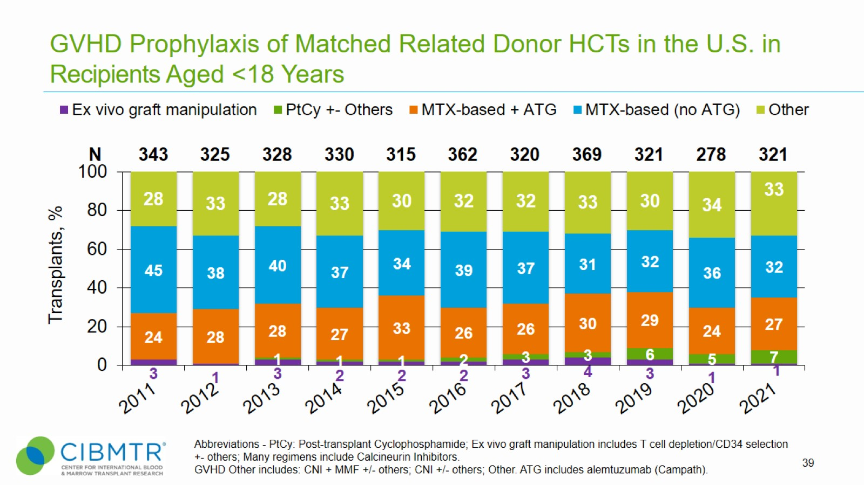
GVHD Prophylaxis of Matched Related Donor HCTs in the U.S. in Recipients Aged <18 Years
Notes:
Slide 39: Year over year, use of MTX-based (no ATG) is the largest GVHD prophylaxis group in Matched Related Donor HCTs and Matched Unrelated Donor HCTs for adult recipients whereas MTX-based + ATG is the predominant GVHD prophylaxis regimen for Matched Unrelated Donor HCTs for recipients <18. Use of ATG with the Methotrexate-based GVHD- prophylaxis regimen is more prominent in pediatric recipients than adult recipients.

Slide 40
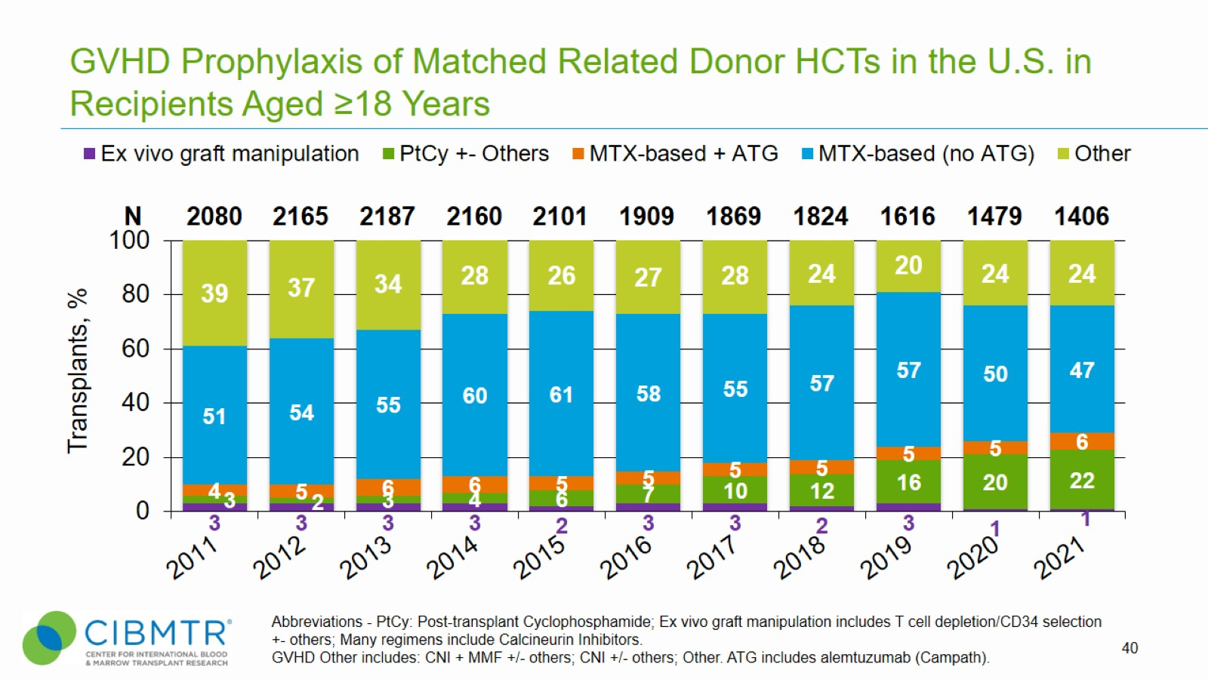
GVHD Prophylaxis of Matched Related Donor HCTs in the U.S. in Recipients Aged ≥18 Years
Notes:
Slide 40: Year over year, use of MTX-based (no ATG) is the largest GVHD prophylaxis group in Matched Related Donor HCTs and Matched Unrelated Donor HCTs for adult recipients whereas MTX-based + ATG is the predominant GVHD prophylaxis regimen for Matched Unrelated Donor HCTs for recipients <18. Use of ATG with the Methotrexate-based GVHD- prophylaxis regimen is more prominent in pediatric recipients than adult recipients.
GVHD prophylaxis in the adult MRD setting is predominantly methotrexate-based, although the use of PtCy is steadily increasing.

Slide 41
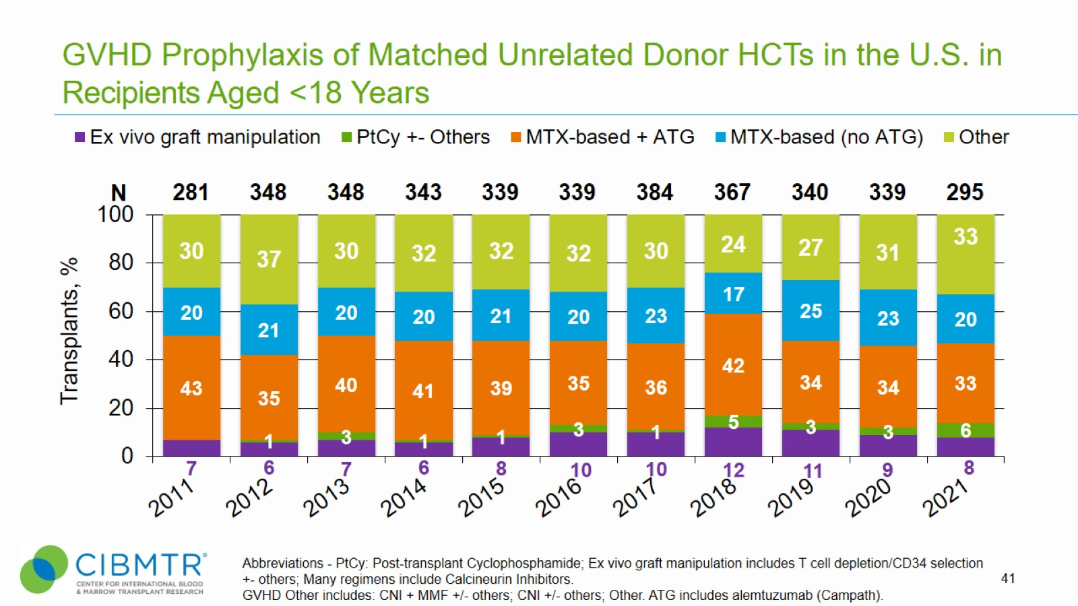
GVHD Prophylaxis of Matched Unrelated Donor HCTs in the U.S. in Recipients Aged <18 Years
Notes:
Slide 41: Year over year, use of MTX-based (no ATG) is the largest GVHD prophylaxis group in Matched Related Donor HCTs and Matched Unrelated Donor HCTs for adult recipients whereas MTX-based + ATG is the predominant GVHD prophylaxis regimen for Matched Unrelated Donor HCTs for recipients <18. Use of ATG with the Methotrexate-based GVHD- prophylaxis regimen is more prominent in pediatric recipients than adult recipients.

Slide 42
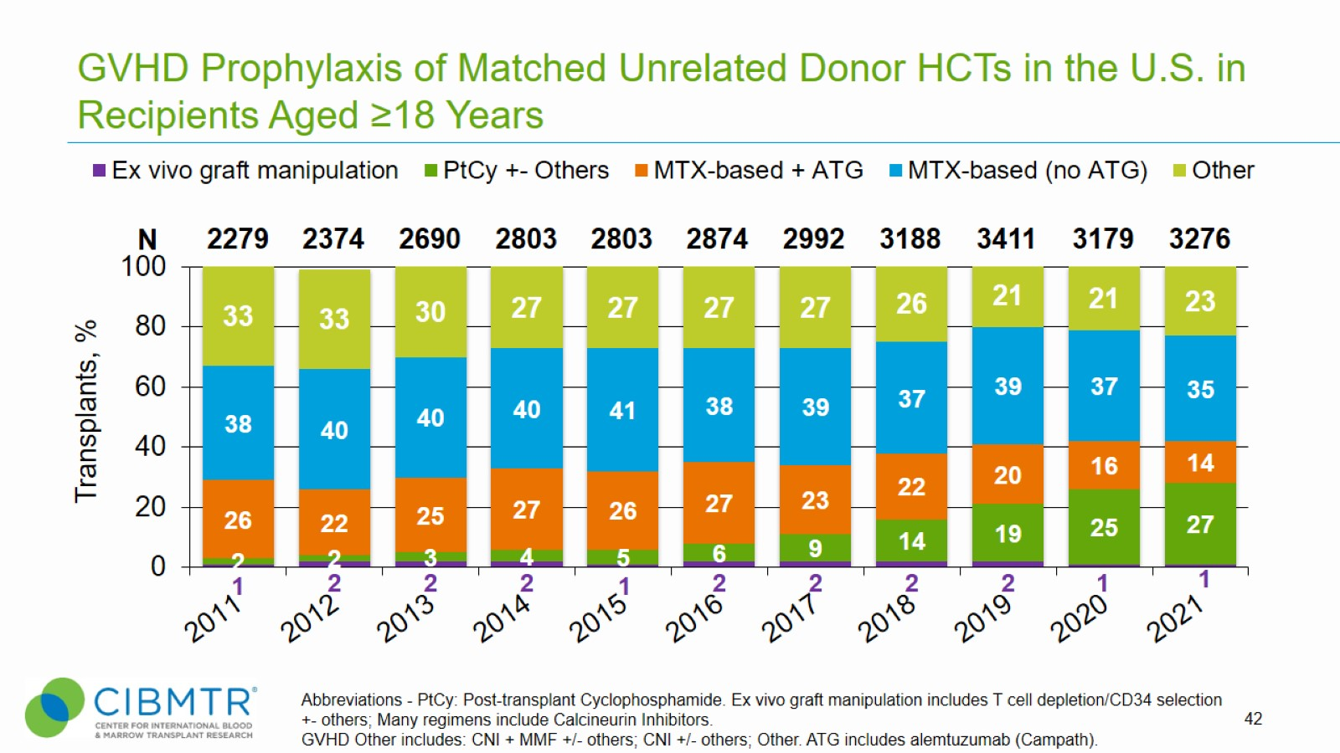
GVHD Prophylaxis of Matched Unrelated Donor HCTs in the U.S. in Recipients Aged ≥18 Years
Notes:
Slide 42: Year over year, use of MTX-based (no ATG) is the largest GVHD prophylaxis group in Matched Related Donor HCTs and Matched Unrelated Donor HCTs for adult recipients whereas MTX-based + ATG is the predominant GVHD prophylaxis regimen for Matched Unrelated Donor HCTs for recipients <18. Use of ATG with the Methotrexate-based GVHD- prophylaxis regimen is more prominent in pediatric recipients than adult recipients.

Slide 43
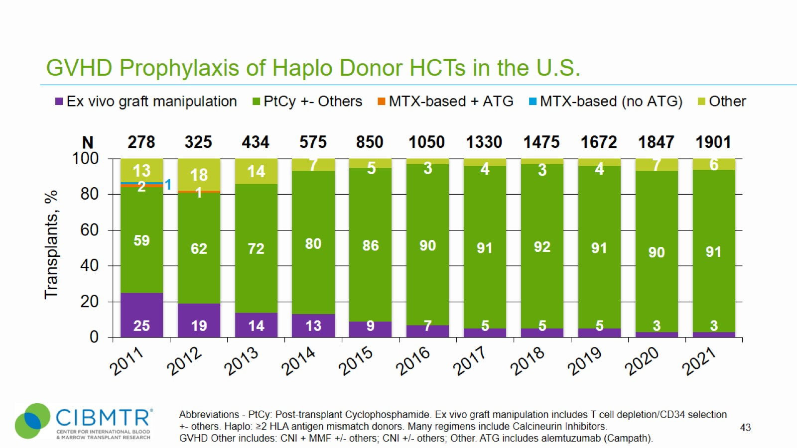
GVHD Prophylaxis of Haplo Donor HCTs in the U.S.
Notes:
Slide 43: Use of Methotrexate-based GVHD prophylaxis regimens for haplo donor HCTs declined and disappeared by 2013.

Slide 44
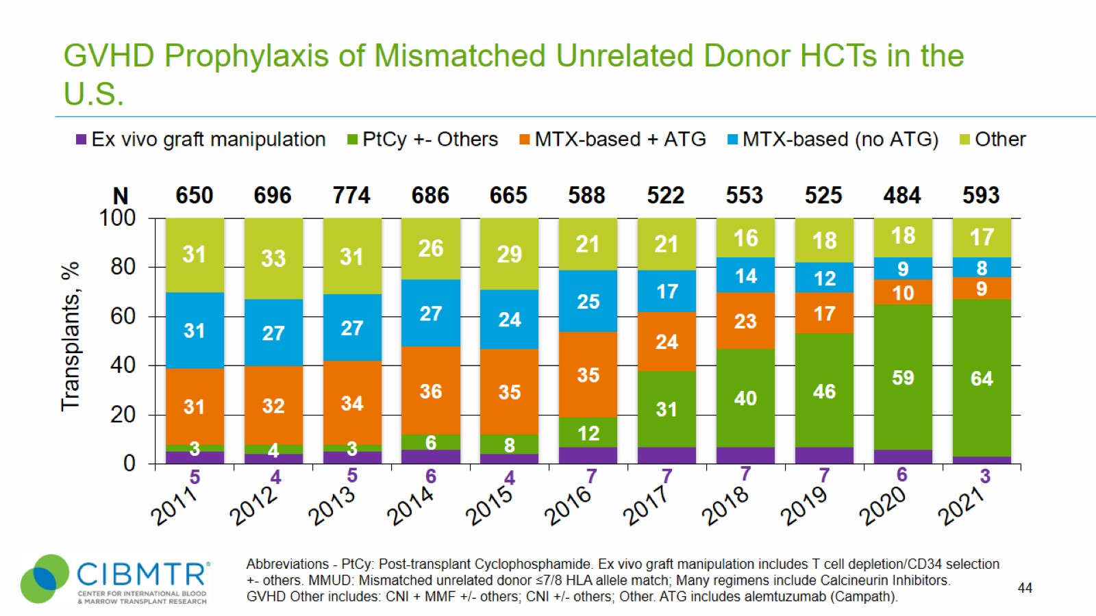
GVHD Prophylaxis of Mismatched Unrelated Donor HCTs in the U.S.
Notes:
Slide 44: GVHD prophylaxis in the MMUD setting has changed in recent years with a steady increase in the use of PtCy, and more than half of cases utilize PtCy since 2020.

Slide 45
Recipient Age of Allogeneic HCTs for Malignant Diseases in the U.S.
Notes:
Slide 45: The percentage of allogeneic transplants for treatment of malignant diseases in patients ≥65 years continues to increase.

Slide 46
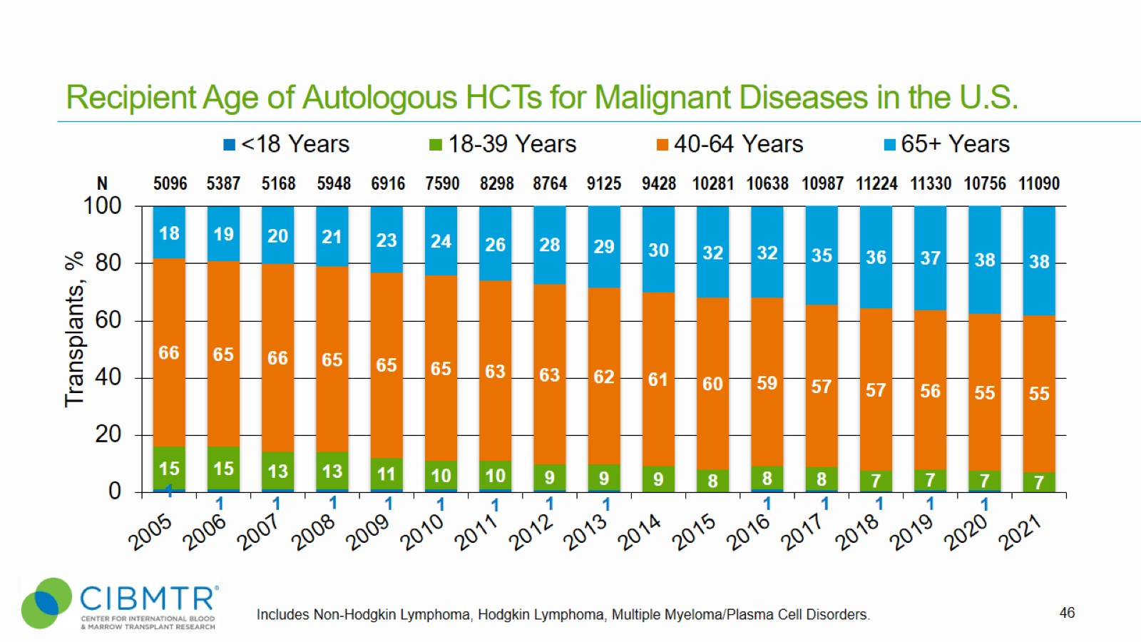
Recipient Age of Autologous HCTs for Malignant Diseases in the U.S.
Notes:
Slide 46: The percentage of autologous transplants for treatment of malignant diseases in patients ≥65 years continues to increase.

Slide 47
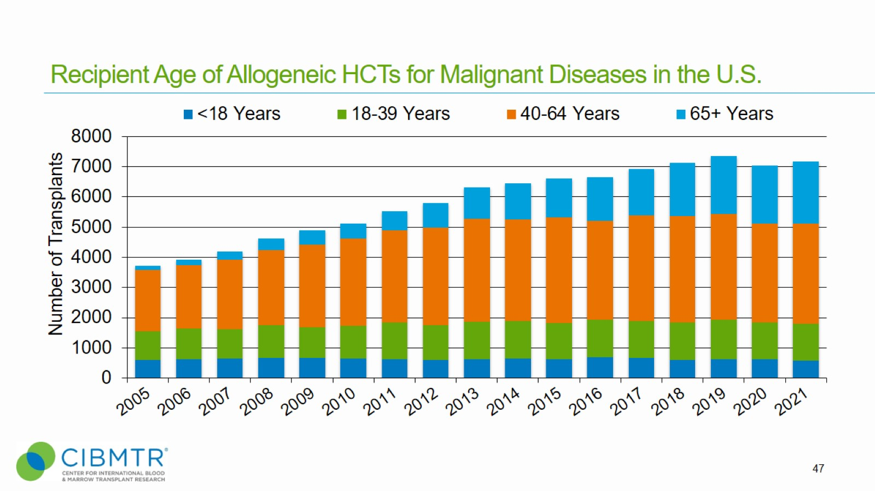
Recipient Age of Allogeneic HCTs for Malignant Diseases in the U.S.
Notes:
Slide 47: This slide shows the number of allogeneic procedures for malignant diseases by recipient age since 2005.

Slide 48
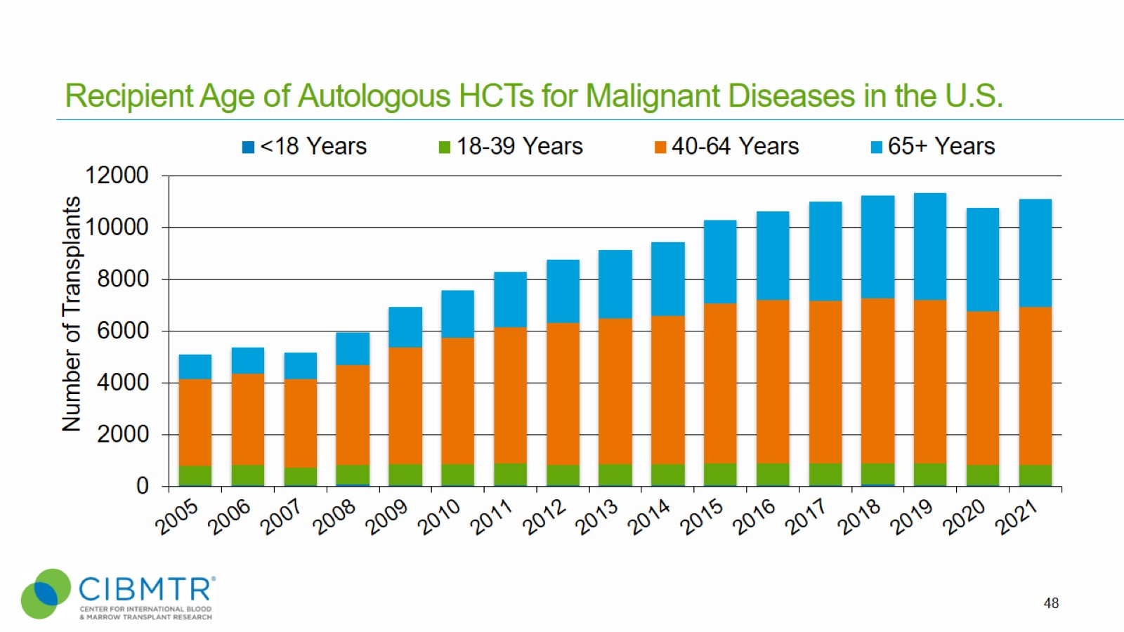
Recipient Age of Autologous HCTs for Malignant Diseases in the U.S.
Notes:
Slide 48: This slide shows the number of autologous procedures for malignant diseases by recipient age since 2005.

Slide 49
Number of HCTs by Indications in the U.S., Pediatric, 2021
Notes:
Slide 49: Allogeneic and autologous indications for HCT in the U.S. in 2021 for pediatric patients. See slide 55 for the breakdown of other malignant diseases and slide 56 for non-malignant diseases.

Slide 50
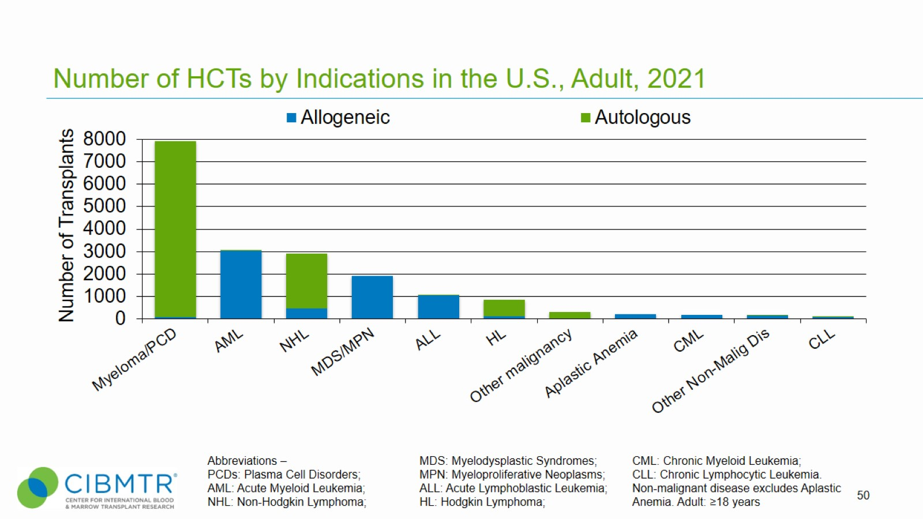
Number of HCTs by Indications in the U.S., Adult, 2021
Notes:
Slide 50: The most common indications for HCT for adults in the U.S. in 2021.

Slide 51
Number of Autologous HCTs by Indications in the U.S., Other Malignant Disease, Pediatric, 2021
Notes:
Slide 51: The other malignant indications for autologous HCT for children in the U.S. in 2021.

Slide 52
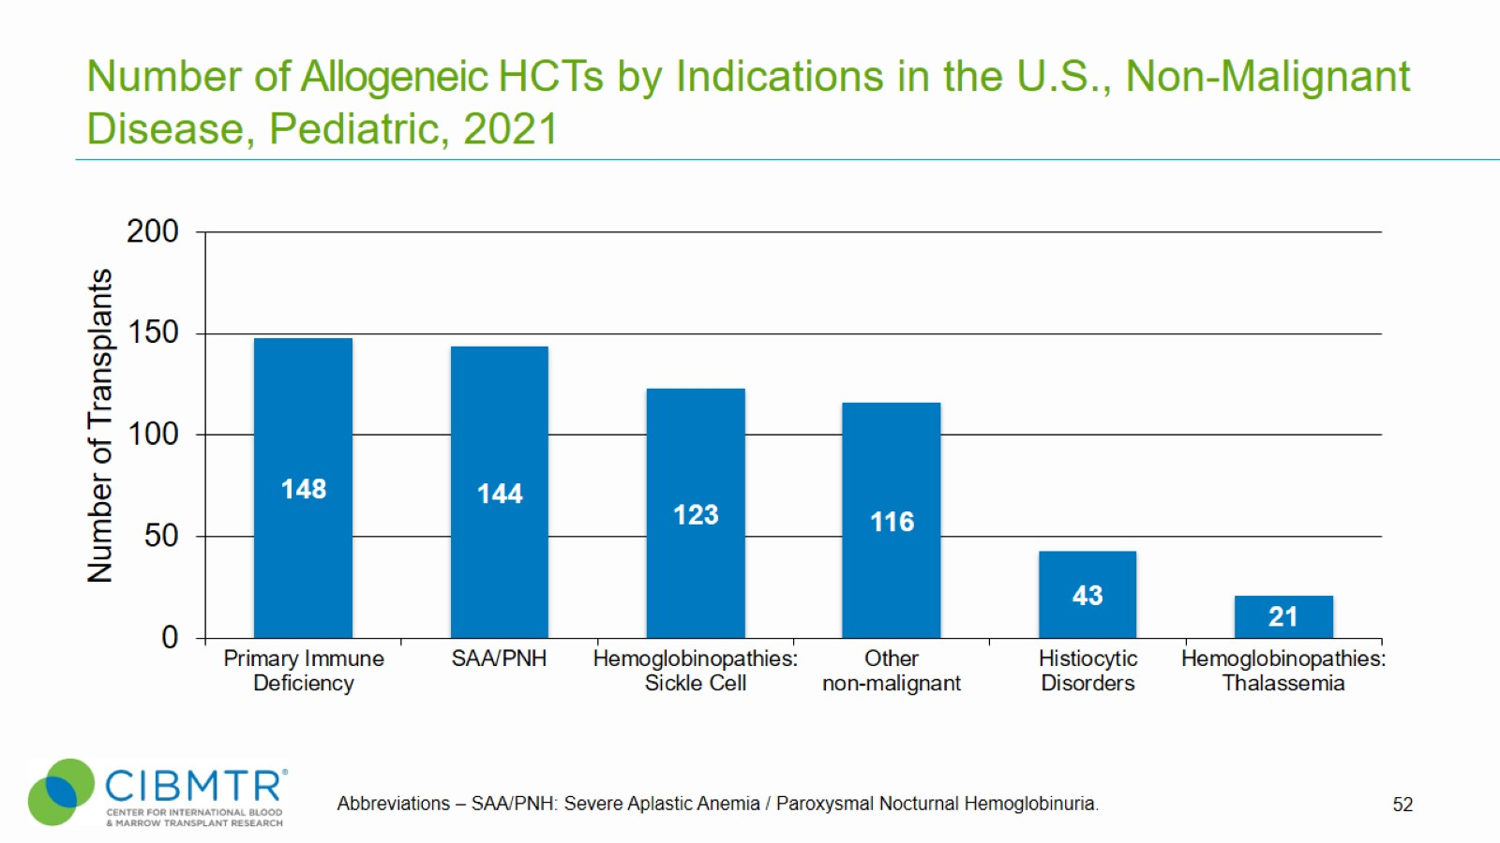
Number of Allogeneic HCTs by Indications in the U.S., Non-Malignant Disease, Pediatric, 2021
Notes:
Slide 52: The other non-malignant indications for allogeneic HCT for children in the U.S. in 2021.

Slide 53
Number of Allogeneic HCTs in the U.S. by Selected Disease
Notes:
Slide 53: AML is the most common indication for allogeneic HCT, accounting for about 50% of procedures.

Slide 54
Number of Allogeneic HCTs for Acute Myeloid Leukemia (AML) by Recipient Age in the U.S.
Notes:
Slide 54: This slide shows trends in AML transplant activity over time according to age group. This shows increased use in older adults (65+), with stable activity in other age groups.

Slide 55
Number of Allogeneic HCTs for Acute Myeloid Leukemia (AML) by Disease Status in the U.S.
Notes:
Slide 55: The use of transplants in AML is particularly increasing in those in CR1, compared to stable utilization among those with CR2+ (2nd or subsequent complete remission), or relapsed disease/ never in CR (includes Primary induction failure).

Slide 56
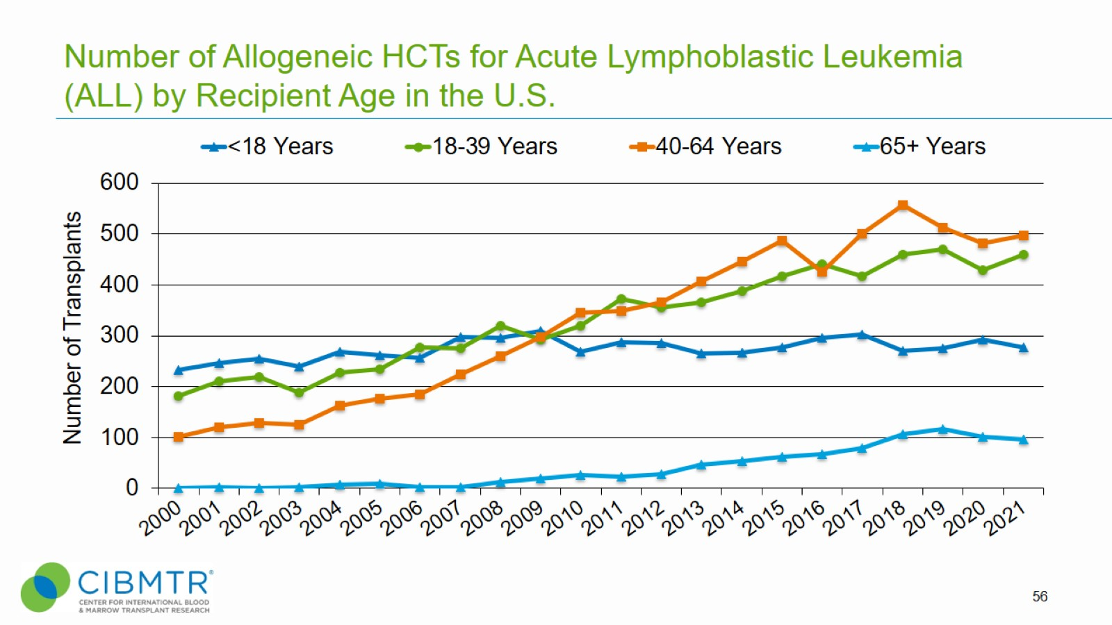
Number of Allogeneic HCTs for Acute Lymphoblastic Leukemia (ALL) by Recipient Age in the U.S.
Notes:
Slide 56: This slide shows trends in ALL transplant activity over time according to age groups.

Slide 57
Number of Allogeneic HCTs for Acute Lymphoblastic Leukemia (ALL) by Disease Status in the U.S.
Notes:
Slide 57: Transplant activity for ALL is fairly stable in recent years.

Slide 58
Number of Autologous HCTs in the U.S. by Selected Disease
Notes:
Slide 58: The number of autologous transplants for MM and Lymphoma.

Slide 59
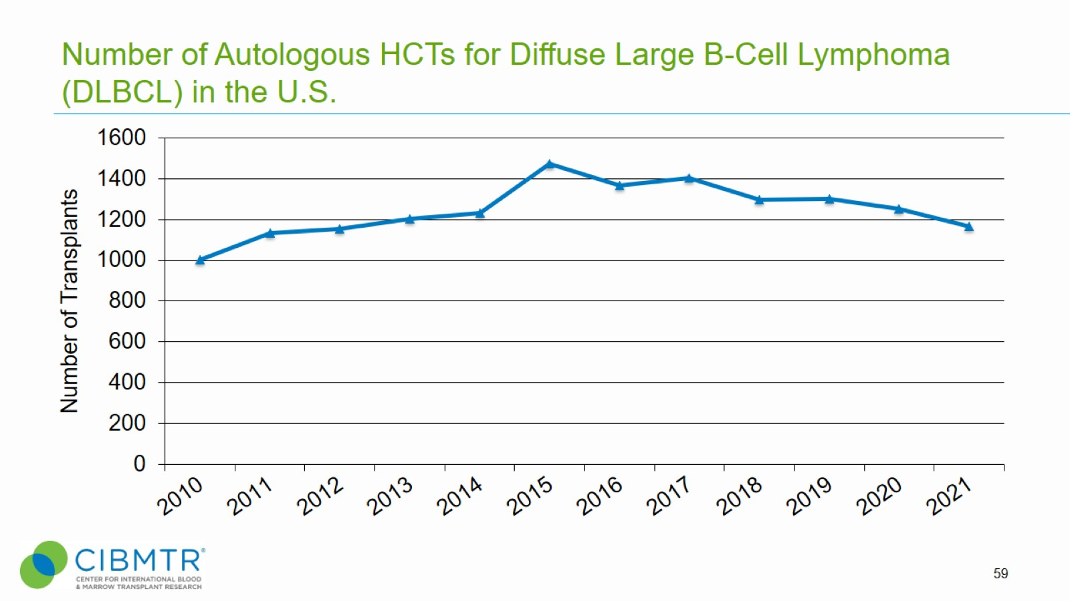
Number of Autologous HCTs for Diffuse Large B-Cell Lymphoma (DLBCL) in the U.S.
Notes:
Slide 59: This slide shows a decrease in autologous HCT for Diffuse Large B-Cell Lymphoma.

Slide 60
Causes of Death after Autologous HCTs in the U.S., 2018-2020
Notes:
Slide 60: Causes of death for recipients undergoing autologous HCT by organ failure or infection decreases significantly after the initial 100 days post transplant.

Slide 61
Causes of Death after Matched Related Donor HCTs in the U.S., 2018-2020
Notes:
Slide 61: Causes of death for recipients undergoing allogeneic HCT are shown according to age and whether death occurred in the first 100 days.

Slide 62
Causes of Death after Matched Unrelated Donor HCTs in the U.S., 2018-2020
Notes:
Slide 62: Causes of death for recipients undergoing MUD HCT are shown according to age and whether death occurred in the first 100 days.

Slide 63
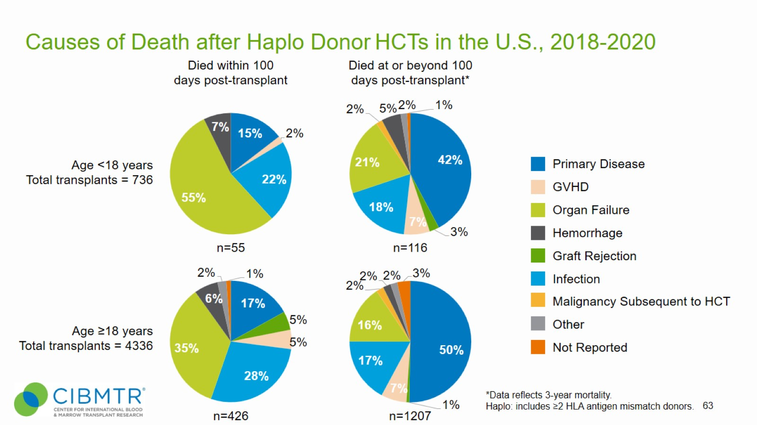
Causes of Death after Haplo Donor HCTs in the U.S., 2018-2020
Notes:
Slide 63: Causes of death for recipients undergoing haplo HCT are shown according to age and whether death occurred in the first 100 days.

Slide 64
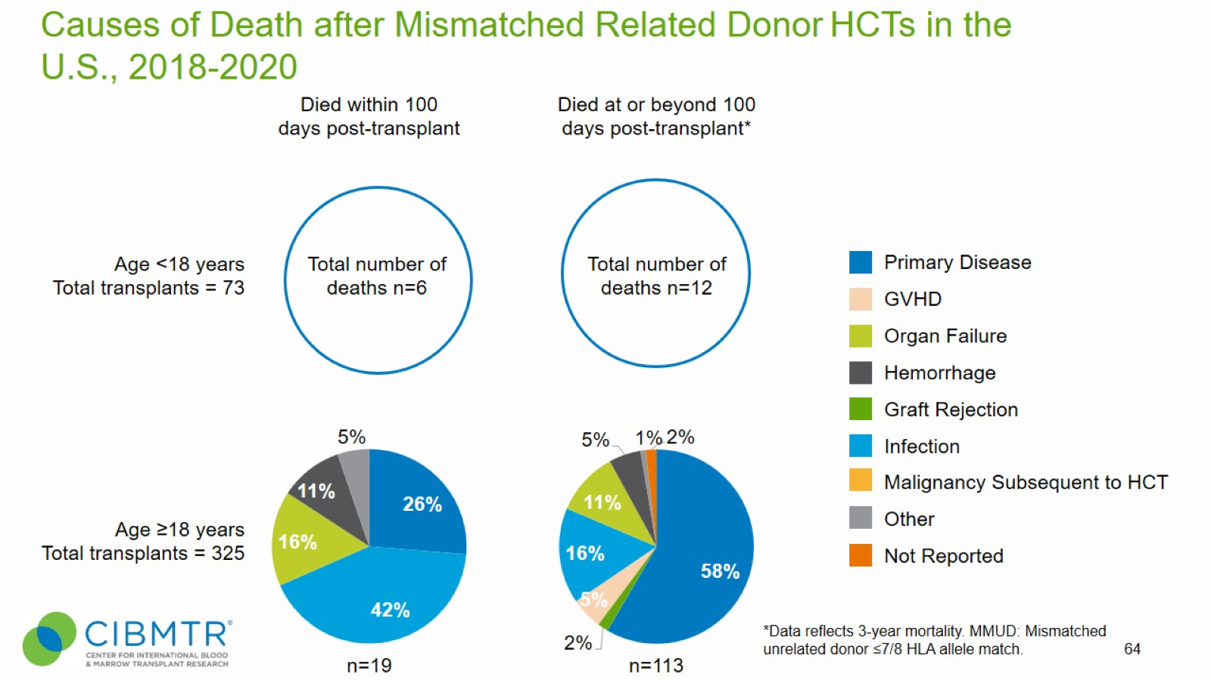
Causes of Death after Mismatched Related Donor HCTs in the U.S., 2018-2020
Notes:
Slide 64: Causes of death for recipients undergoing mismatched (non-haplo) related HCT are shown according to age and whether death occurred in the first 100 days.

Slide 65
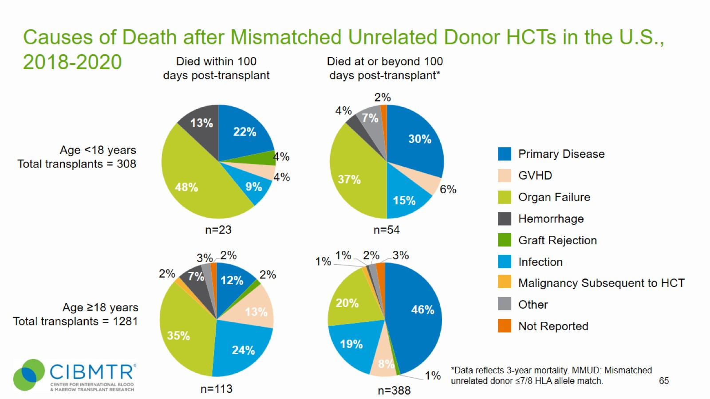
Causes of Death after Mismatched Unrelated Donor HCTs in the U.S., 2018-2020
Notes:
Slide 65: Causes of death for recipients undergoing mismatched unrelated donor HCT are shown according to age and whether death occurred in the first 100 days.

Slide 66
Common Conditioning Regimens in Acute Myeloid Leukemia (AML) and Myelodysplastic Syndromes/Myeloproliferative Neoplasms (MDS/MPN) Allogeneic HCTs in the U.S., 2019-2021
Notes:
Slide 66: This slide shows a breakdown of commonly used conditioning regimens for myeloablative (MAC) and reduced intensity/non-myeloablative (RIC/NMA) conditioning in patients with AML or MDS/MPN.
Myeloablative conditioning regimen: regimens with total body irradiation doses of ≥500 cGY, single fractionated doses of ≥800 cGY, busulfan doses of >9mg/kg oral or Bu >= 7.2 mg/kg IV, or melphalan doses of >150 mg/m² given as single agents or in combination with other drugs.
Reduced-intensity conditioning/non-myeloablative regimen: regimens with lower doses of total body irradiation, fractionated radiation therapy, Busulfan, and Melphalan than those used to define a myeloablative conditioning regimen (above).
References for conditioning intensity:
1. Bacigalupo A, Ballen K, Rizzo D, Giralt S, Lazarus H, Ho V, et al. Defining the intensity of conditioning regimens: working definitions. Biology of blood and marrow transplantation : journal of the American Society for Blood and Marrow Transplantation. 2009;15(12):1628–1633. doi: 10.1016/j.bbmt.2009.07.004.
2. Giralt S, Ballen K, Rizzo D, Bacigalupo A, Horowitz M, Pasquini M, et al. Reduced-intensity conditioning regimen workshop: defining the dose spectrum. Report of a workshop convened by the center for international blood and marrow transplant research. Biology of blood and marrow transplantation : journal of the American Society for Blood and Marrow Transplantation. 2009;15(3):367–369. doi: 10.1016/j.bbmt.2008.12.497.

Slide 67
Common Conditioning Regimens in Acute Lymphoblastic Leukemia (ALL) Allogeneic HCTs in the U.S., 2019-2021
Notes:
Slide 67: This slide shows a breakdown of commonly used conditioning regimens for myeloablative (MAC) and reduced intensity/Non-myeloablative (RIC/NMA) conditioning in patients with ALL.
Myeloablative conditioning regimen: regimens with total body irradiation doses of ≥500 cGY, single fractionated doses of ≥800 cGY, busulfan doses of >9mg/kg oral or Bu >= 7.2 mg/kg IV, or melphalan doses of >150 mg/m² given as single agents or in combination with other drugs.
Reduced-intensity conditioning/Non-myeloablative regimen: regimens with lower doses of total body irradiation, fractionated radiation therapy, Busulfan, and Melphalan than those used to define a myeloablative conditioning regimen (above).
References for conditioning intensity:
1. Bacigalupo A, Ballen K, Rizzo D, Giralt S, Lazarus H, Ho V, et al. Defining the intensity of conditioning regimens: working definitions. Biology of blood and marrow transplantation : journal of the American Society for Blood and Marrow Transplantation. 2009;15(12):1628–1633. doi: 10.1016/j.bbmt.2009.07.004.
2. Giralt S, Ballen K, Rizzo D, Bacigalupo A, Horowitz M, Pasquini M, et al. Reduced-intensity conditioning regimen workshop: defining the dose spectrum. Report of a workshop convened by the center for international blood and marrow transplant research. Biology of blood and marrow transplantation : journal of the American Society for Blood and Marrow Transplantation. 2009;15(3):367–369. doi: 10.1016/j.bbmt.2008.12.497.

Slide 68
Indications of Allogeneic HCTs in the U.S. by Race and Ethnicity, 2021
Notes:
Slide 68: Percentage of racial/ethnic allogeneic recipients according to disease.
Non-malignant disease includes inherited abnormalities erythrocyte differentiation or function, Severe Combined Immunodeficiency (SCID) and other immune system disorders, inherited abnormalities of platelets, inherited disorders of metabolism, histiocytic disorders, and autoimmune diseases.

Slide 69
Indications of Autologous HCTs in the U.S. by Race and Ethnicity, 2021
Notes:
Slide 69: Percentage of racial/ethnic autologous recipients according to disease.

Slide 70
Allogeneic HCTs in the U.S. by Race and Ethnicity and Donor Type, 2019-2021
Notes:
Slide 70: Percentage of racial/ethnic allogeneic recipients according to graft type.

Slide 71
Autologous HCTs in the U.S. by Race and Ethnicity
Notes:
Slide 71: Percentage of racial/ethnic autologous recipients according to year of transplant.

Slide 72
Allogeneic HCTs in the U.S. by Race and Ethnicity
Notes:
Slide 72: Percentage of racial/ethnic allogeneic recipients according to year.

Slide 73
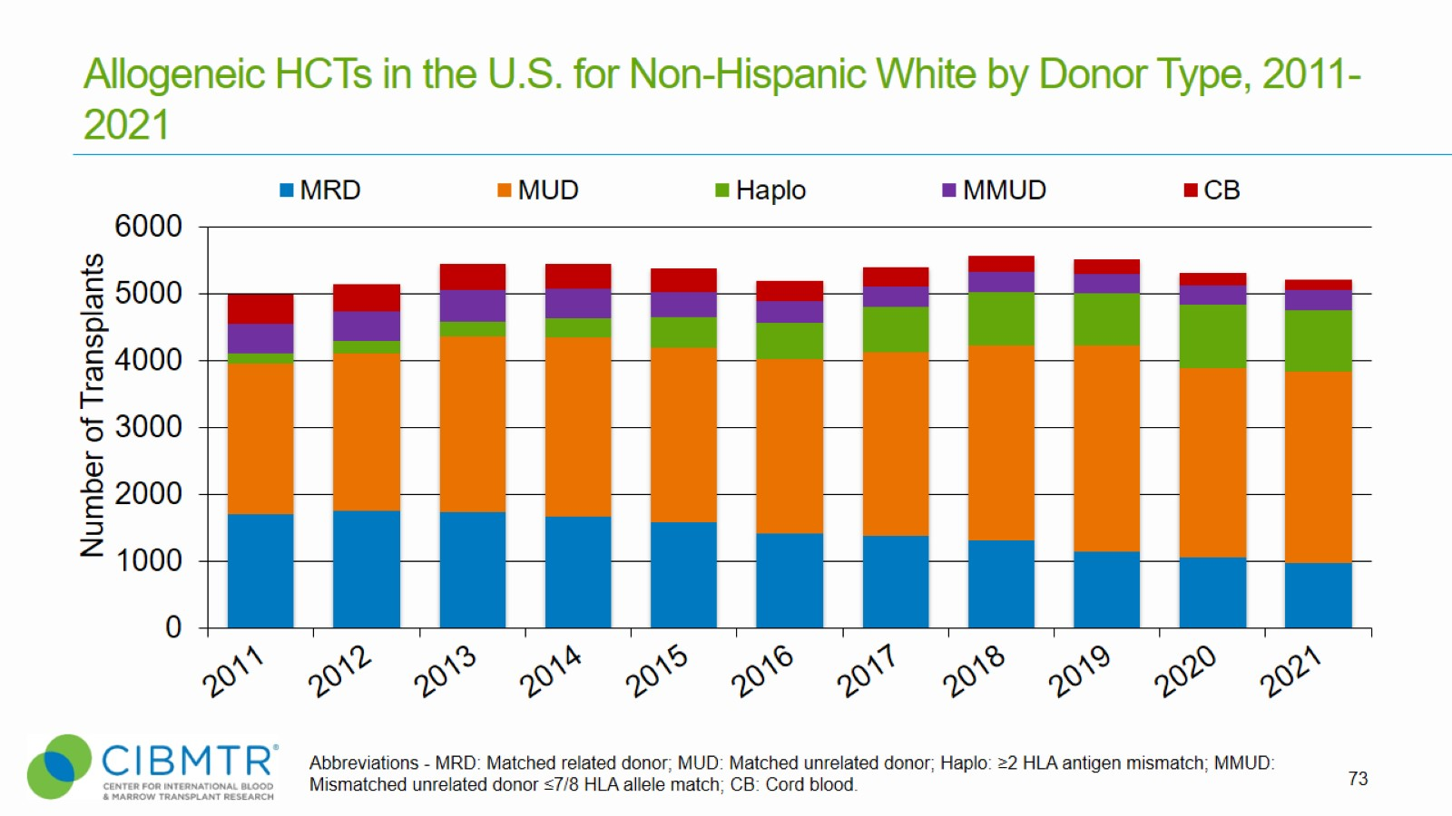
Allogeneic HCTs in the U.S. for Non-Hispanic White by Donor Type, 2011-2021
Notes:
Slide 73: Number of different graft sources for allogeneic non-Hispanic White recipients according to year.

Slide 74
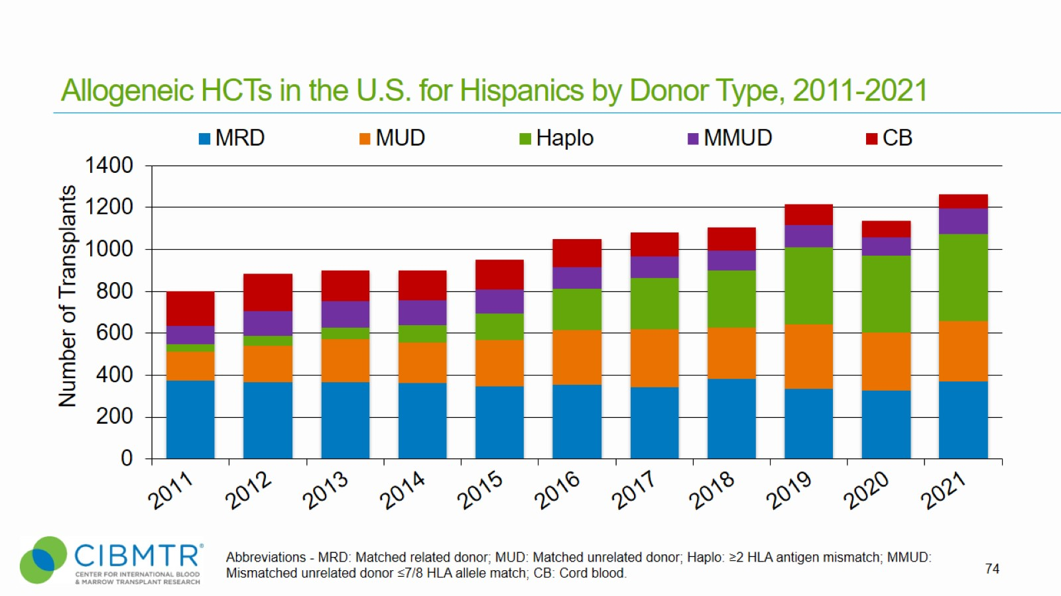
Allogeneic HCTs in the U.S. for Hispanics by Donor Type, 2011-2021
Notes:
Slide 74: Number of different graft sources for allogeneic Hispanic recipients according to year.

Slide 75
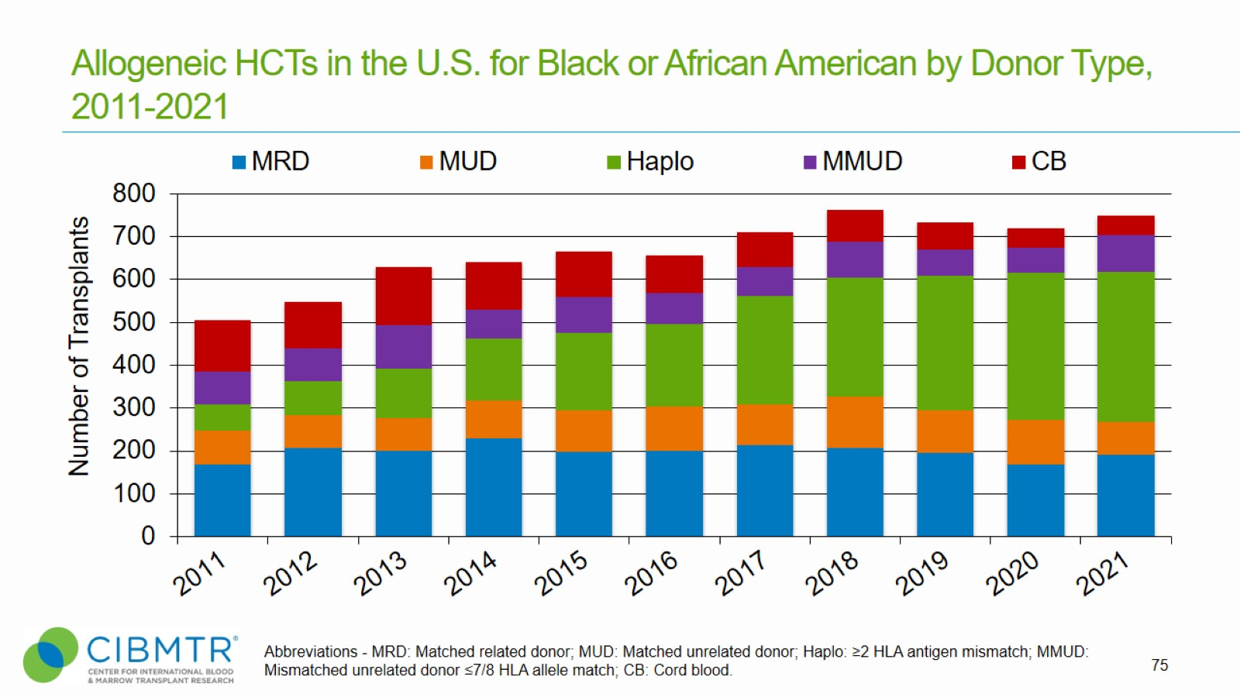
Allogeneic HCTs in the U.S. for Black or African American by Donor Type, 2011-2021
Notes:
Slide 75: Number of different graft sources for allogeneic Black or African American recipients according to year.

Slide 76
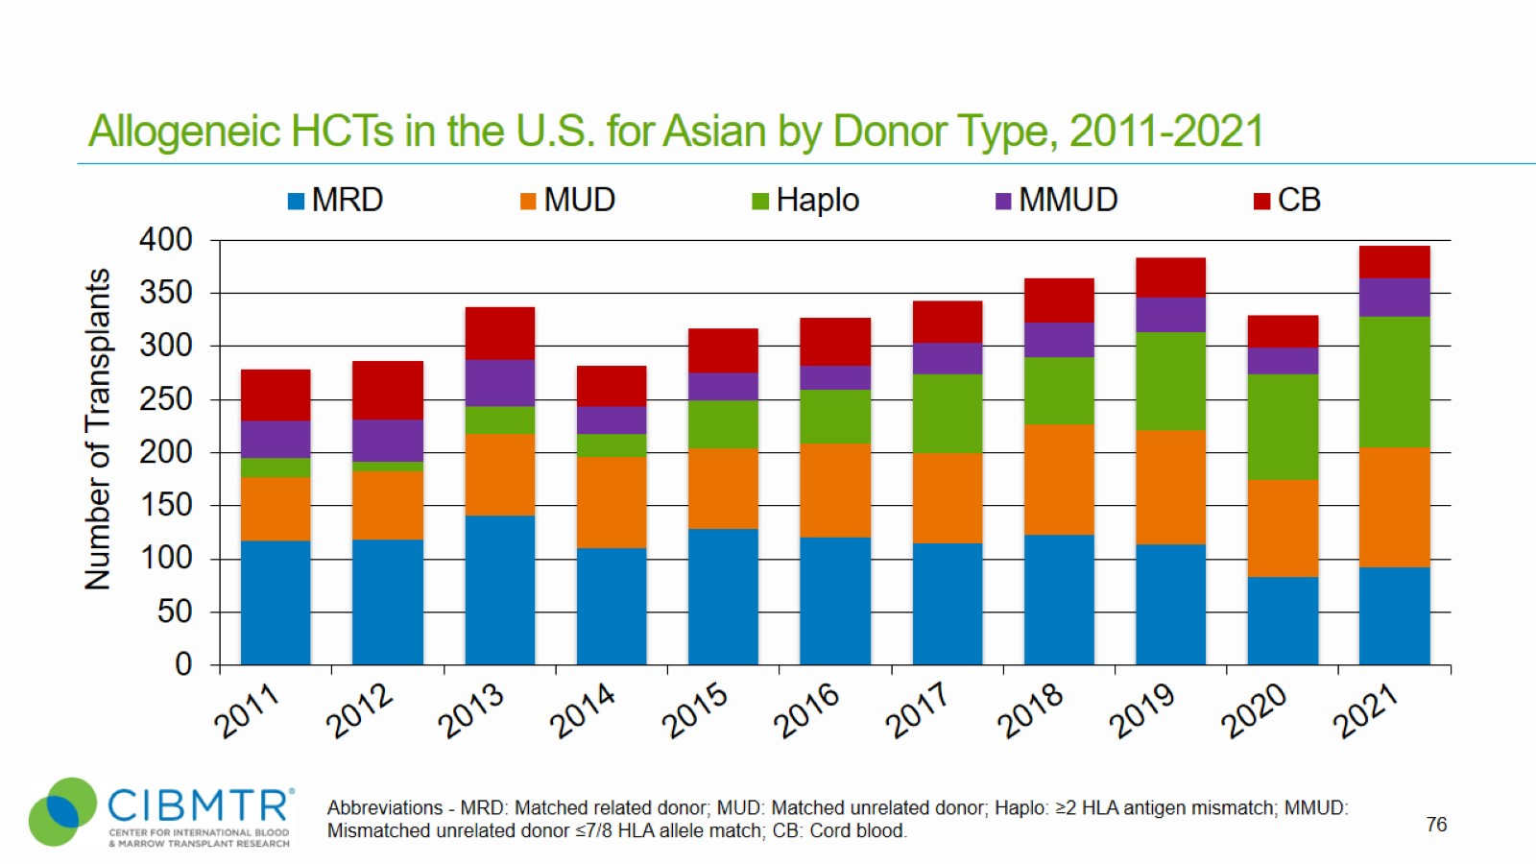
Allogeneic HCTs in the U.S. for Asian by Donor Type, 2011-2021
Notes:
Slide 76: Number of different graft sources for allogeneic Asian recipients according to year.

Slide 77
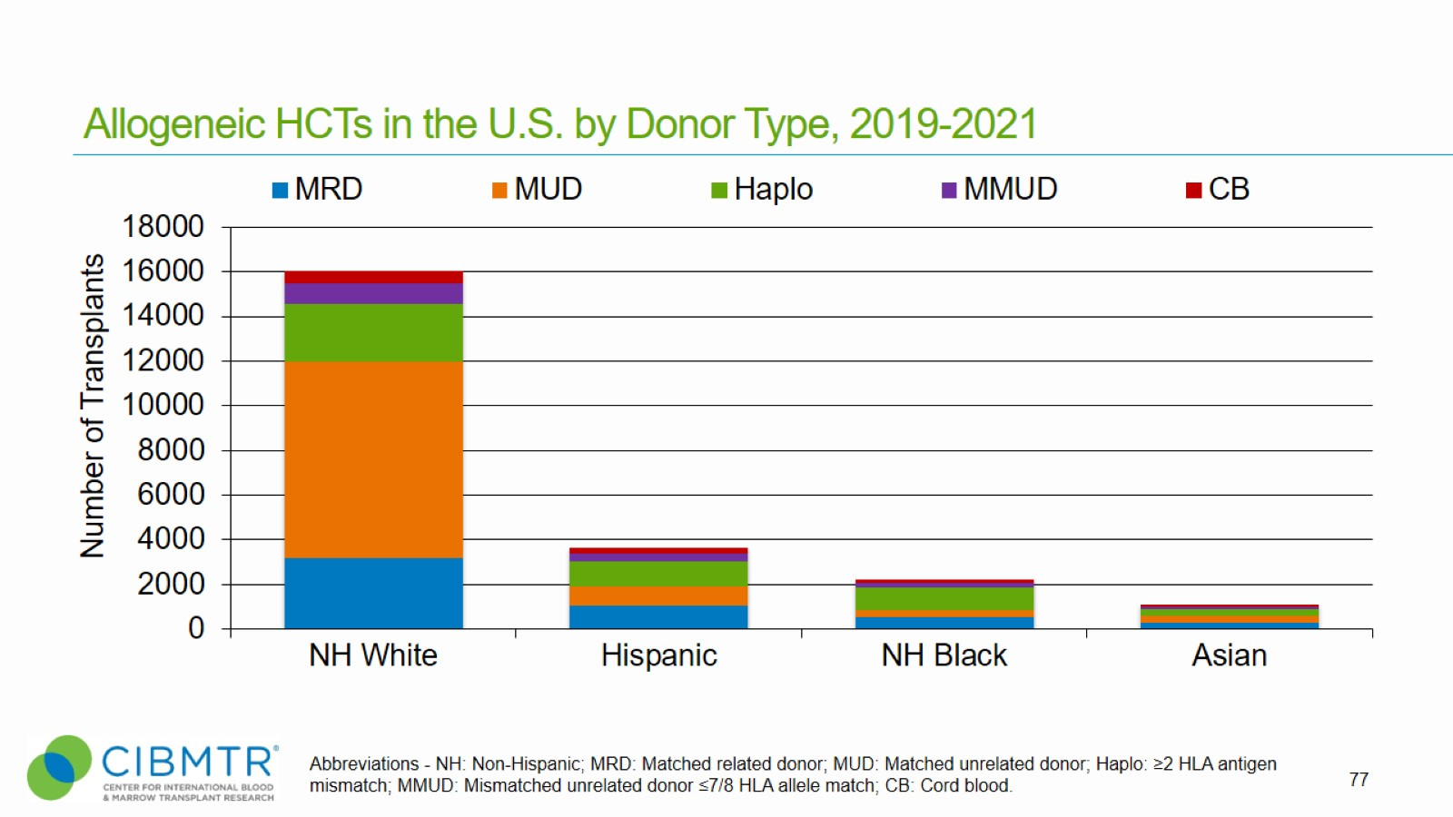
Allogeneic HCTs in the U.S. by Donor Type, 2019-2021
Notes:
Slide 77: Number of different graft sources for allogeneic recipients according to race/ethnicity.

Slide 78
Survival after Allogeneic HCTs for Acute Myeloid Leukemia (AML), Using Matched Donors, Age <18 Years, in the U.S., 2010-2020
Notes:
Slide 78: Among pediatric patients with AML receiving matched related donor transplant between 2010 and 2020, the 3-year probabilities (95%CI) of survival following transplant according to disease status are:
CR1 69% (64-74%)
CR2+ (2nd or subsequent complete remission) 66% (58-75%)
Relapsed disease/Never in CR (includes Primary induction failure) 28% (18-42%)
Among pediatric patients with AML receiving matched unrelated donor transplant between 2010 and 2020, the 3-year probabilities (95%CI) of survival following transplant according to disease status are:
CR1 64% (59-70%)
CR2+ (2nd or subsequent complete remission) 66% (60-73%)
Relapsed disease/Never in CR (includes Primary induction failure) 37% (29-48%)
Trend data only is presented, and any significant p-values reflect global differences between indicated groups and not any specific differences between indicated groups. Caution interpreting these univariate curves is important as adjustment for other relevant factors using multi-variable analyses has not been done.

Slide 79
Survival after Allogeneic HCTs for Acute Myeloid Leukemia (AML), Using Matched Donors, Age ≥18 Years, in the U.S., 2010-2020
Notes:
Slide 79: Among adult patients with AML receiving matched related donor transplant between 2010 and 2020, the 3-year probabilities (95%CI) of survival following transplant according to disease status are:
CR1 57% (56-59%)
CR2+ (2nd or subsequent complete remission) 53% (50-56%)
Relapsed disease/Never in CR (includes Primary induction failure) 31% (29-34%)
Among adult patients with AML receiving matched unrelated donor transplant between 2010 and 2020, the 3-year probabilities (95%CI) of survival following transplant according to disease status are:
CR1 55% (54-56%)
CR2+ (2nd or subsequent complete remission) 53% (51-55%)
Relapsed disease/Never in CR (includes Primary induction failure) 30% (28-32%)
Trend data only is presented, and any significant p-values reflect global differences between indicated groups and not any specific differences between indicated groups. Caution interpreting these univariate curves is important as adjustment for other relevant factors using multi-variable analyses has not been done.

Slide 80
Survival after Allogeneic HCTs for Acute Myeloid Leukemia (AML), Using Mismatched Donors, Age <18 Years, in the U.S., 2010-2020
Notes:
Slide 80: Among pediatric patients with AML receiving haplo donor transplant between 2010 and 2020, the 3-year probabilities (95%CI) of survival following transplant according to disease status are:
CR1 62% (54-72%)
CR2+ (2nd or subsequent complete remission) 60% (49-73%)
Relapsed disease/Never in CR (includes Primary induction failure) 34% (24-49%)
Among pediatric patients with AML receiving Mismatched unrelated donor transplant between 2010 and 2020, the 3-year probabilities (95%CI) of survival following transplant according to disease status are:
CR1 53% (46-62%)
CR2+ (2nd or subsequent complete remission) 59% (47-73%)
Relapsed disease/Never in CR (includes Primary induction failure) 30% (18-51%)
Trend data only is presented, and any significant p-values reflect global differences between indicated groups and not any specific differences between indicated groups. Caution interpreting these univariate curves is important as adjustment for other relevant factors using multi-variable analyses has not been done.

Slide 81
Survival after Allogeneic HCTs for Acute Myeloid Leukemia (AML), Using Mismatched Donors, Age ≥18 Years, in the U.S., 2010-2020
Notes:
Slide 81: Among adult patients with AML receiving Haplo donor transplant between 2010 and 2020, the 3-year probabilities (95%CI) of survival following transplant according to disease status are:
CR1 50% (48-53%)
CR2+ (2nd or subsequent complete remission) 53% (49-58%)
Relapsed disease/Never in CR (includes Primary induction failure) 27% (23-31%)
Among adult patients with AML receiving mismatched unrelated donor transplant between 2010 and 2020, the 3-year probabilities (95%CI) of survival following transplant according to disease status are:
CR1 49% (46-52%)
CR2+ (2nd or subsequent complete remission) 42% (38-47%)
Relapsed disease/Never in CR (includes Primary induction failure) 26% (22-30%)
Trend data only is presented, and any significant p-values reflect global differences between indicated groups and not any specific differences between indicated groups. Caution interpreting these univariate curves is important as adjustment for other relevant factors using multi-variable analyses has not been done.

Slide 82
Survival after Allogeneic HCTs for Myelodysplastic Syndromes (MDS), Using Matched Donors, Age ≥18 Years, in the U.S., 2010-2020
Notes:
Slide 82: For allotransplants performed between 2010 and 2020 in recipients with early and advanced disease MDS, the 3-year probabilities (95%CI) of survival following transplant with a matched related donor according to disease status are:
Early disease 50% (47-54%)
Advanced disease 46% (43-48%)
The 3-year probabilities (95%CI) of survival following transplant according for matched unrelated donor according to disease status are:
Early disease 48% (45-51%)
Advanced disease 44% (42-46%)
Reference for MDS classifications:
https://higherlogicdownload.s3.amazonaws.com/ASBMT/43a1f41f-55cb-4c97-9e78-c03e867db505/UploadedImages/ASBMT_RFI_2018B_CIBMTR_Disease_Classifications.pdf
Trend data only is presented, and any significant p-values reflect global differences between indicated groups and not any specific differences between indicated groups. Caution interpreting these univariate curves is important as adjustment for other relevant factors using multi-variable analyses has not been done.

Slide 83
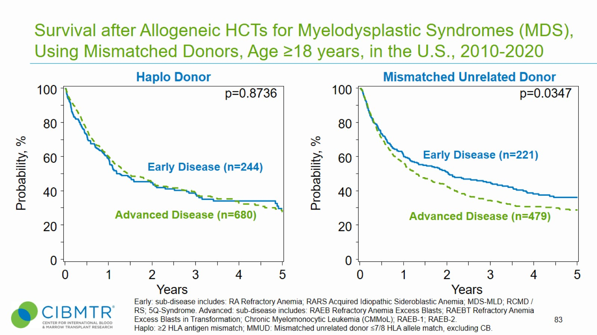
Survival after Allogeneic HCTs for Myelodysplastic Syndromes (MDS), Using Mismatched Donors, Age ≥18 years, in the U.S., 2010-2020
Notes:
Slide 83: Allogeneic transplant is a potentially curative treatment for Myelodysplastic Syndromes (MDS). Outcomes differ according to disease status at the time of transplant. For allotransplant for early and advanced MDS performed between 2010 and 2020. The 3-year probabilities (95%CI) of survival following transplant according for haplo donor according to disease status are:
Early disease 39% (32-47%)
Advanced disease 39% (34-43%)
The 3-year probabilities (95%CI) of survival following transplant according for mismatched unrelated donor according to disease status are:
Early disease 46% (39-53%)
Advanced disease 34% (29-39%)
Trend data only is presented, and any significant p-values reflect global differences between indicated groups and not any specific differences between indicated groups. Caution interpreting these univariate curves is important as adjustment for other relevant factors using multi-variable analyses has not been done.

Slide 84
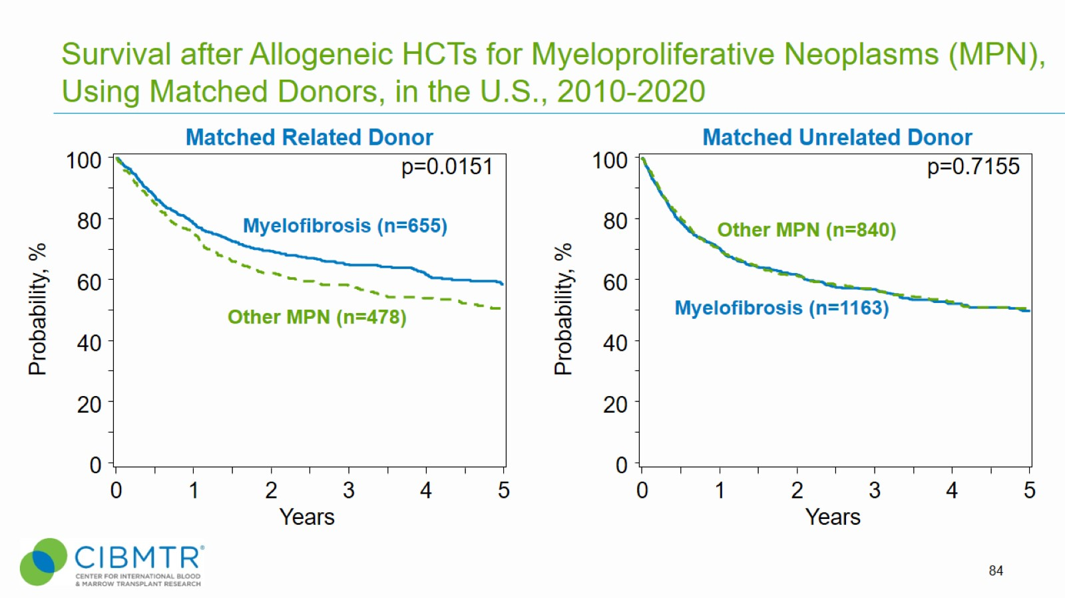
Survival after Allogeneic HCTs for Myeloproliferative Neoplasms (MPN), Using Matched Donors, in the U.S., 2010-2020
Notes:
Slide 84: Allogeneic transplants are a treatment choice for patients with Myeloproliferative Neoplasms (MPN) who have high risk features. The CIBMTR has data for 1,133 patients receiving a matched related donor allotransplant for myeloproliferative neoplasms between 2010 and 2020, including 655 patients with myelofibrosis. The 3-year probabilities (95%CI) of survival following transplant according to disease status are:
Myelofibrosis 65% (61-69%)
Other MPN 58% (53-63%)
The CIBMTR has data for 2,003 patients receiving a matched unrelated donor allotransplant for myeloproliferative neoplasms between 2010 and 2020, including 1,163 patients with myelofibrosis. The 3-year probabilities (95%CI) of survival following transplant according to disease status are:
Myelofibrosis 57% (54-60%)
Other MPN 58% (54-61%)
Trend data only is presented, and any significant p-values reflect global differences between indicated groups and not any specific differences between indicated groups. Caution interpreting these univariate curves is important as adjustment for other relevant factors using multi-variable analyses has not been done.

Slide 85
Survival after Allogeneic HCTs for Myeloproliferative Neoplasms (MPN), Using Mismatched Donors, in the U.S., 2010-2020
Notes:
Slides 85: Allogeneic transplants are a treatment choice for patients with Myeloproliferative Neoplasms (MPN) who have high risk features.
The CIBMTR has data for 413 patients receiving a haplo donor allotransplant for Myeloproliferative Neoplasms between 2010 and 2020, including 228 patients with Myelofibrosis. The 3-year probabilities (95%CI) of survival following transplant according to disease status are:
Myelofibrosis 56% (49-64%)
Other MPN 49% (42-59%)
The CIBMTR has data for 277 patients receiving a mismatched unrelated donor allotransplant for Myeloproliferative Neoplasms between 2010 and 2020, including 153 patients with Myelofibrosis. The 3-year probabilities (95%CI) of survival following transplant according to disease status are:
Myelofibrosis 49% (41-58%)
Other MPN 47% (39-58%)
Trend data only is presented, and any significant p-values reflect global differences between indicated groups and not any specific differences between indicated groups. Caution interpreting these univariate curves is important as adjustment for other relevant factors using multi-variable analyses has not been done.

Slide 86
Survival after Allogeneic HCTs for Acute Lymphoblastic Leukemia (ALL), Using Matched Donors, Age <18 Years, in the U.S., 2010-2020
Notes:
Slide 86: Among pediatric patients with ALL, chemotherapy generally has a high success rate, therefore allogeneic transplantation is commonly reserved for patients with high-risk disease (i.e. high leukocyte count at diagnosis and the presence of poor-risk cytogenetic markers), those who fail to achieve remission or those who relapse after chemotherapy.
Among the 792 patients younger than 18 years receiving a matched related donor transplant for ALL between 2010 and 2020, the 3-year probabilities (95%CI) of survival following transplant according to disease status are:
CR1 79% (74-84%)
CR2+ (2nd or subsequent complete remission) 70% (66-75%)
Relapsed disease/Never in CR (includes Primary induction failure) 62% (48-80%)
Among the 788 patients younger than 18 years receiving a matched unrelated donor transplant for ALL between 2010 and 2020, the 3-year probabilities (95%CI) of survival following transplant according to disease status are:
CR1 77% (72-82%)
CR2+ (2nd or subsequent complete remission) 65% (61-70%)
Relapsed disease/Never in CR (includes Primary induction failure) 69% (55-86%)
Trend data only is presented, and any significant p-values reflect global differences between indicated groups and not any specific differences between indicated groups. Caution interpreting these univariate curves is important as adjustment for other relevant factors using multi-variable analyses has not been done.

Slide 87
Survival after Allogeneic HCTs for Acute Lymphoblastic Leukemia (ALL), Using Matched Donors, Age ≥18 Years, in the U.S., 2010-2020
Notes:
Slide 87: Older age at disease onset is a high-risk feature in ALL. Consequently, a larger proportion of ALL patients 18 years of age or older undergo allogeneic HCT for early disease. Among 3,132 patients ≥18 years of age receiving matched related donor HCT for ALL between 2010-2020, the 3-year probabilities (95%CI) of survival following transplant according to disease status are:
CR1 64% (62-66%)
CR2+ (2nd or subsequent complete remission) 45% (41-49%)
Relapsed disease/Never in CR (includes Primary induction failure) 37% (31-45%)
Among the 3,683 recipients of matched unrelated donor HCT. The 3-year probabilities (95%CI) of survival following transplant according to disease status are:
CR1 63% (61-65%)
CR2+ (2nd or subsequent complete remission) 46% (42-50%)
Relapsed disease/Never in CR (includes Primary induction failure) 37% (32-44%)
Trend data only is presented, and any significant p-values reflect global differences between indicated groups and not any specific differences between indicated groups. Caution interpreting these univariate curves is important as adjustment for other relevant factors using multi-variable analyses has not been done.

Slide 88
Survival after Allogeneic HCTs for Acute Lymphoblastic Leukemia (ALL), Using Mismatched Donors, Age <18 Years, in the U.S., 2010-2020
Notes:
Slide 88: Among the 367 patients younger than 18 years receiving a haplo donor transplant for ALL between 2010 and 2020, the 3-year probabilities (95%CI) of survival following transplant according to disease status are:
CR1 70% (62-80%)
CR2+ (2nd or subsequent complete remission) 64% (57-71%)
Relapsed disease/Never in CR (includes Primary induction failure) NE% (NE-NE%)
Among the 310 patients younger than 18 years receiving mismatched unrelated donor transplant for ALL between 2010 and 2020. The 3-year probabilities (95%CI) of survival following transplant according to disease status are:
CR1 67% (59-76%)
CR2+ (2nd or subsequent complete remission) 58% (51-66%)
Relapsed disease/Never in CR (includes Primary induction failure) 50% (31-82%)
Trend data only is presented, and any significant p-values reflect global differences between indicated groups and not any specific differences between indicated groups. Caution interpreting these univariate curves is important as adjustment for other relevant factors using multi-variable analyses has not been done.

Slide 89
Survival after Allogeneic HCTs for Chronic Myeloid Leukemia (CML), Using Mismatched Donors, in the U.S., 2010-2020
Notes:
Slide 89: The CIBMTR has data for 263 haplo donor transplants for CML from 2010 to 2020. The 3-year probabilities (95%CI) of survival following transplant according to disease status are:
Hematologic CR 71% (61-82%)
Chronic phase 62% (54-72%)
Accelerated phase 67% (52-85%)
Blast phase 28% (10-76%)
For mismatched unrelated donor transplants (n=226), the 3-year probabilities (95%CI) of survival following transplant according to disease status are:
Hematologic CR 61% (51-73%)
Chronic phase 60% (51-71%)
Accelerated phase 38% (22-66%)
Blast phase 33% (18-61%)
Trend data only is presented, and any significant p-values reflect global differences between indicated groups and not any specific differences between indicated groups. Caution interpreting these univariate curves is important as adjustment for other relevant factors using multi-variable analyses has not been done.

Slide 90
Survival after Allogeneic HCTs for Chronic Lymphocytic Leukemia (CLL), in the U.S., 2010-2020
Notes:
Slide 90: There has been a decline in allogeneic HCT utilization in Chronic Lymphocytic Leukemia (CLL) with the availability of newer and effective non-transplant therapies in recent years.
Among 1,505 patients who underwent transplantation for CLL between 2010 and 2020, the 3-year probabilities (95%CI) of survival following transplant according by donor type are:
Matched related donors 64% (60-69%)
Matched unrelated donors 60% (57-64%)
Haplo donors 47% (39-55%)
Mismatched unrelated donors 57% (49-66%)
Trend data only is presented, and any significant p-values reflect global differences between indicated groups and not any specific differences between indicated groups. Caution interpreting these univariate curves is important as adjustment for other relevant factors using multi-variable analyses has not been done.

Slide 91
Survival after Allogeneic HCTs for Chronic Lymphocytic Leukemia (CLL), in the U.S., 2010-2020
Notes:
Slide 91: Among 2,041 patients who underwent transplantation for CLL between 2010 and 2020, the 3-year probabilities (95%CI) of survival following transplant according to disease stage are:
Early Disease 59% (56-62%)
Advanced Disease 46% (42-50%)
Trend data only is presented, and any significant p-values reflect global differences between indicated groups and not any specific differences between indicated groups. Caution interpreting these univariate curves is important as adjustment for other relevant factors using multi-variable analyses has not been done.

Slide 92
Survival after Allogeneic HCTs for Severe Aplastic Anemia (SAA), in the U.S., 2010-2020
Notes:
Slide 92: Allogeneic HCT is the treatment of choice for young patients with Severe Aplastic Anemia (SAA) who have an HLA-matched sibling donor.
Among 1,070 pediatric patients who underwent transplantation for SAA between 2010 and 2020, the 3-year probabilities (95%CI) of survival following transplant according by donor type are:
Matched related donors 98% (96-99%)
Matched unrelated donors 91% (88-94%)
Haplo donors 86% (79-93%)
Mismatched unrelated donors 79% (71-87%)
Among 1,540 adult patients who underwent transplantation for SAA between 2010 and 2020, the 3-year probabilities (95%CI) of survival following transplant according by donor type are:
Matched related donors 85% (82-88%)
Matched unrelated donors 76% (73-80%)
Haplo donors 80% (73-86%)
Mismatched unrelated donors 63% (55-73%)
Trend data only is presented, and any significant p-values reflect global differences between indicated groups and not any specific differences between indicated groups. Caution interpreting these univariate curves is important as adjustment for other relevant factors using multi-variable analyses has not been done.

Slide 93
Survival after Autologous or Allogeneic HCTs for Hodgkin Lymphoma (HL), in the U.S., 2010-2020
Notes:
Slide 93: Autologous transplantation for Hodgkin Lymphoma (HL) is indicated in patients with relapsed disease after initial therapy. Survival after transplant in HL depends on disease response to salvage therapy. Among the 8,276 patients receiving autologous HCT for HL between 2010 and 2020, the 3-year probabilities (95%CI) of survival following transplant according to disease status are:
Chemosensitive disease 89% (88-89%)
Chemoresistant disease 79% (75-82%)
Among the 1,603 patients receiving allogeneic HCT for HL between 2010 and 2020, the 3-year probabilities (95%CI) of survival following transplant according to disease status are:
Chemosensitive disease 68% (65-70%)
Chemoresistant disease 51% (45-57%)
Trend data only is presented, and any significant p-values reflect global differences between indicated groups and not any specific differences between indicated groups. Caution interpreting these univariate curves is important as adjustment for other relevant factors using multi-variable analyses has not been done.

Slide 94
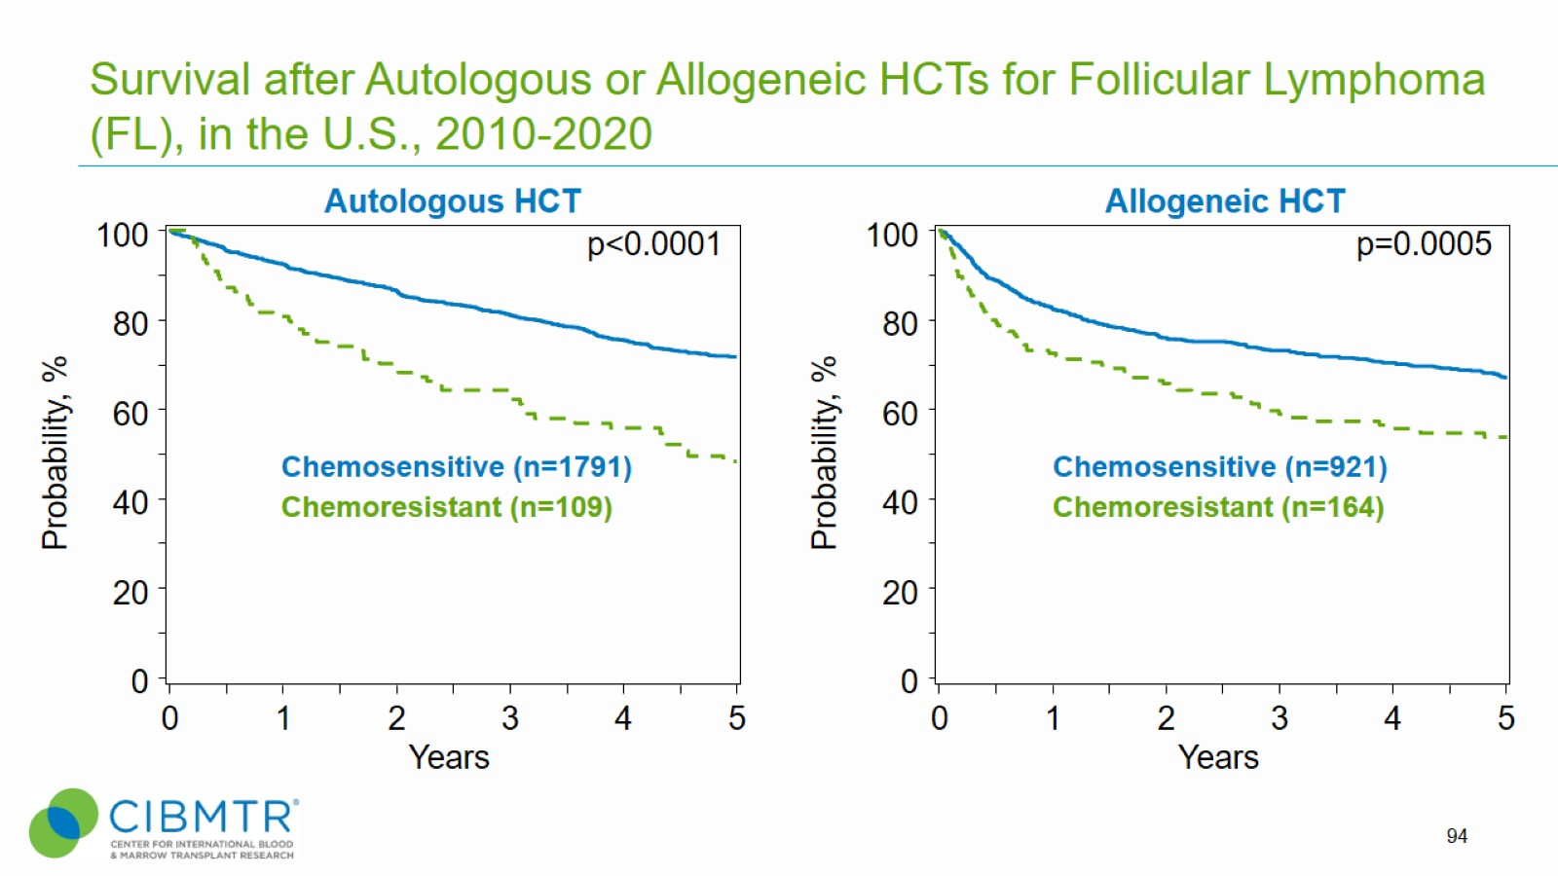
Survival after Autologous or Allogeneic HCTs for Follicular Lymphoma (FL), in the U.S., 2010-2020
Notes:
Slide 94: Transplantation for Follicular Lymphoma (FL) is generally reserved for patients with recurrent or aggressive disease. Autologous HCT is utilized in patients with chemosensitive disease. Among the 1,900 patients receiving autologous HCT for FL between 2010 and 2020, the 3-year probabilities (95%CI) of survival following transplant according to disease status are:
Chemosensitive disease 81% (79-83%)
Chemoresistant disease 64% (56-74%)
Among the 1,085 patients receiving allogeneic HCT for FL between 2010 and 2020, the 3-year probabilities (95%CI) of survival following transplant according to disease status are:
Chemosensitive disease 73% (70-76%)
Chemoresistant disease 59% (51-67%)
Trend data only is presented, and any significant p-values reflect global differences between indicated groups and not any specific differences between indicated groups. Caution interpreting these univariate curves is important as adjustment for other relevant factors using multi-variable analyses has not been done.

Slide 95
Survival after Autologous HCTs for Multiple Myeloma (MM) and other Plasma Cell Disorders (PCDs), in the U.S., 2010-2020
Notes:
Slide 95: Several Plasma Cell Disorders (PCDs) can be treated with autologous HCT. Transplant outcomes are dependent on the type of underlying PCD. The 3-year probabilities (95%CI) of survival after autologous HCT are:
POEMS Syndrome (or Osteosclerotic Myeloma) 94% (91-97%)
Amyloidosis 86% (85-87%)
Multiple Myeloma 80% (80-82%)
Plasma Cell Leukemia, a highly aggressive PCD 47% (42-51%)
Trend data only is presented, and any significant p-values reflect global differences between indicated groups and not any specific differences between indicated groups. Caution interpreting these univariate curves is important as adjustment for other relevant factors using multi-variable analyses has not been done.

